Slide 1


Sharing Best Practice
Session 2 - Low Carbon Materials
Asphalt Industry Alliance

Slide 2
Climate Change
Heatwaves, floods, droughts and wildfires have become more common in Europe during summer months, and May 2024 was the 12th consecutive month with record-high temperatures.
In June 2024, the devastating floods in Germany and Poland caused several fatalities and significant economic damage.
Intense rainfall in Dubai, the UAE and Oman in April 2024.
In May 2024, southern Brazil experienced heavy rains which lead to widespread flooding, displacing about 150,000 people.

Slide 3
Climate Change
In April 2024, temperatures in Mali hit 48.5C during an extreme heatwave across the Sahel region of Africa, which was linked to increased hospitalisations and deaths.
In parts of East Africa, there were five failed rainy seasons in a row between 2020 and 2022, as the region suffered its worst drought for 40 years. This displaced 1.2 million people in Somalia alone.
The Amazon rainforest had it’s worst drought in at least half a century in the second half of 2023.

Slide 4
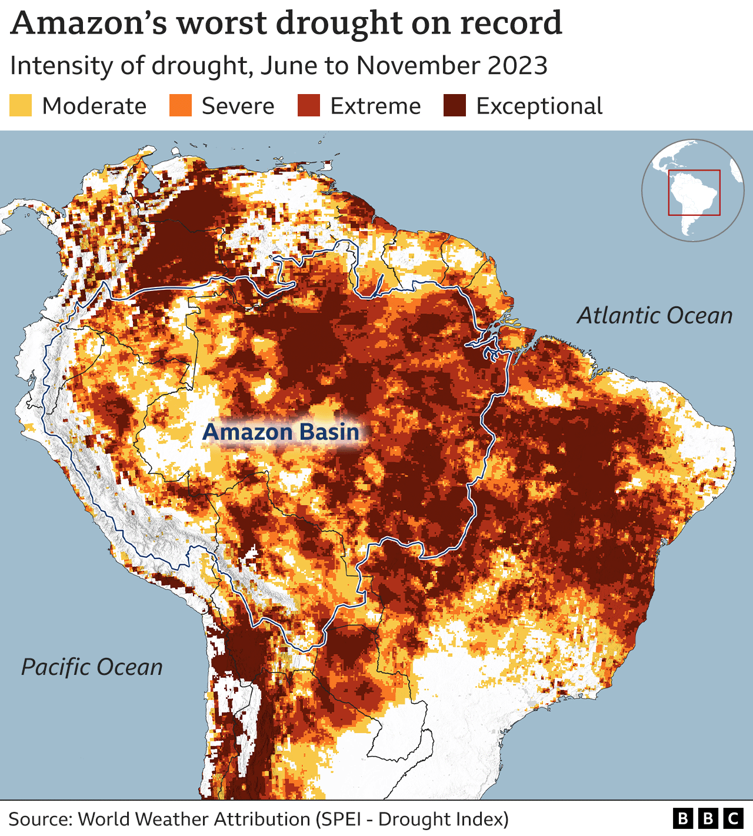
Climate Change

Slide 5
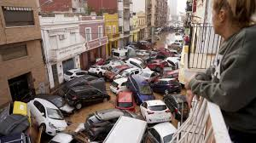
Spain

Slide 6


Slide 7

Notes:
Im a bit more familiar with this type of weather…
The flip side of our very hot weather is the extreme cold we get in snaps across winter. This winter saw a very cold two week snap which will have accelerated freeze thaw in pavements that were fatigued and a spate of pot holes (as confirmed in the Alarm report) and the back log of repairs that then presents us with.

Slide 8


Economic Challenges & Current Road Condition

Slide 9
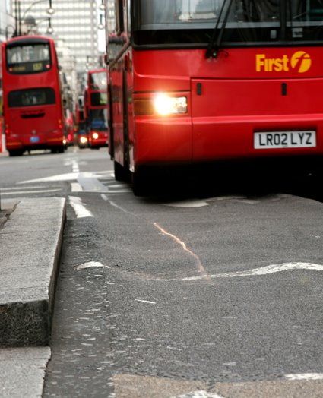
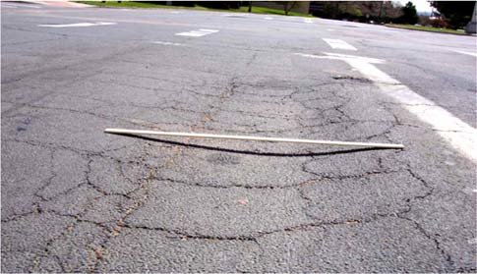
Notes:
These are some of the challenges that the extreme weather can present to our pavements. The Left hand picture shows deformation from heavy traffic and high temperatures. The right hand image shows a failing pavement, likely due to saturated foundation or pavement that has not been designed to cope with modern day loading. They both look the same, but the cause and solutions are different.
Pavements will also need to be designed to cope with Automonous vehicles and the channelised loadings that will be created by these.

Slide 10
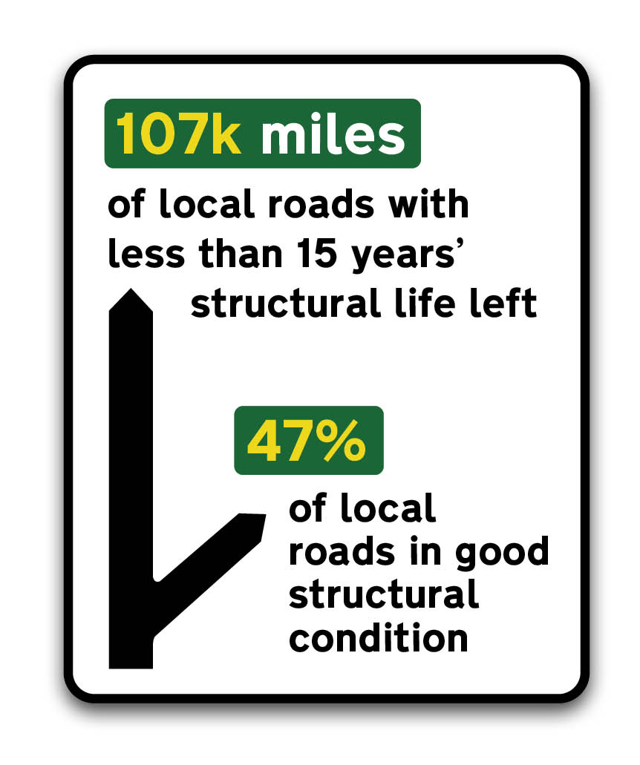
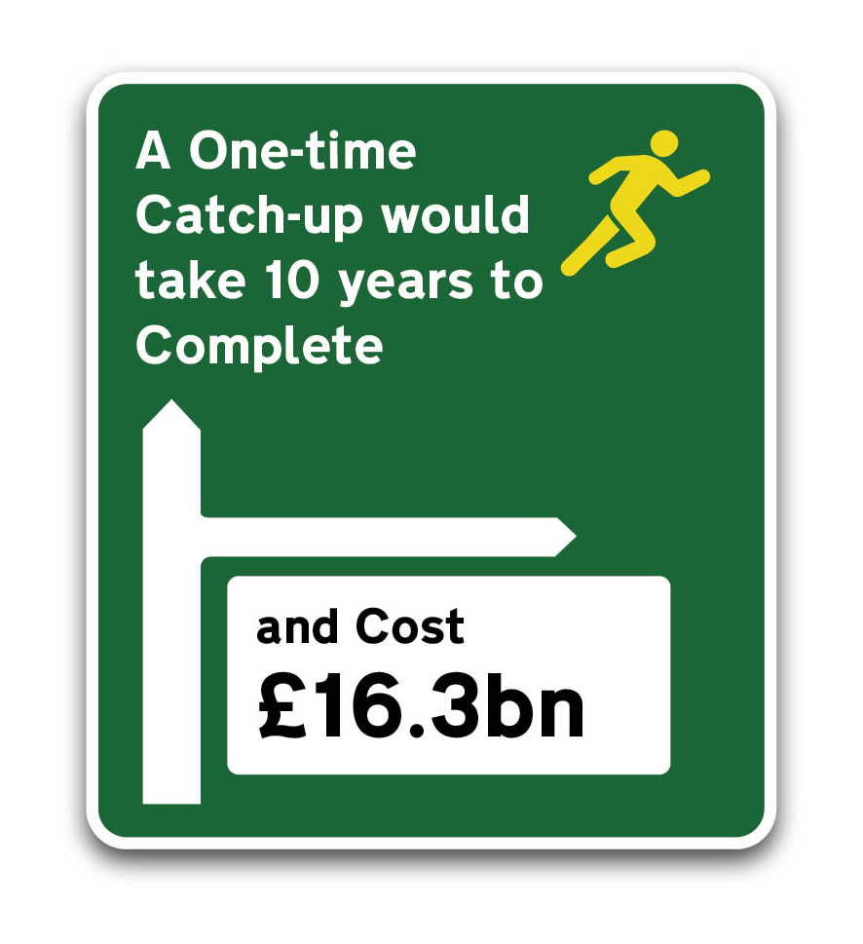
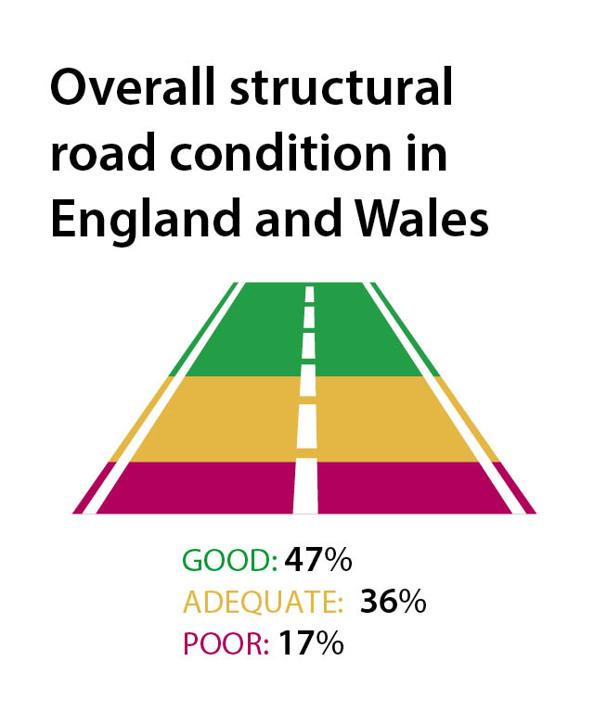
ALARM 2024: Key findings
Notes:
More than half the local road network is reported as having 15 years, or less, of structural life remaining and the cost to bring roads up to scratch now stands at more than £16 billion – the highest figure we have seen in 29 years of reporting.
Local authority highway teams are doing their best, but they are working with one hand tied behind their back. ALARM highlights that they just don’t have the funds needed to maintain their networks to target conditions. Any highway maintenance budget increases seen over the last year have been eaten up by inflation, so they’ve actually experienced a real-terms cut. This, coupled with long-term underfunding, rising traffic volumes and more extreme weather events, have all contributed to accelerated decline and contributed to the eye watering sums now needed to put our roads back on track.

Slide 11
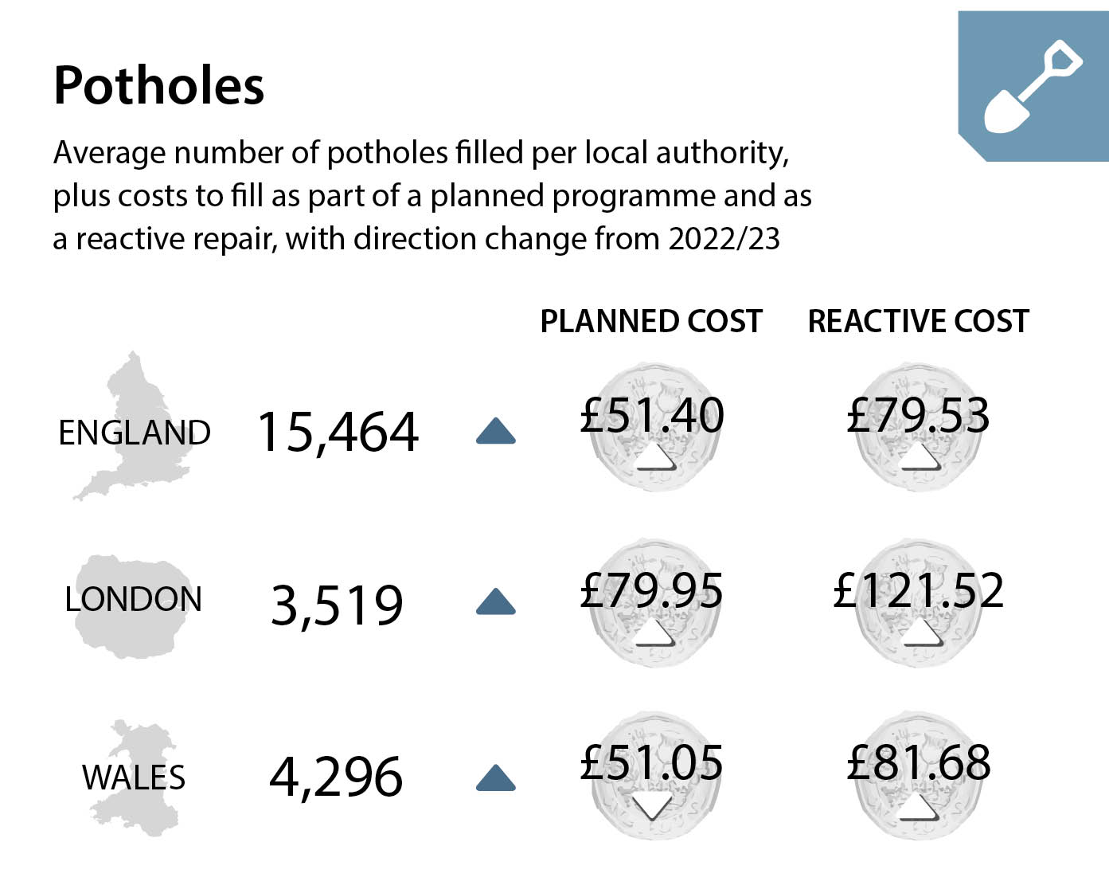
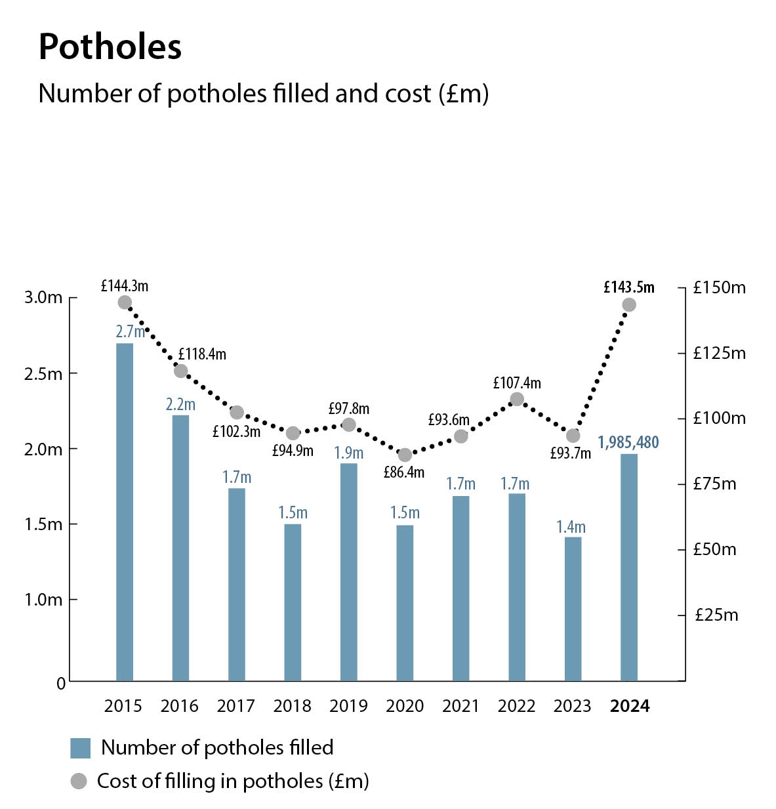
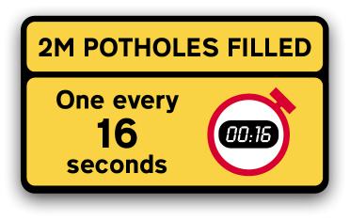
ALARM 2024: Potholes
Notes:
Potholes
Potholes are a clearly visible symptom of inadequately maintained roads and can be used as indicators of resilience, potentially pointing to underlying structural issues.
The total number of potholes filled reported in this year’s survey has jumped 43% to 2.0 million (2022/23: 1.4m ; This is the largest number reported since ALARM 2016 and is the equivalent of one pothole being addressed every 16 seconds in England (including London) and Wales.
Qualitative feedback highlighted that more frequent weather extremes are taking their toll across the network and that pothole repairs remain only one element of the challenges local authorities dealt with in the last year. Almost 90% (88%) of authorities responding to the ALARM survey stated that they use a guideline depth of 40mm (or less) to define a pothole. Depth definition is not always the only means of prioritising repairs as the potential effect of a surface defect can vary dramatically depending on the area affected, the nature of the traffic on the road and its location.
The disparity in cost between filling potholes as part of a planned programme of carriageway repairs compared to that as a reactive repair is again apparent (see graphic right). Taking the average cost for filling a pothole across each region to be £72.26, the total amount spent in England and Wales last year is estimated at £143.5 million, up 50% from the £95.6 million reported last year. This is the highest cost reported since ALARM 2015 when 35% more potholes were filled (2.7 million) for a similar cost .

Slide 12
The Public Impact
Potholes are dangerous – Motorists looking for pot holes to avoid.
Even more dangerous for Cyclists and Motorcyclists – personal injury
Cost to motorist – tyres, suspension etc
Direct cost or an insurance claim which puts premiums up.
Extra fuels costs when travelling on rough and uneven roads
Means extra fuel production
Climate Change accelerator

Slide 13
What Can We Do ?
And how can we do it Sustainably ?

Slide 14
Low Carbon Options
Higher RAP contents
Cold Mix materials
Foam Mix materials
Warm Mix
Single Layers
Bio binders
Bio rejuvenators
Longer lasting binders
Lower carbon constituents
Lower carbon production and installation fuels
Net Zero cold lay bagged products
Smoother roads

Slide 15

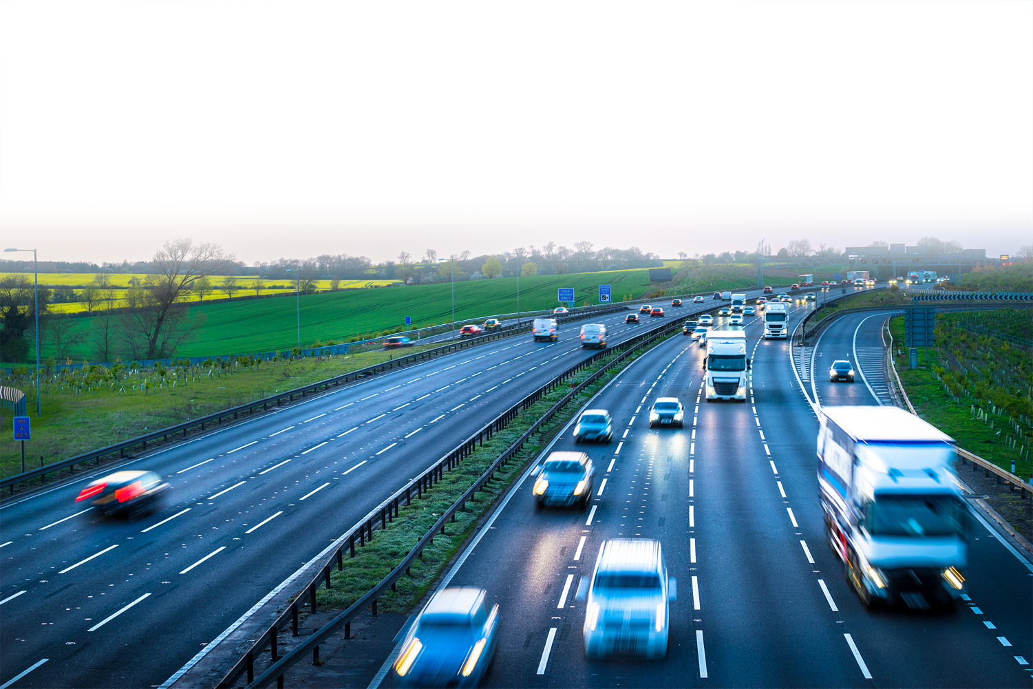
Single layer asphalts
Reduced public disruption
Reduced onsite costs
Reduced carbon footprint

Slide 16

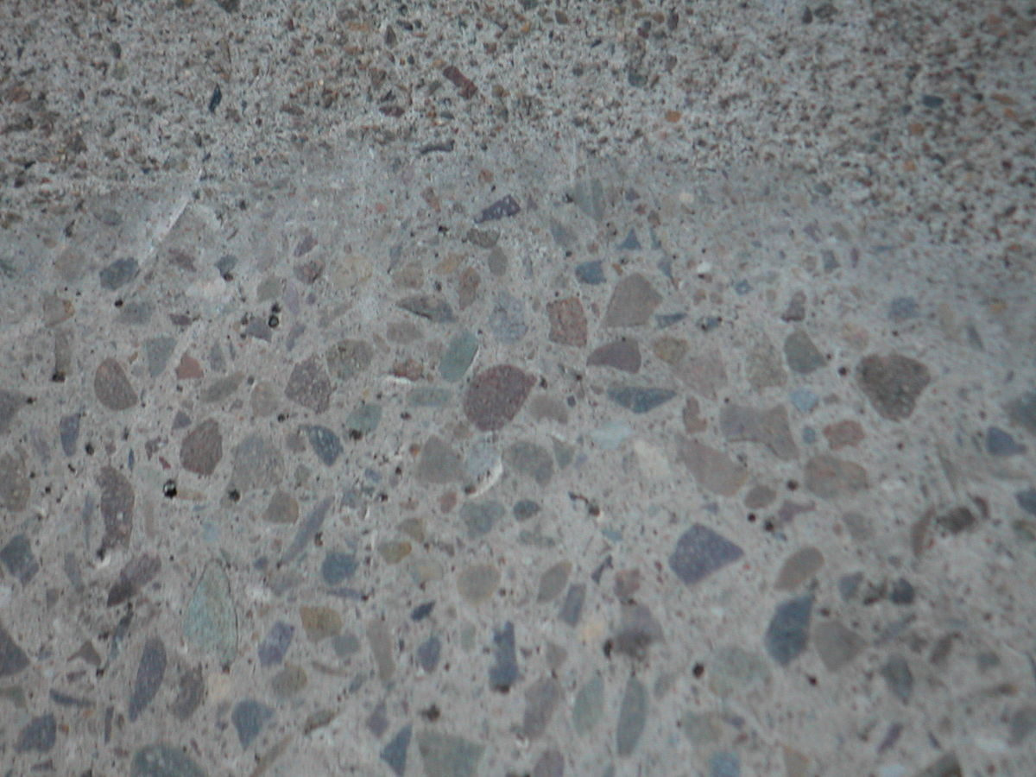


Traditional Design
Tarmac Solution
40mm
Surface
Single Layer
New
New
60mm
Binder
Existing Pavement
Existing
Existing
Existing Pavement

Slide 17

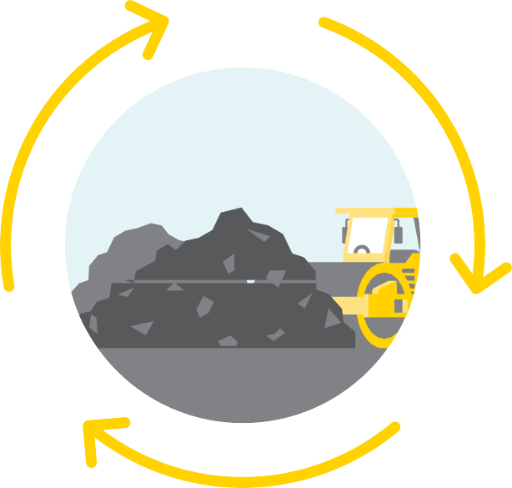


Shell Bitumen CarbonSink
A natural carbon sink is formed when natural materials absorb carbon as part of their growth or life cycle. This sink expires when the natural materials reach the end of their lives and breakdown into organic matter, which over time sends carbon back into the atmosphere.
A temporary carbon sink is created when biomass is used in industry. Carbon from CO₂ is locked into the product until it’s re-released during decomposition or burning. Biofuels, for example, re-release carbon primarily as CO₂ when burned.
Shell’s new bio-component binder locks carbon into asphalt and bitumen, turning the road into a technical carbon sink. As the asphalt road is recyclable, most of this carbon will not re-enter the atmosphere, even at the end of its life, helping you on your path to net zero.

Slide 18

Section 1 A689
Bio-UltiPave
Dense 20mm Binder Bio Prototype 375
Lowest Carbon Footprint installed
Standard Performance

Slide 19
Section 2 A689
UltiPave PMB LongLife
Dense 20mm Binder Bio Prototype 375
Enhanced Performance (Additional Life)
Less of a Carbon reduction

Slide 20




Art of the Possible : Hartlepool Scenario 1
A1 - A3 : 80% reduction
A4 - : 100% reduction
A5 - : 98.9% reduction
Prototype 375 bio content
83% reduction overall
 | Enhanced vs Standard | Prototype vs Enhanced | Prototype vs Standard
A1 - A3 | 32.21% | 71.36% | 80.59%
A4 | 22.90% | 100.00% | 100.00%
A5 | 24.85% | 98.66% | 98.99%
A1 - A5 | 31.30% | 74.92% | 82.77%
Notes:
A1 - A3 : 80% reduction
A4 - : 100% reduction
A5 - : 98.9% reduction
Prototype X bio content
83% reduction overall

Slide 21
Art of the Possible : Hartlepool Scenario 2
A1 - A3 : 70% reduction
A4 - : 100% reduction
A5 - : 98.9% reduction
Ultipave Long Life - longer life paving solution
70% reduction overall
20% extension
(up to 3 years)
 | Enhanced vs Standard | Prototype vs Enhanced | Prototype vs Standard
A1 - A3 | 32.21% | 56.91% | 70.79%
A4 | 22.90% | 100.00% | 100.00%
A5 | 24.85% | 98.66% | 98.99%
A1 - A5 | 31.30% | 62.34% | 74.13%
Notes:
A1 - A3 : 70% reduction
A4 - : 100% reduction
A5 - : 98.9% reduction
AGESAFE- longer life paving solution
74% reduction overall
20% extension (up to 3 years)
Includes Agesafe ONLY – Longer life paving
a pavement life extension of up to 3 years and a 20% improvement

Slide 22





Ulti-Bio
Longer Life
Lowest Installed Carbon Footprint
Enhanced Performance

Slide 23
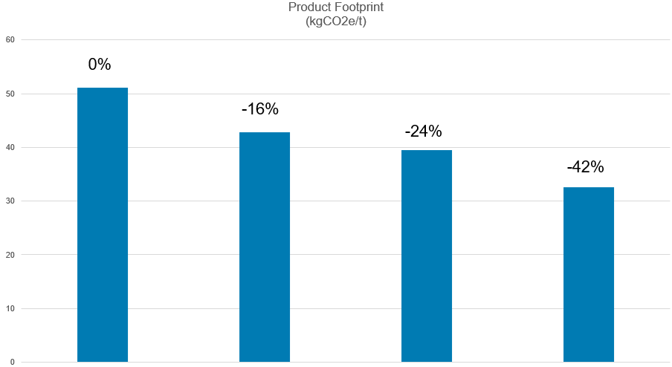
The Asphalt Journey so far
Historical
Now
0%
-16%
-24%
-42%
Target
Tomorrow
-70%
-100%
Hot mix Hot mix + RAP Warm mix + RAP Bio bitumen
/Warm/RAP
Notes:
Our base line column on the left of this slide so shows our starting point for a typical asphalt hot mix material (around 2000). Since 2000 industry has been working hard to increase the percentage of recycled material within our products, this is commonly referred to as RAP (Recycled Asphalt Planings) where we recover the aggregate and bitumen from old roads and this delivered a typical carbon improvement of 16%.
More recently we have led the introduction of warm mix to the UK, this is exactly the same materials but typically manufactured at approx. 40oC cooler than hot mix. This delivers energy effiencies and with RAP addition, gets us to around 24% reduction. Which as the quiz question details, is where we are now.
The next step to further Carbon effientcy is a recent development in bitumen technology which is using Bio bitumen (along with RAP and warm mix technology and this will help deliver further carbon improvements up to 42%, I will now hand over to Callam Brough from Shell our supply chain partners who will talk through bitumen innovation

Slide 24
Impact of proper Road Maintenance
Dr. Carsten Karcher, Secretary General
European Asphalt Pavement Association
Brussels, September 2022

Slide 25
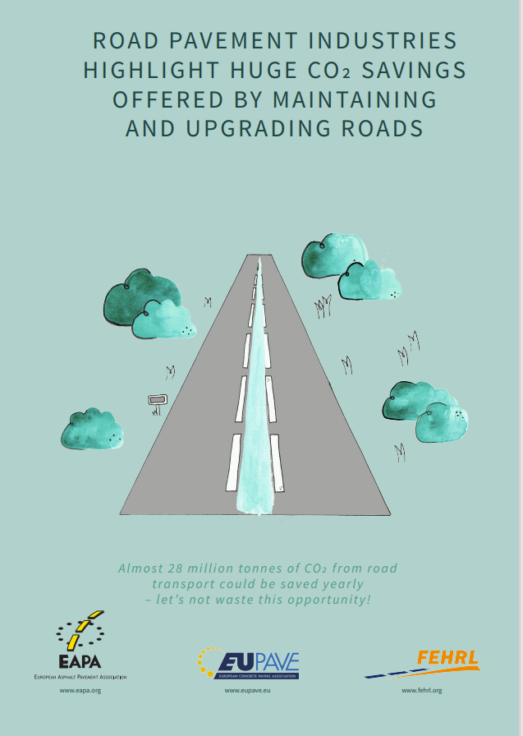
Contributions of Asphalt Industry in EU
During Production
40-60kg of CO2eq/t of Asphalt with 215 Mt of Asphalt
produced (2019/EU-27)
→ appr. 10 Mt of CO2eq per year
In Road Transport
Appr. 860 Mt of CO2eq are related to road transport
>5% can be saved with smooth and even roads and tailor made asphalt surfaces*
→ >40 Mt of CO2eq per year → Road maintenance is very important

Slide 26

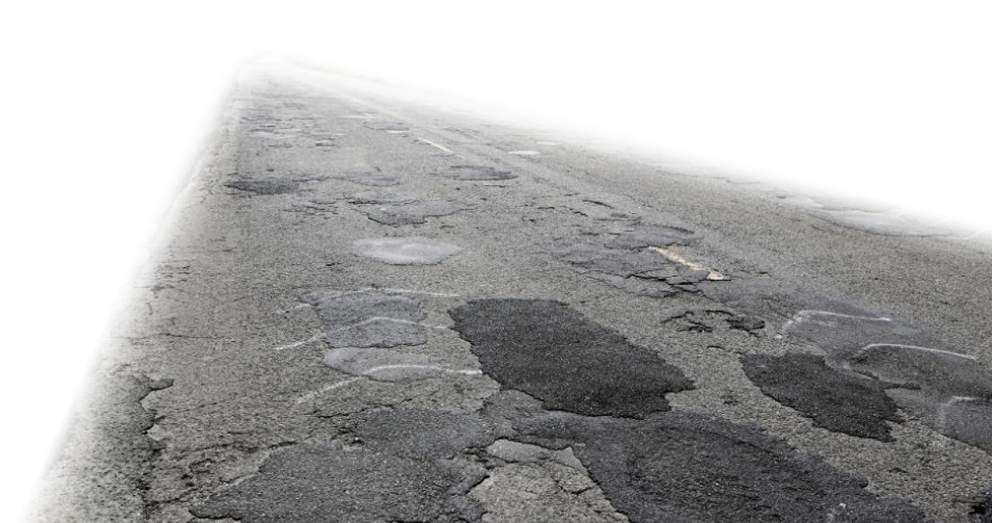
Low Rolling Resistance Asphalt
Reduce the tyre’s rolling resistance, but don’t compromise safety
Texture depth reduction, smaller nominal size aggregate, reduced surface roughness
Improved ride quality – improved vehicle dynamics
Danish paper in 2016 identified
up to 7% reduction in fuel consumption is possible
by changing surface
characteristics
Notes:
If you have road that looks like this, lots of energy spend moving vehicle up and down.

Slide 27
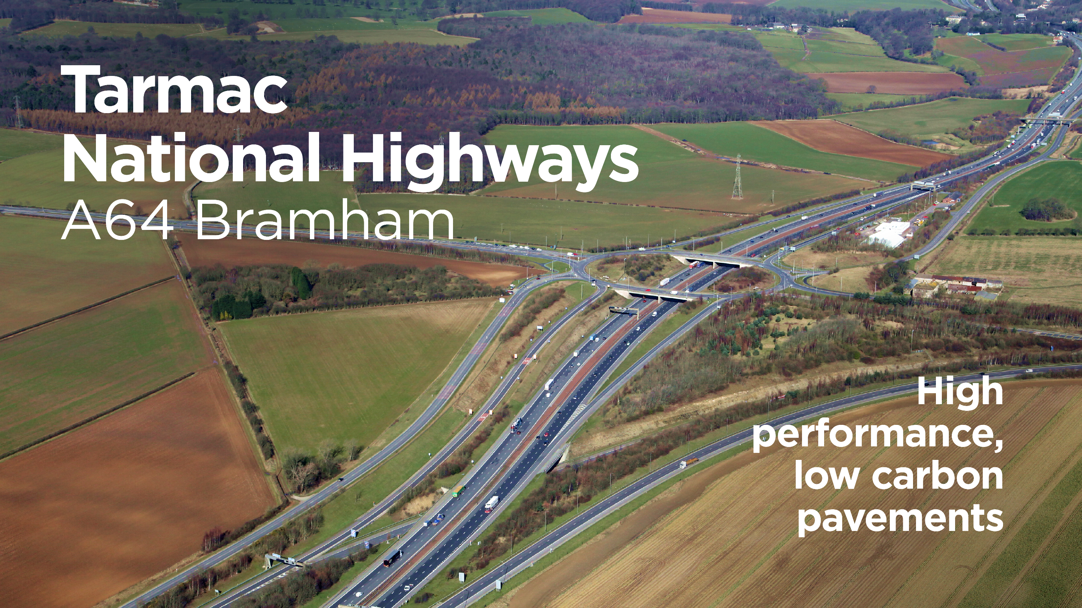

Slide 28
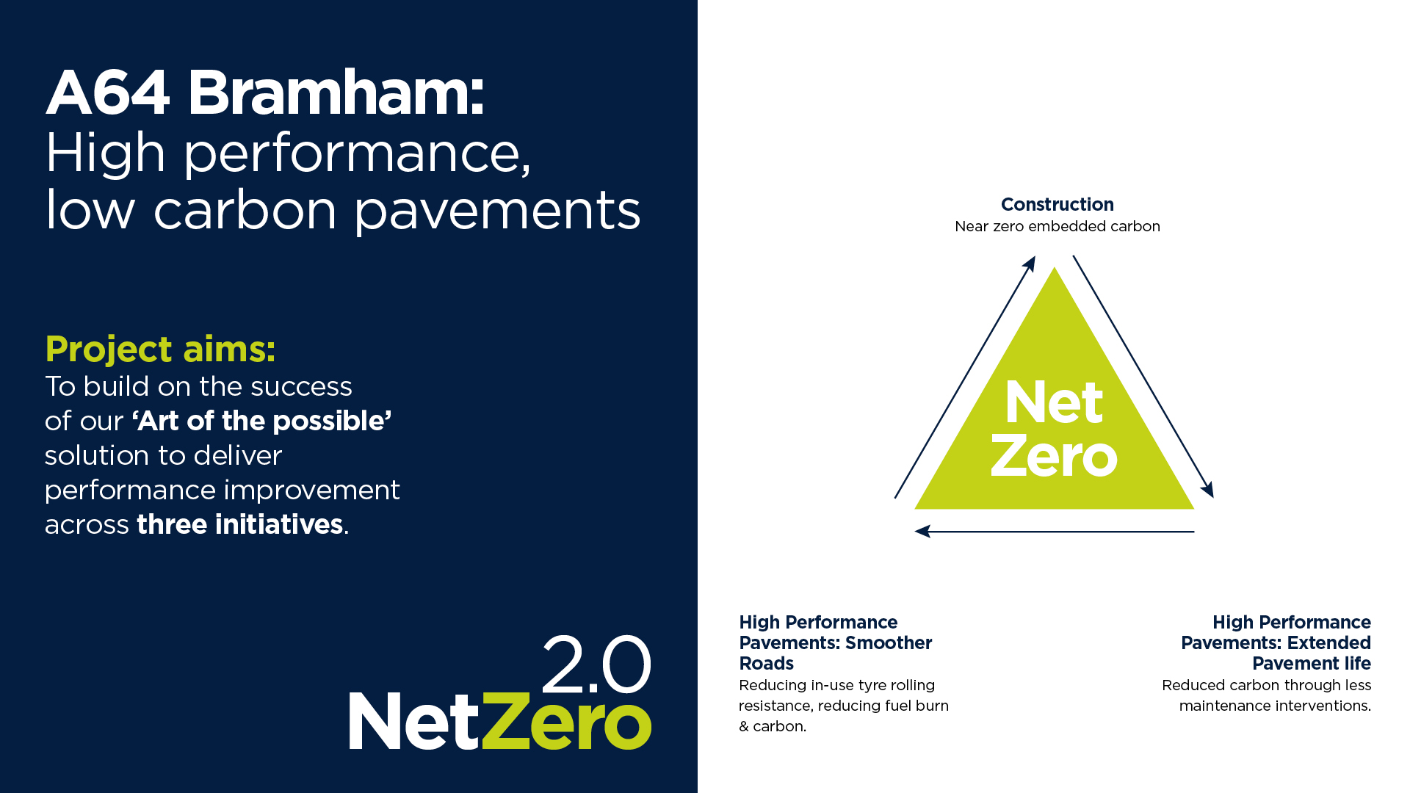



Slide 29
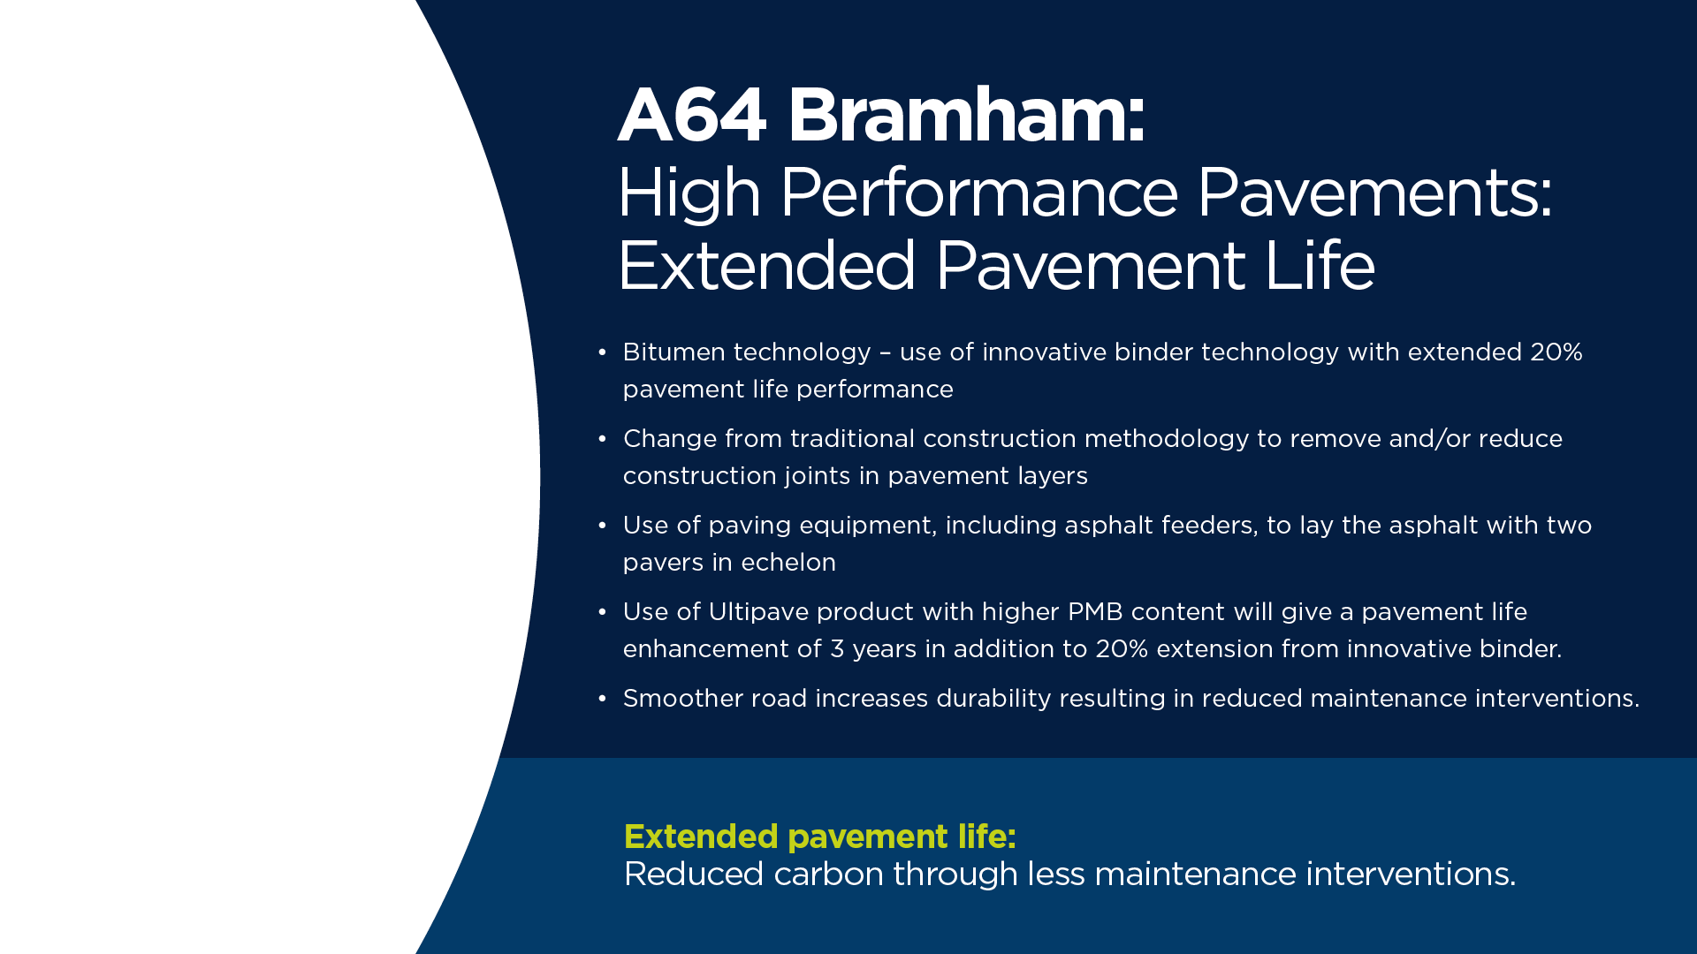

Slide 30
A64 General Use
Bio-UltiPave Longlife PMB
Dense 20mm Bio Binder Bio
Dense 32mm Bio Base
Surface Course bitumen used Shell BIO Agesafe to obtain the extended life.
Bitumen used in Binder/Base was Shell “Carbon Sink” CS375.
RAP 20% in SC and 40% RAP in Base/Binder Course
75% Carbon Reduction Achieved + Extended Life

Slide 31
A64 Target Net Zero 150m Section
Bio UltiPave 70/100 Pen
20mm Bio Binder 40/60 Pen (With 3% ACLA)
Bitumen used was Shell “Carbon Sink” CS375, blended with 20% RAP in SC and 40% RAP in Binder Course
Net Zero Achieved

Slide 32
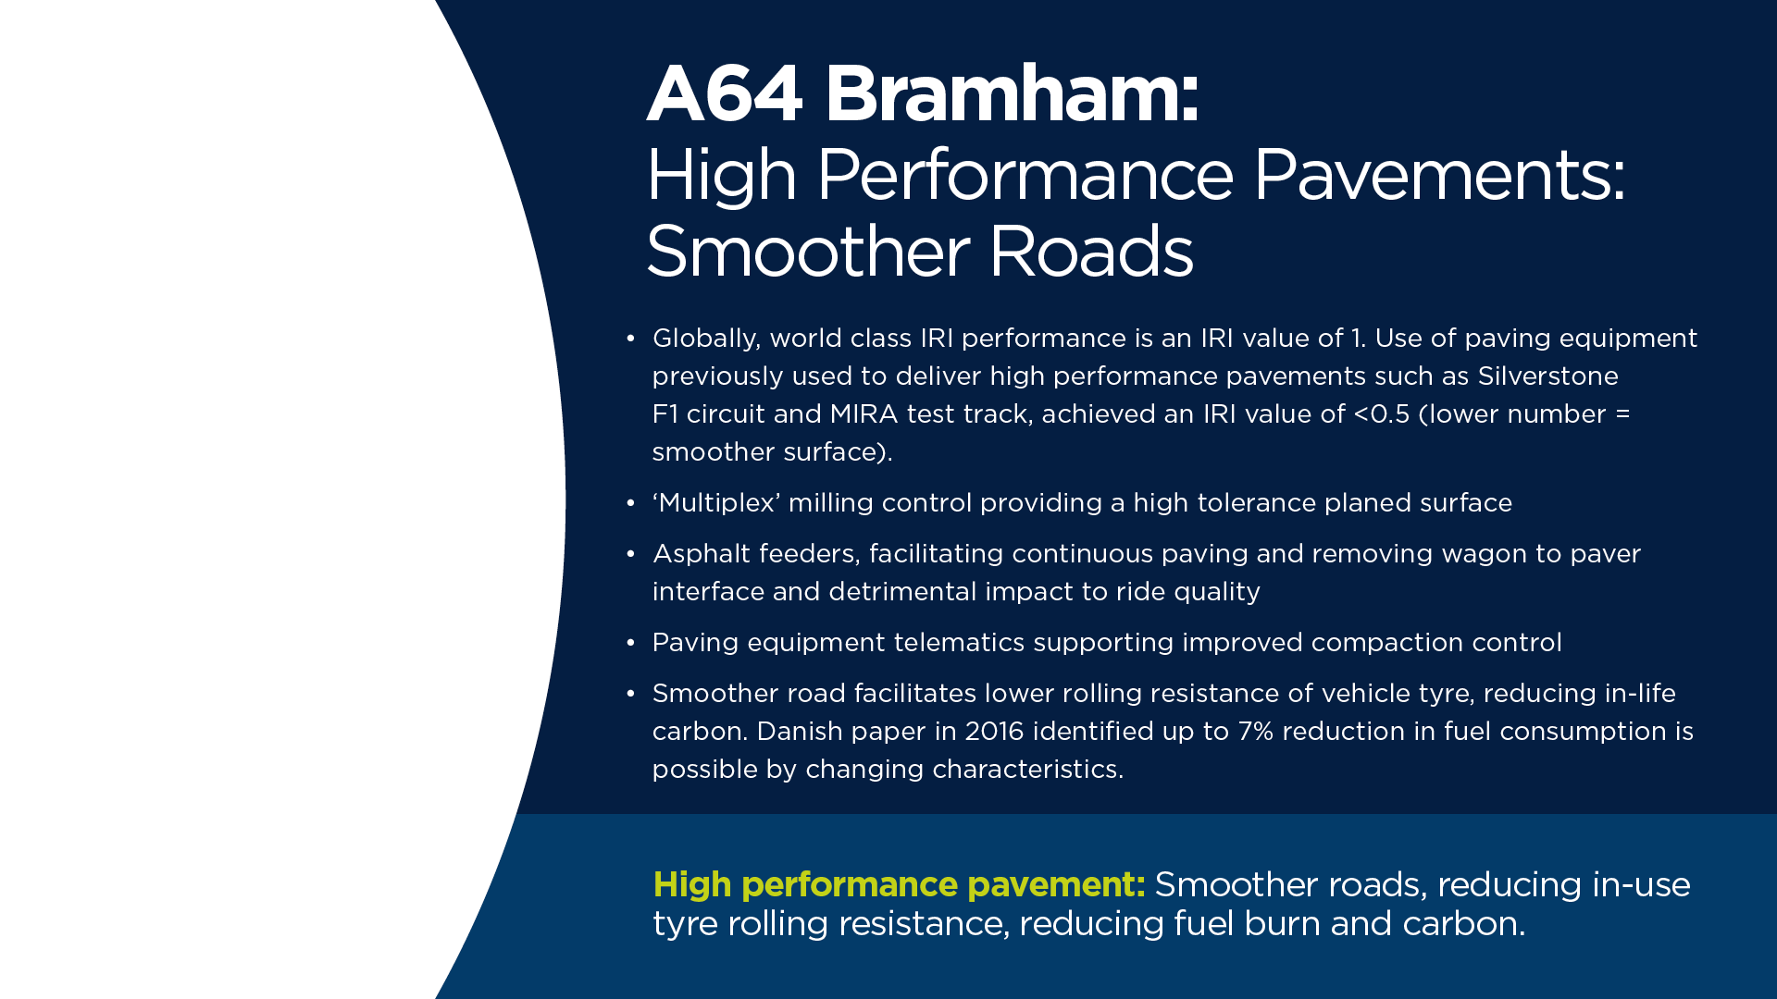

Slide 33
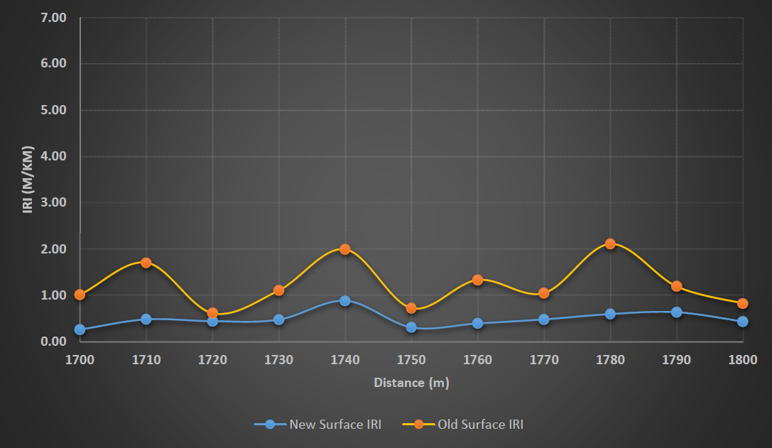

Slide 34
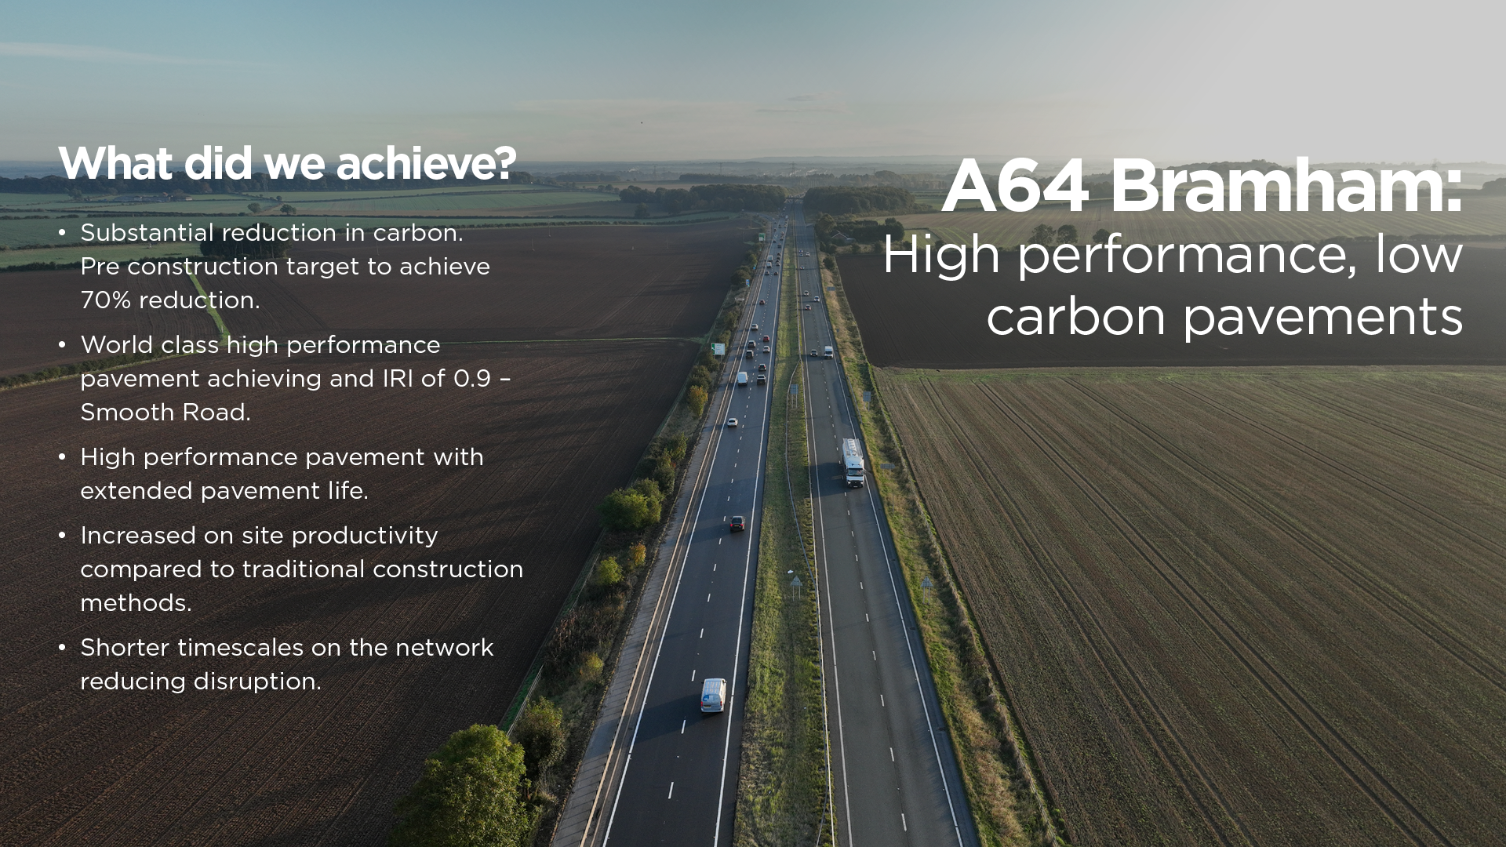

Slide 35
Accelerate Change
Credible supporting data and 3rd party validation
Successful trials - home or abroad
Present in specifications in another country (or countries)
Guarantees provided
Sustainability credentials
Significant volumes and benefits nationally
Do you have to wait for a national specification ?

Slide 36
Accelerate Change
Major rewrite of the SHW for 2025 – May provide new opportunities ?
If involved with Local Authorities – Can you be bolder ?
Low risk – significant benefit
Build in to Local Authority climate action plans
Drive through Procurement – change the procurement model
Encourage / Educate Designers
How up to date is industry training ?

Slide 37
Progress
Needs a National Highways and Local Authority Procurement process that encourages green investment and greener delivery, which in turn will drive economies of scale.
Sustainability cost will reduce with consistent demand
Make the commitment and watch the supply industry and our suppliers deliver the most economical, sustainable and long lasting pavements possible.
We can do it now !
Our industry has prepared and is ready - Is the client ?

