Slide 1

Low Carbon Highways
Moving from Strategy to Implementation
Paul Binks. Lancashire County Council. Asset Manager
Neil Leake. Aggregate Industries. National Technical Manager

Slide 2
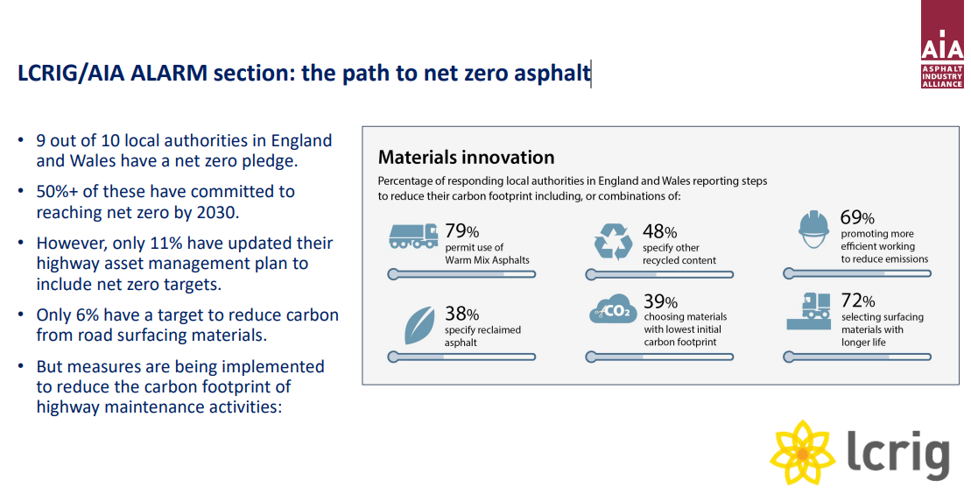
Moving from Strategy to Implementation

Slide 3
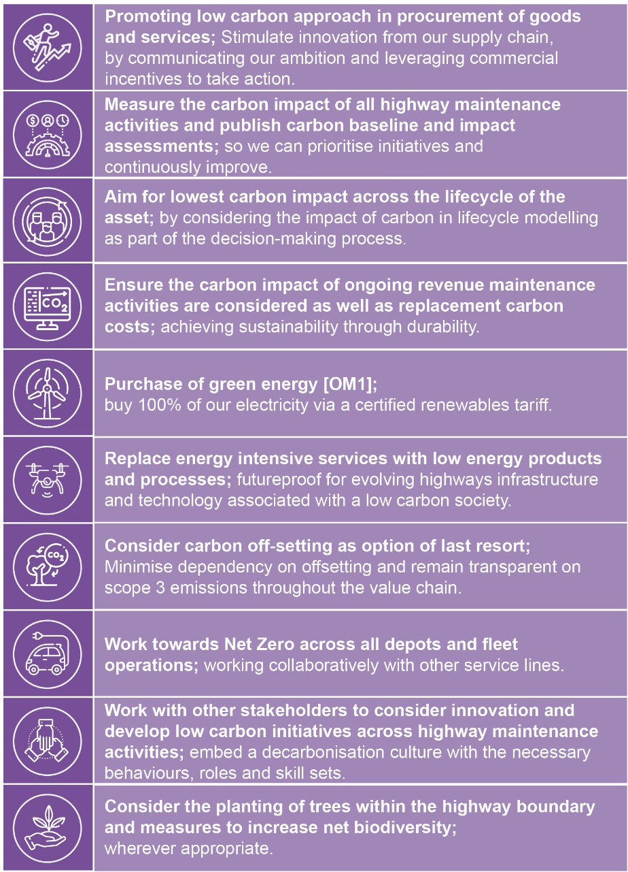


Moving from Strategy to Implementation

Slide 4
The need for sustainable materials and practices.
Road construction contributes to carbon emissions in a number of ways:
Material production: The production of concrete, asphalt, and steel are the main sources of emissions in this phase.
Construction: Construction work, such as land preparation and the use of construction plant and equipment, generates emissions.
Maintenance and servicing: These activities also generate emissions.
Lighting and signage: Roadside and tunnel lighting and signage contribute to carbon emissions.
Network expansion: More vehicles on the road, higher traffic speeds, and longer journeys all contribute to increased carbon emissions.
Notes:
Read bullets,
But todays carbon footprint looks very different.

Slide 5
Asphalt Carbon Footprint
1 tonne of asphalt emits an average of 50kgCO2e/tonne (A1-A3)
The UK asphalt market is approx 22,000,000 tonnes per year
Leading to just over 1.1 million tonnes of CO2e emitted every year
Notes:
Asphalt accounts for over 90% of all road construction materials and the industry produces around 22millions tonnes annually.
At approx 50kg/Co2e/tonne this amounts to over 1 million tonnes of equivalent Co2e emissions.
Thats equivalent to……………

Slide 6
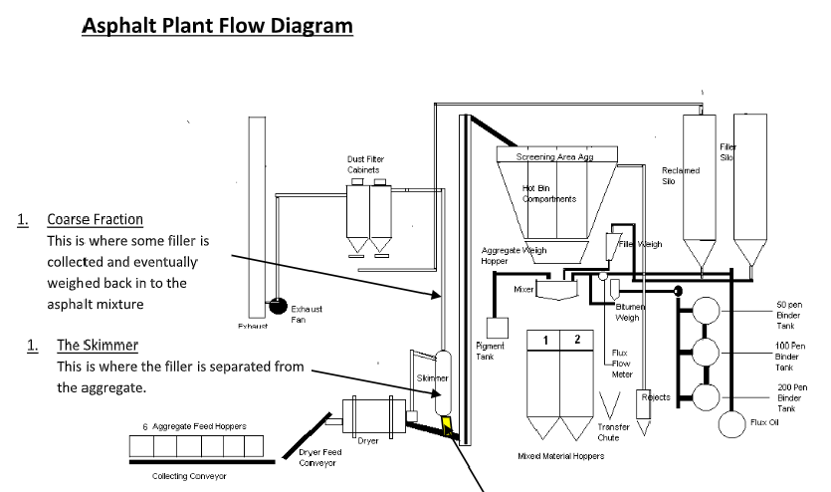

Typical Hot Mix Asphalt Carbon Map
Raw Material Delivery
Reclaimed Filler
0%
Heat
Imported Filler
13%
1%
50kgco2e/t
Additives
11%
1%
Bitumen
21%
Aggregates
RAP
53%
Dryer
Notes:
So lets look where the carbon intensity lies in asphalt.
Standard hot asphalt has a carbon footprint determined by 4 principle components, material sourcing, material components, and asphalt production and delivery.
Combined this accounts for around 50kg CO2e / tonne (Scope A1-A3) ie before delivery to the construction site
You can see that over 50% of the carbon comes from the drying and heating of the aggregates
Foamix reduces this value to around half that of hot mix asphalt through recycling asphalt planings and cold mix technology.
Foamix Eco takes this another step further.

Slide 7
So what is Foamix?
Foamix is classed as a Cold Recycled Base Material (CRBM) within the MCHW Specification for Highway Works, Clause 948
It’s a sustainable, cold mix alternative that reuses the existing road materials
Established as a base/binder material it is used as a replacement for regular hot asphalt and cementitious materials in lower pavement layers.
Foamix delivers a low carbon footprint approx half that of traditional Hot asphalt (approx. 25kgCO2/tonne) due to its cold manufacturing process and high recycled aggregate content.
Our challenge was to further develop Foamix in an attempt to eliminate the remaining embodied carbon across its A1-A3 (Cradle to Gate) scope
Notes:
A lower carbon alternative to hot mix asphalt already exists. Cold Recycled Base Material (CRBM) already has a place in the pavement engineers

Slide 8
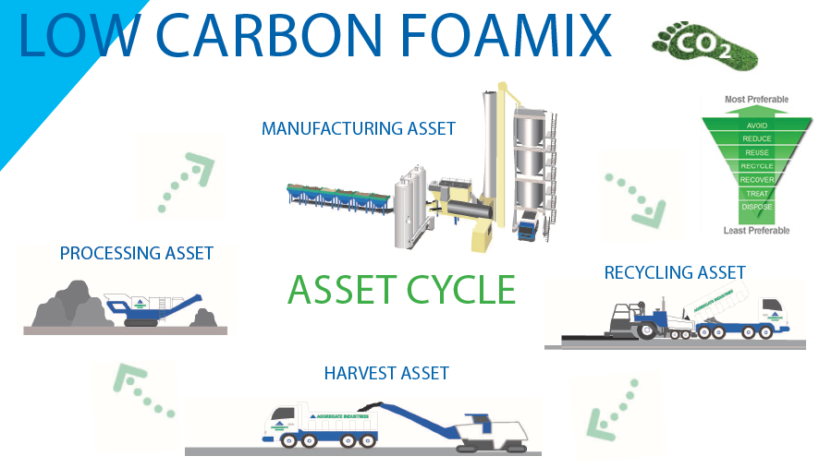
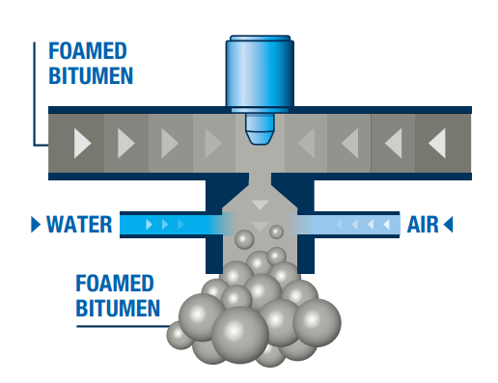
What is the Process and how it works
Notes:
Harvest the asset
Process the asset
On site Manufacture
Installation
Inject of cold water and air into hot bitumen at high pressure
Foamed bitumen increases volume and reduces viscosity for a short period.
This enables coating of cold damp aggregate.

Slide 9
Typical Carbon comparisons
Foamix carbon values show the following compared to Hot Mix Asphalt:
Foamix
Carbon scope | Kgco2e/t
A1 (Raw materials) | 15
A2 (Raw material transport) | 3
A3 (Manufacture) | 2
Total | 20
WMA
Carbon scope | Kgco2e/t
A1 | 17
A2 | 7
A3 | 21
Total | 45
HMA
Carbon scope | Kgco2e/t
A1 | 17
A2 | 7
A3 | 26
Total | 50
Notes:
You can see that the cold process and on site manufacture give reduced carbon footprint by circa 50% against HMA
WMA saves around 10% on HMA as the heating process is reduced
WMA is now the standard asphalt supply
Our challenge was to make Foamix zero carbon..

Slide 10

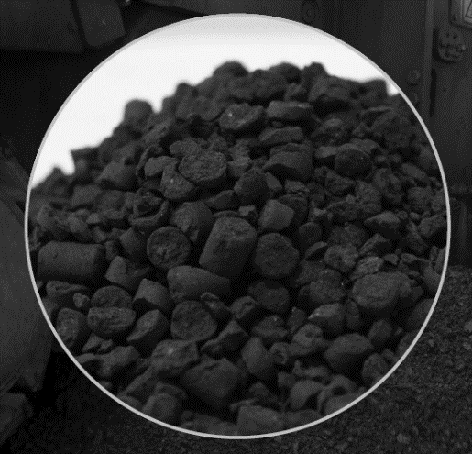
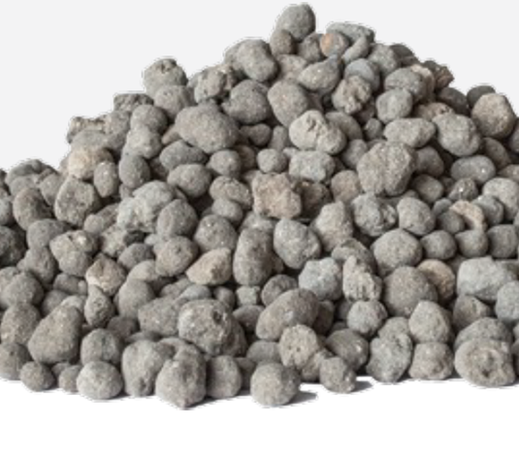
Foamix Eco – What is the product
Manufacture & Installation are the same as standard Foamix
Foamix Eco still recycles the old asphalt from the site and re-purposed it to provide over 90% recycled aggregate.
It incorporates the latest carbon negative aggregates.
The bitumen used is the latest in carbon neutral Biogenic binder
With no reduction in performance
Notes:
Carbon negative agg. The increase in Carbon capture is quickly progressing and there are many solutions available, from BioChar, to MLS to ACLA, these additives need R&D processing and trials to confirm both carbon values within the mix and performance.
Bio Bitumens. As most of you will know the source plants for biomass capture CO₂ as they grow through photosynthesis and when blended with bitumen reduces the embodied carbon of bitumen component by around 50% and lock the carbon into the road structure.
Still gives the same performance as Foamix and compliant to standards

Slide 11
Foamix Eco - Carbon intensity
Typical values
Foamix
Carbon scope | Kgco2e/t
A1 (Raw materials) | 15
A2 (Raw material transport) | 3
A3 (Manufacture) | 2
Total | 20
Foamix Eco
Carbon scope | Kgco2e/t
A1 (Raw materials) | -5.01
A2 (Raw material transport) | 3
A3 (Manufacture) | 2
Total | 0
Notes:
Comparing a standard Foamix asphalt with a Foam ix Eco you can see that the reduction comes from the raw materials.
This being the Bio genic bitumen and the carbon negative aggregates.
The % of carbon negative aggregate can be tailored to the scheme to increase radius

Slide 12
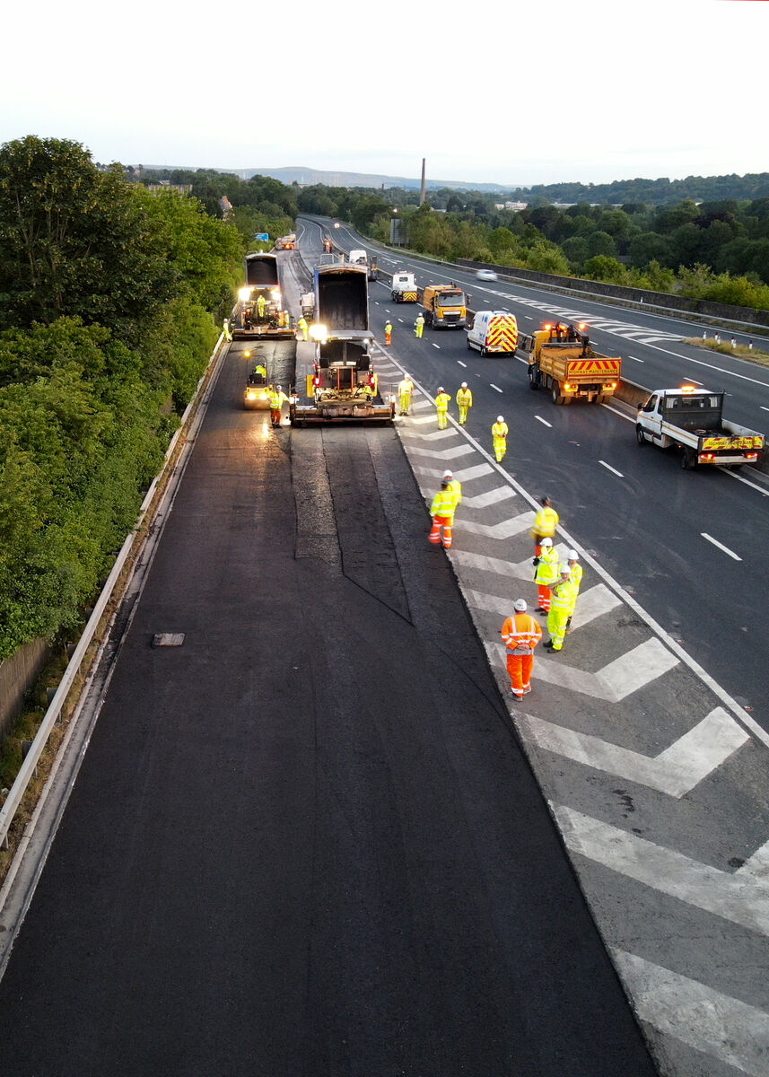
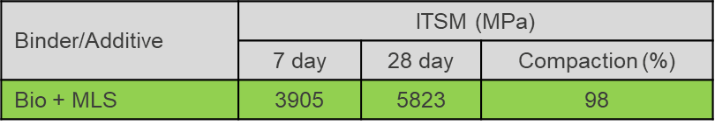
Foamix Eco - Carbon Neutral Trial
M65 Lancashire
Through the collaborative framework we aimed to reach zero carbon with Foamix
Extensive R&D trials were undertaken with Nottingham Uni and AI in-house laboratory to assess various bio bitumen and carbon-negative aggregates
The trial was undertaken on the M65 Slip Road in July 2023
Pavement design consisted of 70mm Foamix Eco, which was overlaid with 40mm SMA asphalt surface course
Manufactured next to scheme to reduce haulage carbon
Recycled hazardous planings used within the mix
Installed using echelon paving under night-time closure
Carbon Module | Carbon Value (kgco2e/t)
A1 – A3 | -0.39
Notes:
The trail was constructed under a night time closure and using echelon paving
70mm of Foamix Eco was placed onto the planned surface and 40mm of SMA laid directly above it the same night
Carbon values had to be third party verified and showed a -0.39kgco2e/t through A1-A3.
Test data showed fully compliance to standards

Slide 13

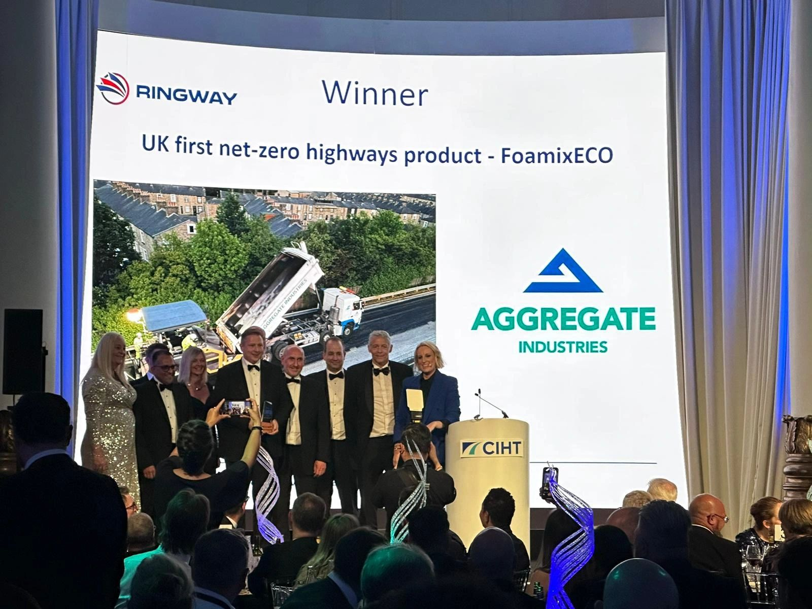


Awards and Recognition
CIHT North West Environment/Sustainability 2024 WINNER
CIHT National Awards first Net=Zero Highways Product 2024 WINNER
WINNER
Notes:
And the industry agree that Foamix Eco is truly a innovative solution, 4 prestige awards already secured.

Slide 14
Thank you

