Slide 1

Knowledge Bank Launch 13th November 2025

Slide 2





Introduction to CEDR and the Knowledge Bank
Purpose of the Session
Journey So Far
Demonstration
Launch of the Knowledge Bank
Feedback and Discussion

Slide 3

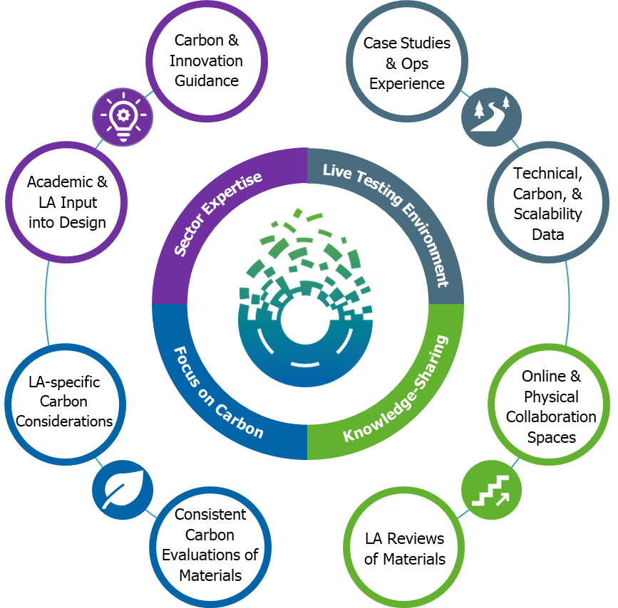



Introduction
A Live Labs 2 theme - paving the way to a low-carbon future through material innovation and collaboration across the highways and local roads sector.
Delivered by North Lanarkshire Council and Transport for West Midlands, in partnership with Amey and Colas
Aims to reduce siloed working and encourage low-carbon material adoption
Supported by live testbeds and knowledge bank for LAs

Slide 4

Why a knowledge bank? The local authority perspective

Slide 5
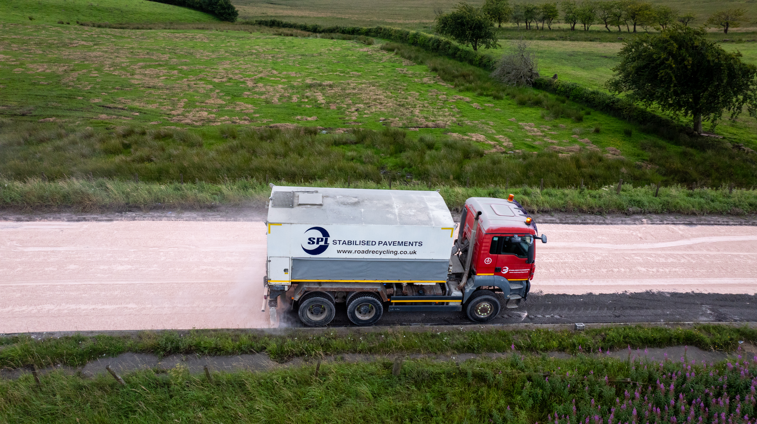
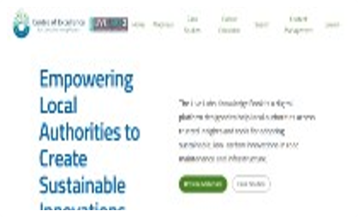
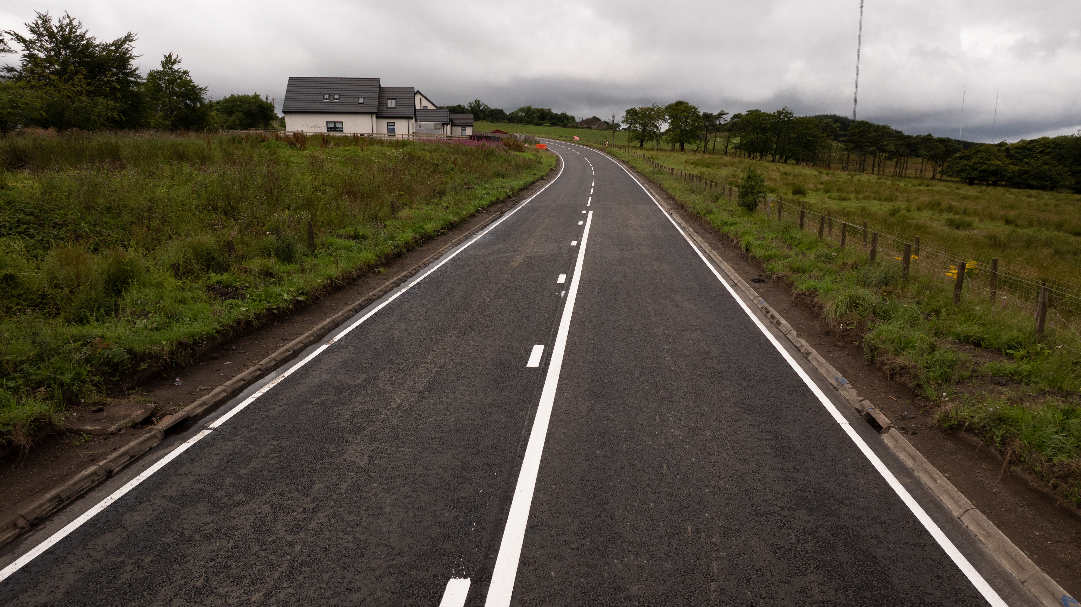
Journey so far
1
2
3
4
Year 1 – 2023/4
Mobilisation
Year 2 – 2024/5
Building evidence
Year 3 – 2025/6
Scaling impact
Post – 2026/31
Monitoring and evaluation
Partner network formed
Market scanning
Innovation scorecard and trial prtocols
Challenge identification
Trials on live road network
Full carbon baseline of NLC and TfWM
Carbon and technical framework developed
Behavioural research
Sandbox
Knowledge Bank
Full carbon and technical evaluations
Assessing long-term change created by the programme
400+ materials identified
40+ live trials of low-carbon materials
Network of local authorities, SMEs, supply chain and industry bodies
Knowledge bank to store evidence of material performance across the UK
Notes:
The journey began with forming a partner network, market scanning, and developing innovation scorecards and trial protocols. Year 1 focused on mobilisation and establishing a carbon baseline. Year 2 is about building evidence and conducting evaluations, while Year 3 will focus on scaling impact and assessing long-term change. The programme has already identified over 400 materials and launched more than 40 live trials, building a robust network of stakeholders and a knowledge bank for sharing results.

Slide 6

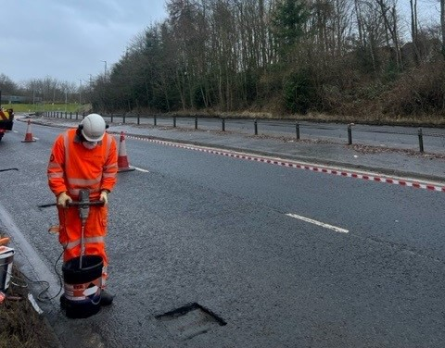
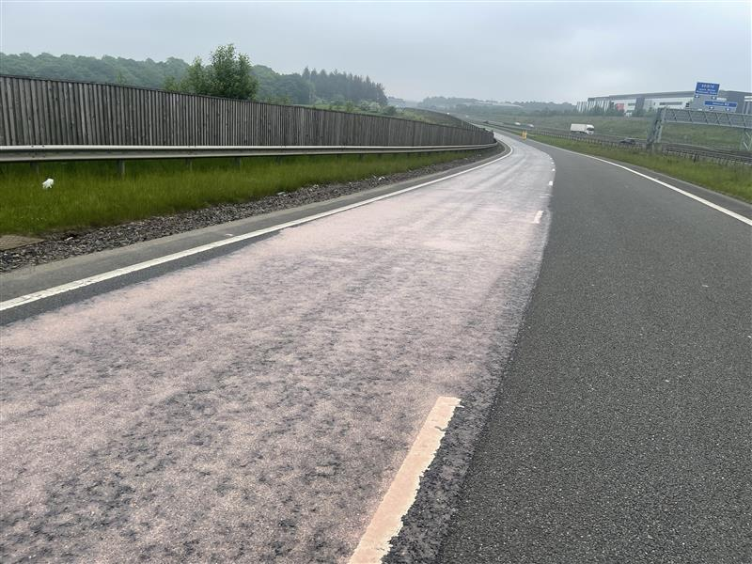
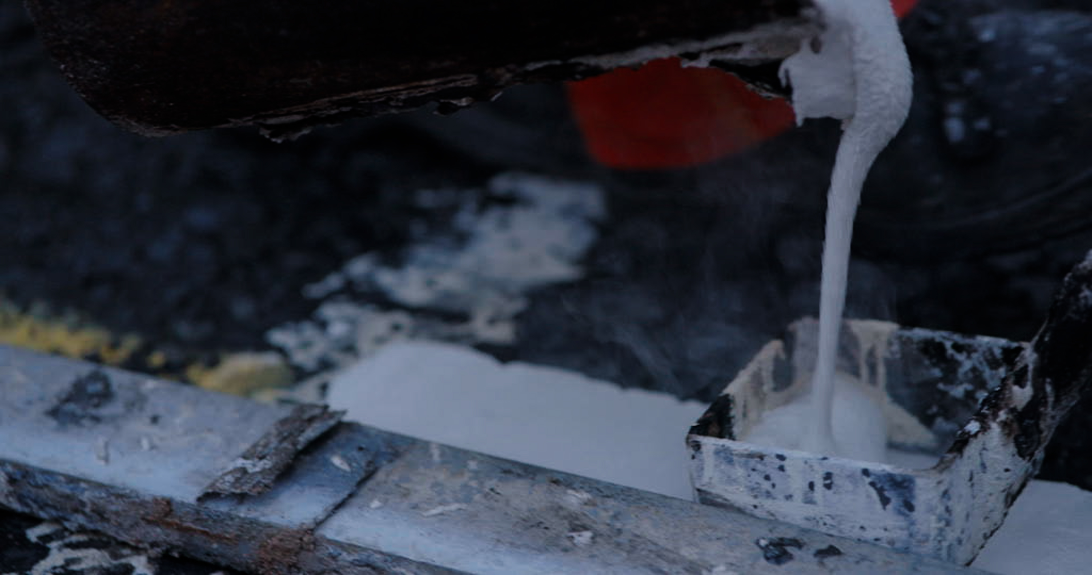
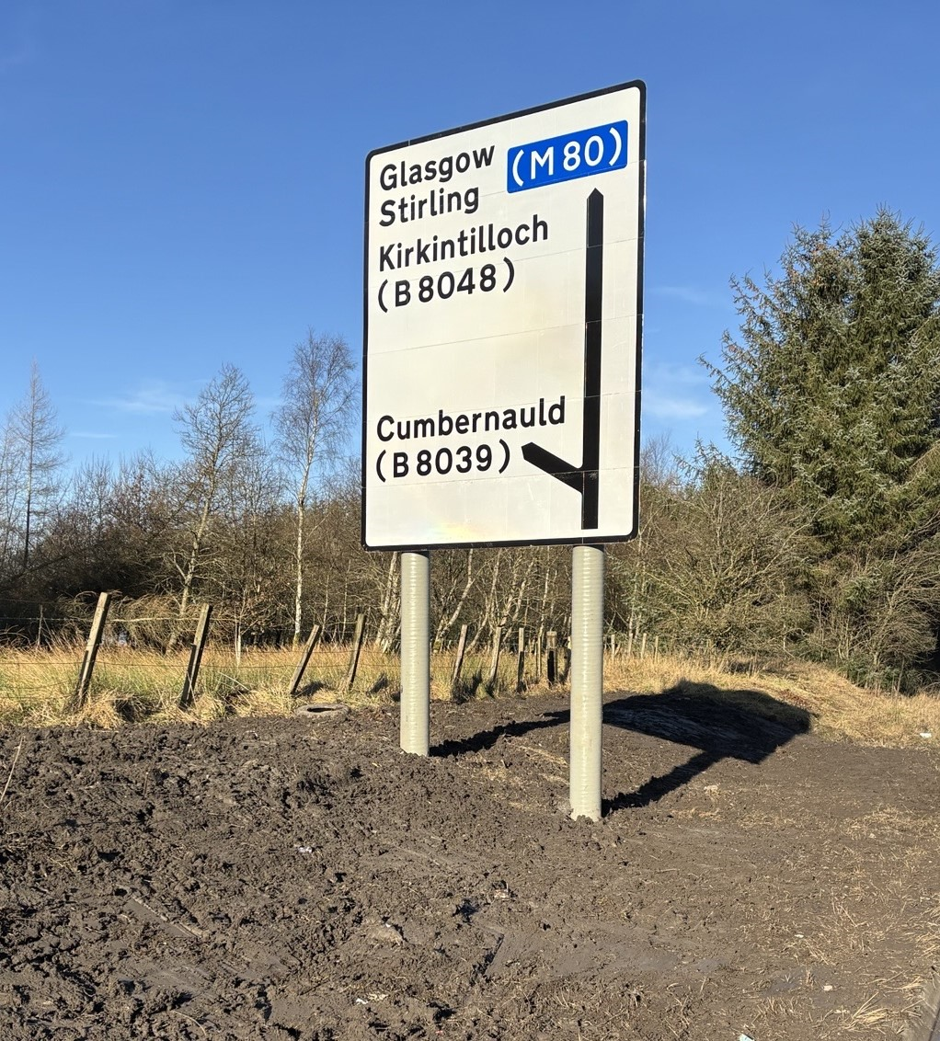
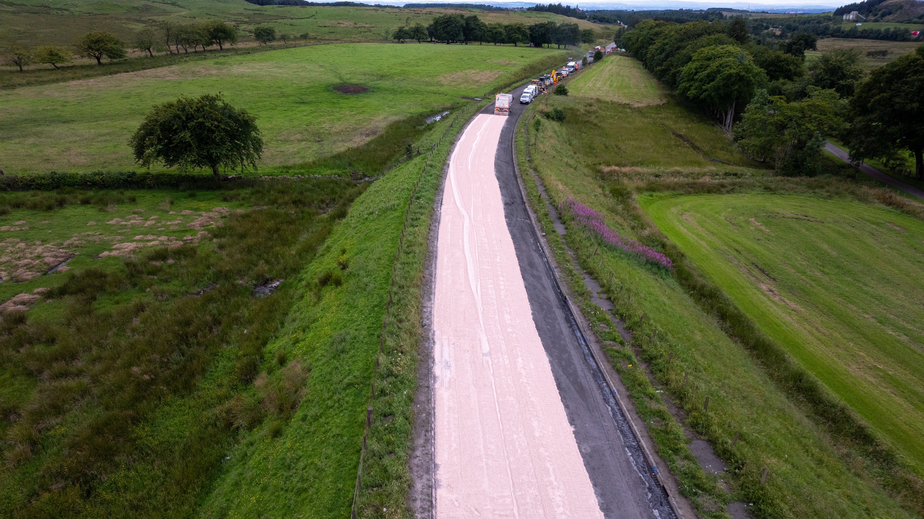
Material trials and research
Pothole Trials
Operational and controlled testing of materials
10+ materials and methods trialled
Rejuvenator & Preservative Trials
Trials on HRA and SMA
Control sections
Testing of cores with University of Nottingham
Line-marking Trials
5 low-carbon materials trialled against thermoplastic
Transverse, refreshed and new lining
Signage Trials
Recycled glass composite signpost that is passively safe
Reed-based sign face
Surfacing Trials
Binder and surface course SuperSites
In-situ recycling, lignin, graphene additives, biogenic PMBs, biogenic binders
6
Notes:
A wide range of trials are underway, including pothole repairs, rejuvenator and preservative testing, line-marking, signage, and surfacing innovations. These trials compare low-carbon alternatives to traditional materials, with rigorous testing in partnership with academic institutions. The aim is to generate robust, comparative data on carbon, cost, and performance.

Slide 7






The Innovation Funnel
Objective
Progress
Discover
Discover challenges to decarbonisation
Behavioural research
Consultation with LAs
Innovation Log with 350+ materials
Global market scanning completed with Connected Places Catapult
Identify
Identify leading low-carbon materials
Qualify
Pre-qualify materials
7 innovation series scorecards completed
Trial
Trial on NLC and TfWM road network
30 material trials
Technical, carbon and scalability evaluation
Carbon profiles created for first trials in FHRG Carbon Analyser
Evaluate
Scale & Share
Embedding as BAU and knowledge bank
Monitoring & evaluation of first trials underway

Slide 8
Journey so Far
1
2
3
4
End-User Requirements
High-level wireframes
IT options appraisal and onboarding
Design and development
Working with Thinks Insight, we conducted behavioural research with 10 LAs across the country to assess challenges and initial design prototypes
Early-stage wireframes and End-User Requirements presented to suppliers and validated by LAs
In-depth designs, development and UAT testing over the last 5 months.
Focus Groups with LAs and Suppliers
Three top suppliers rated against key criteria, and top supplier (Microsoft with Transparity) were onboarded

Slide 9
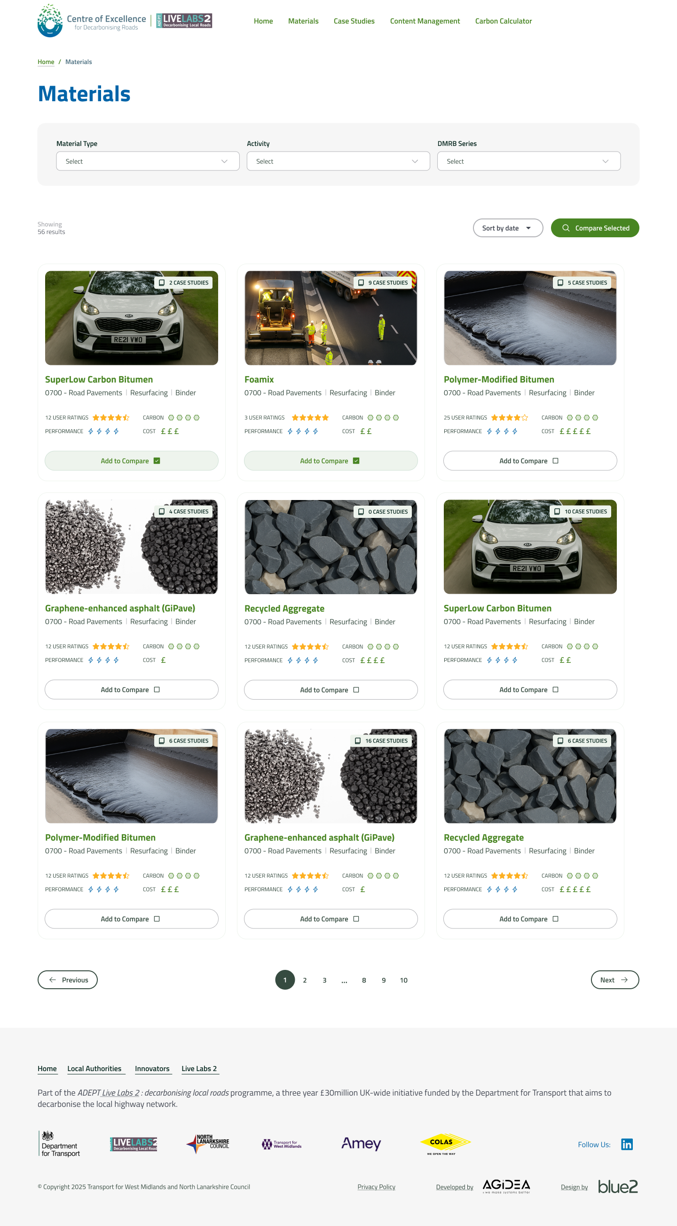
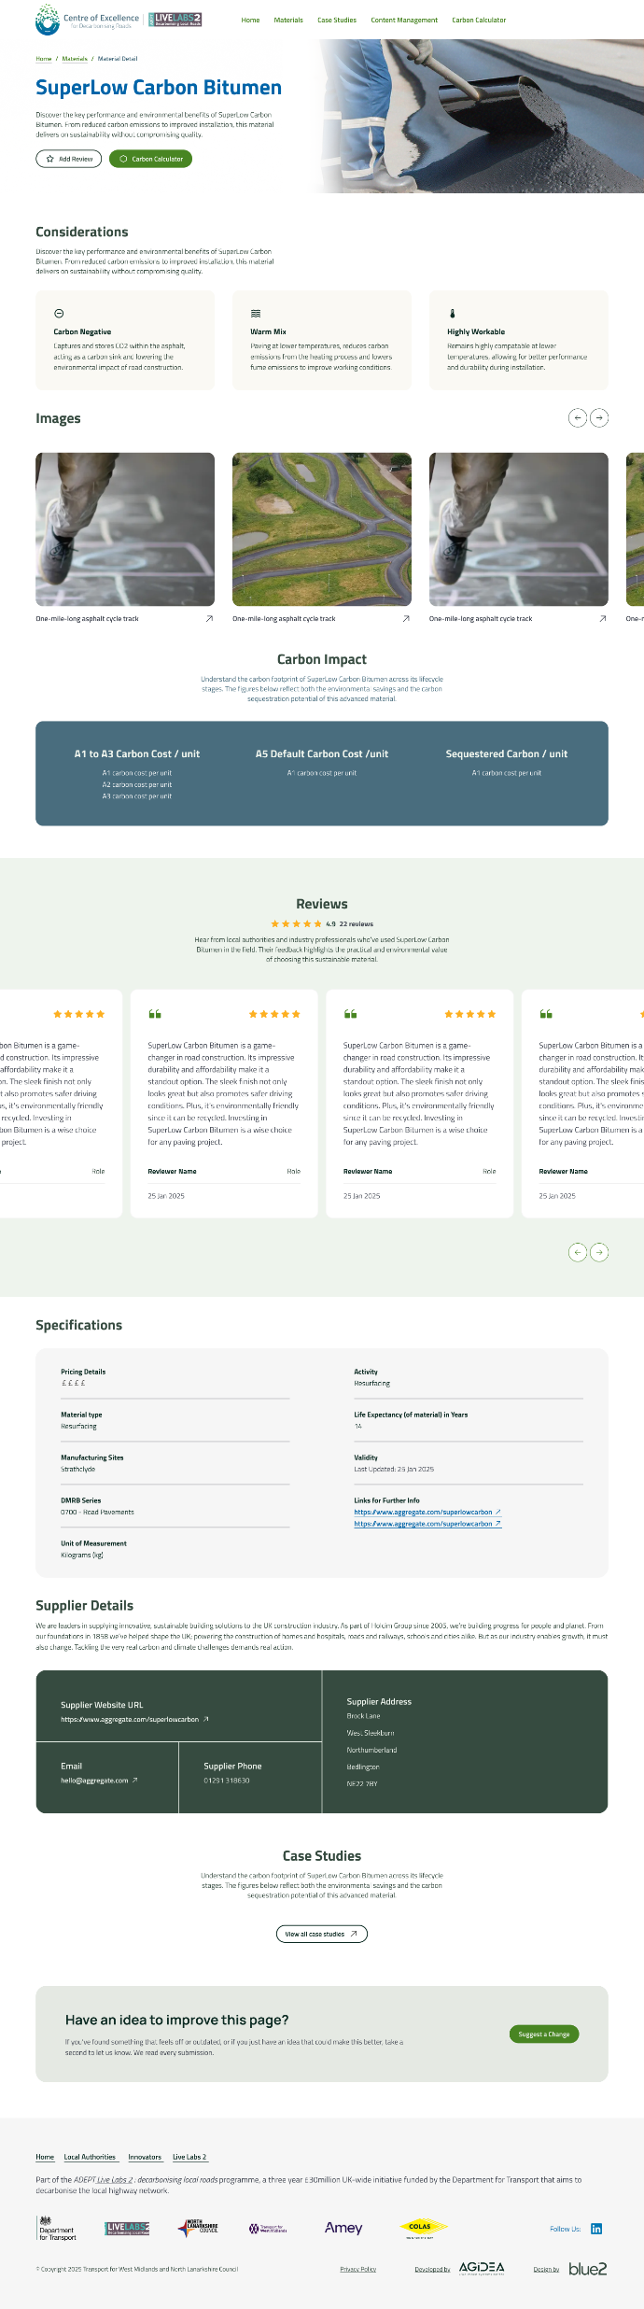

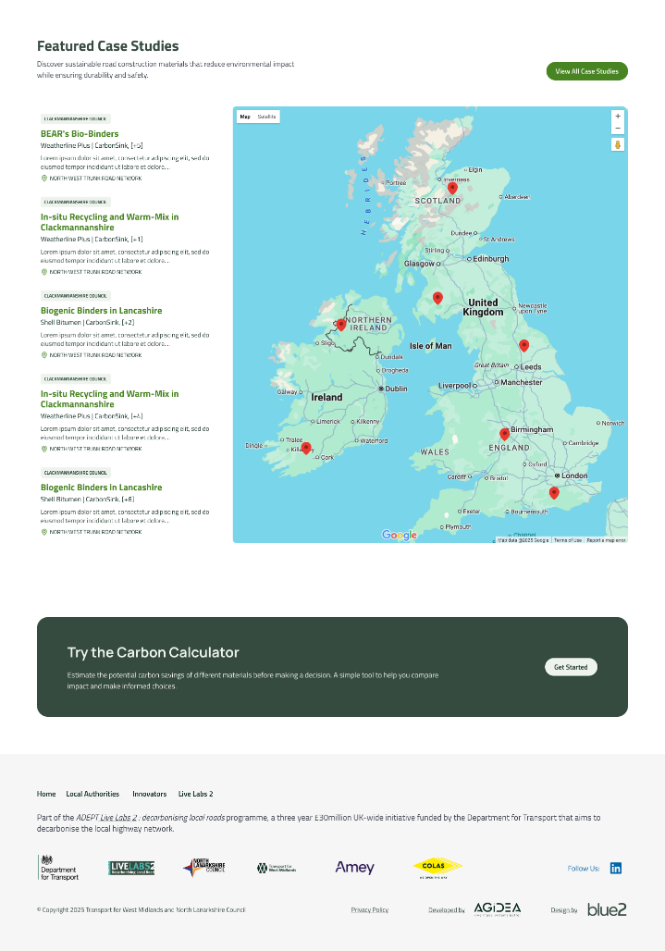
Intention of the knowledge bank
Comprehensive menu of options, with carbon, cost and performance consistently measured
Evidence base for local authority innovation and excellence across the UK
Not the finished item – We need your input and data!
Peer reviews and culture of local authority collaboration

Slide 10




What’s Next for the Knowledge Bank
Regular re-Releases
Iterative Development
Launch
Based on your feedback, prioritisation of additional features such as:
AI chatbot
LA forum
Supplier and LA interaction
Specification guidance
Collection and collation of user feedback
Verification with suppliers
Carbon tool editing
Webinar
Demos at events across UK
Additional data cleansing and input
Notes:
he next steps include minor edits, launch activities, and a Phase 2 focused on feature enhancements and data input. Planned outreach includes a launch event, webinar, LinkedIn campaign, and press release. Future priorities, based on user feedback, include AI integration, a mix design tool, and specification guidance

Slide 11


Demonstration
Homepage
Materials list
Case studies list
Carbon calculator
Considerations
Awaiting user input – this is a community tool that needs you!
Validating carbon information – so most are not currently submitted
Phase 1, with further developments and features to come
Supplier validation in progress – please send your feedback and edits
Some materials are those we have identified and are awaiting further supplier details

Slide 12


The Knowledge Bank
https://kb.decarbonisingroads.co.uk/

Slide 13


Leave your feedback here
Questions & Discussion
Notes:
PRG:
Achievements:
Completed proof of concept and materials testing
Secured agreement for live road trial with southern council
Obtained MOUs for tyre-derived bitumen supply
Won innovation award from Motor Industry Transport Research Association
Primary Barriers Identified:
Need £750,000 for prototype development - too large for angel investors, too small for VCs, too early for commercial lenders
Increasing tyre exports reducing domestic availability
Testing, certification and regulatory approval for new materials
Mentor Feedback & Actions:
Connected with Holcim for small-scale pothole trials
Introduced to National Highways standards team - bitumen represents 25% of NH's CO2 footprint
Identified need for different approaches: local councils (price-focused) vs National Highways (lifecycle-focused)
SIMA:
Mitigation Strategies:
Gradual approach: smaller reductions to stay within PD6691 recommendations
Rebrand as "recycled polymer" vs. "recycled plastic"
Seek real-life collaborative trials with multiple stakeholders
Offer equipment rental instead of purchase
Pursue certified carbon footprint analysis
Ecopals
Technology: Echo Flex pellets - recycled plastic modifications for asphalt
Maturity: TRL 8-9 with 35+ projects in Germany
Dosage: 2-4 kg per tonne of asphalt
Key Barriers Identified:
UK regulations not aligned with recycled plastics
Microplastic leaching and water contamination
Compatibility with RAP and long-term reusability
Competition: Positioning against bio-binders and biochar
Trial Readiness: No active UK trial data
Key Findings:
Local councils have flexibility to modify regulations
EPDs and PCFs identified as key environmental assessment documents
HAPAS certification valuable long-term but not immediately required
Need to address stigma from previous failed recycled plastic trials
Uberbinder
Key Achievements:
Growing lab team and relocating to Liverpool
Board seat at International Road Federation
UNESCO Global Engineering Day showcase selection
Challenge: Market vs Mission-Driven Approaches
Stakeholders expect "shovel-ready" solutions despite early TRL stage
Mismatch between technology maturity and market expectations
Stakeholders acting as gatekeepers rather than strategic enablers
Models Referenced:
Massachusetts Model: State-wide climate tech leadership with higher risk tolerance
EU Forum: 20-company consortium for holistic circular transportation infrastructure
Insights:
Need strategic mentors and enablers, not just gatekeepers
Focus on mission-driven collaboration over market-driven specifications
Relationship building and finding right stakeholder fit critical
Biozeroc:
Findings from Exploration Phase:
Data credibility issues - testing data from small startup vs. established manufacturers like Marshalls
Requirements for different shapes, sizes, colours necessitate new testing/certification for each variant
Scale-up and Cost Barriers: Confirmed as significant obstacles; limited funding for decarbonization despite industry willingness
Risk Premium: Higher costs associated with startup partnerships due to limited insurance backing
Venture capital traction requirements differ from construction industry expectations
Mitigation Stage work:
Exploring different market opportunities beyond road infrastructure
Investigating lower-risk product profiles
Considering low-cost trials combined with scale-up grounds
Pivot: Repositioning from product manufacturer to raw material supplier (bio-cement additive replacing up to 20% of cement)
DMAT:
Identified Barriers:
CE marking vs. UKCA requirements post-Brexit
No established UK protocols for testing self-healing properties
Alignment with UK carbon performance standards
UK dominated by 4-5 major vertically integrated ready-mix/cement producers
Mitigation Stage work:
Engage UK regulatory consultants and laboratories
Send samples to Norfolk laboratory for testing
Pursue Environmental Product Declaration (EPD)
Focus on smaller precasters and ready-mix suppliers rather than major cement producers
Target specific applications (retaining walls, road barriers)

