Slide 1
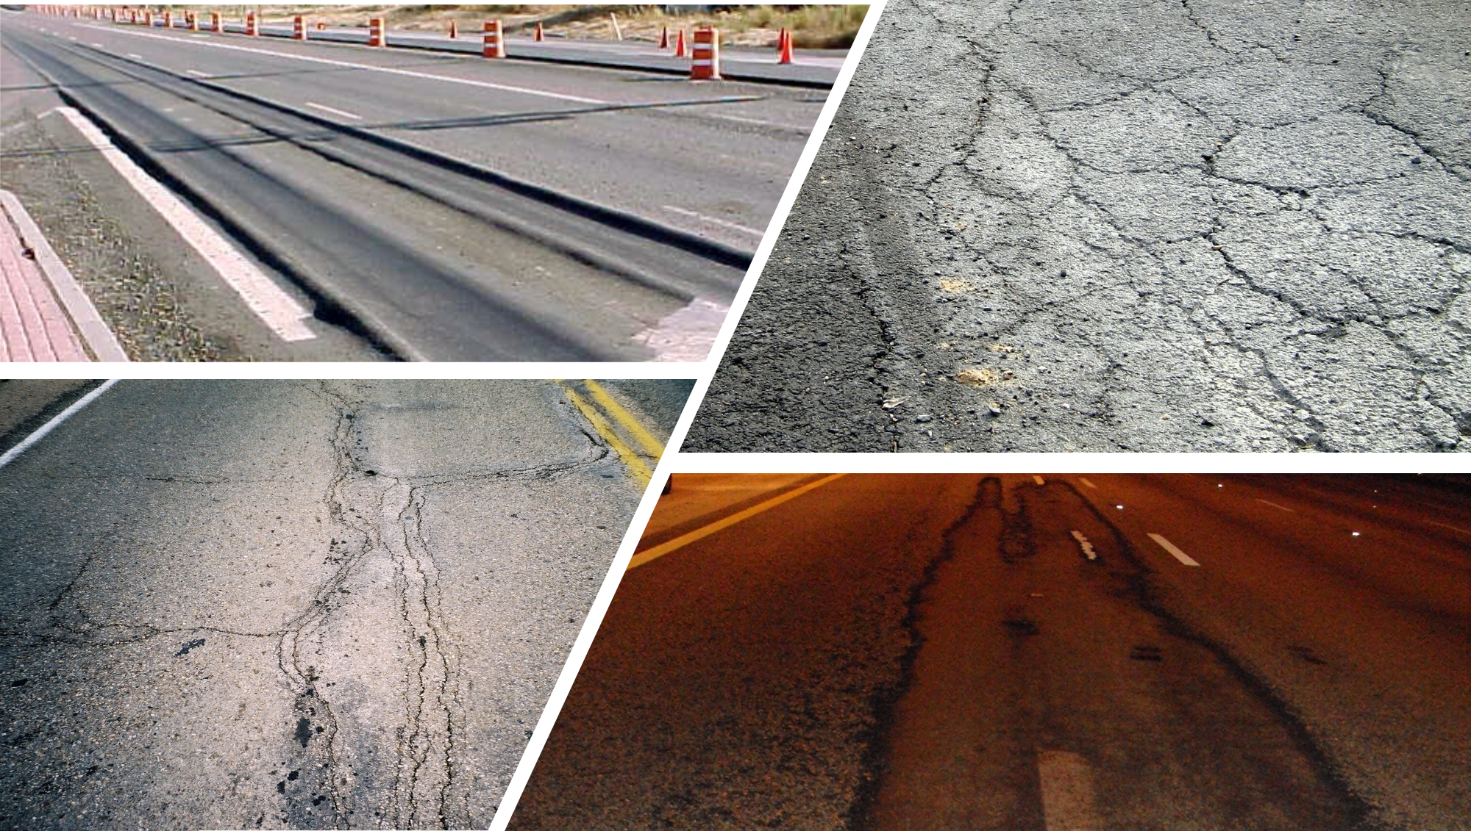
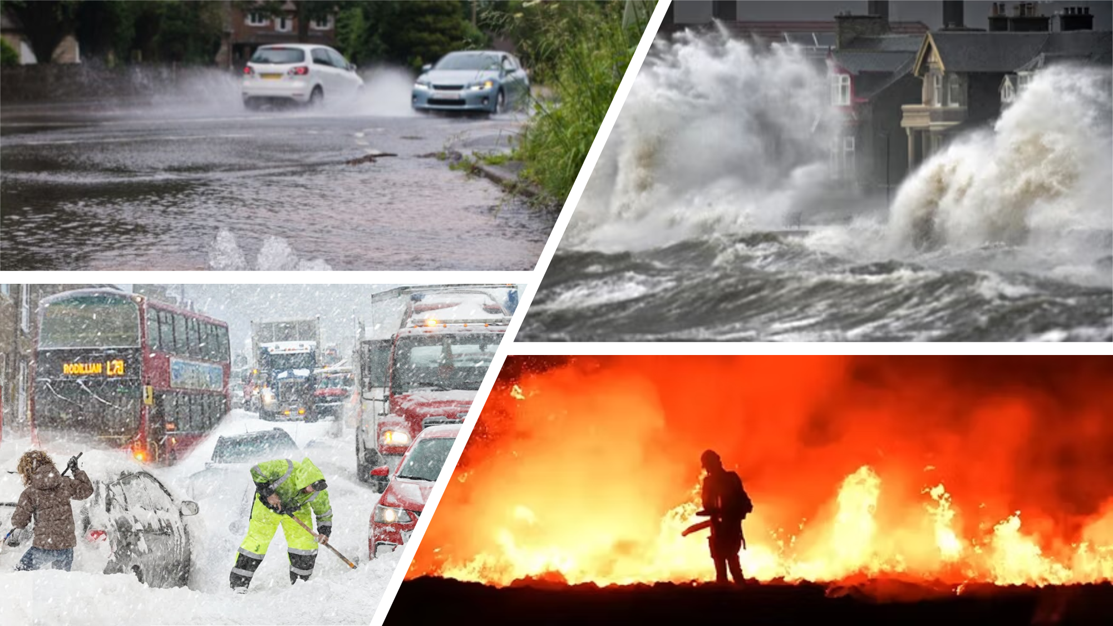
Asset Management in the Time of Climate Change
Are we heading for a perfect storm?
  a particularly violent storm arising from a rare combination of adverse meteorological factors
  an especially bad situation caused by a combination of unfavourable circumstances.

Slide 2
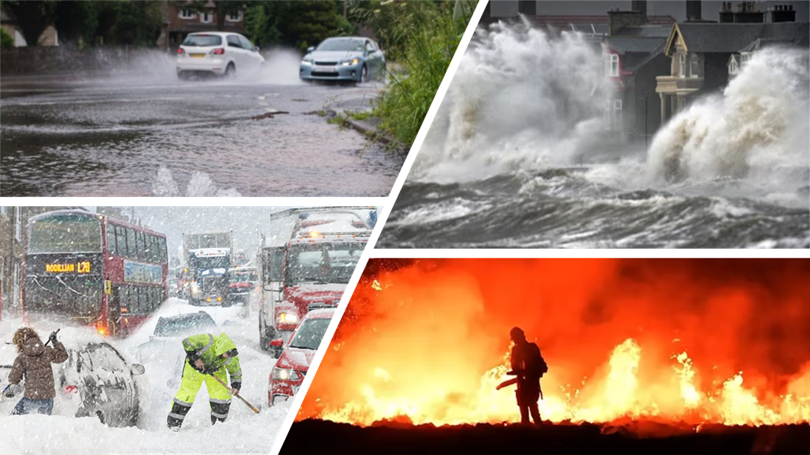
What is climate change?
A long-term shift in average weather patterns that characterise a region
  Temperature
  Rainfall
  Wind
  Others

Slide 3
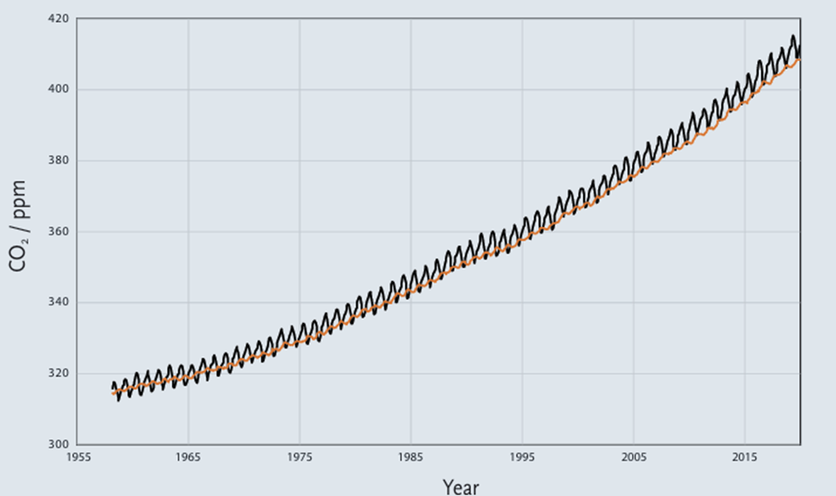
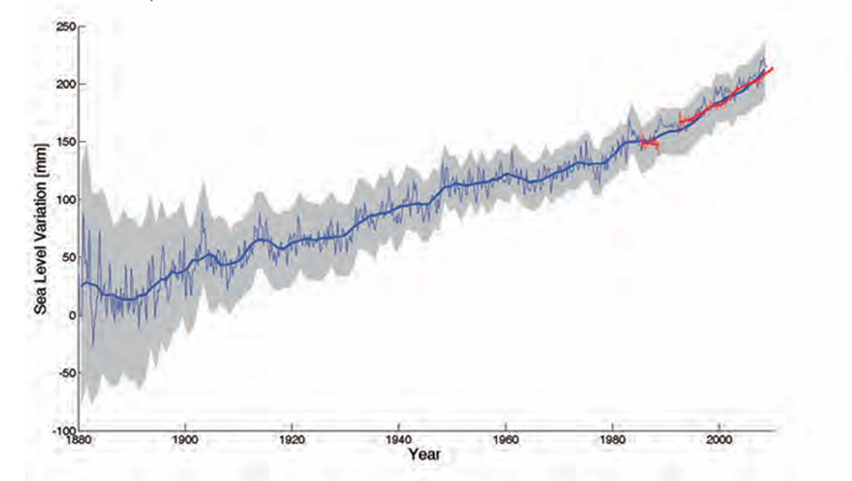
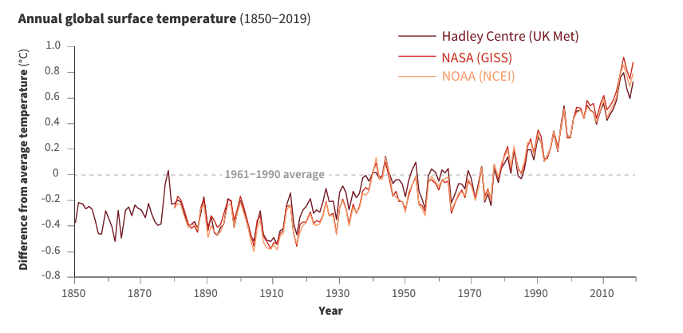
What is the evidence?
Source: Climate Change Evidence & Causes. The Royal Society and National Academy of Sciences. 2020.
Carbon dioxide
Sea level
Surface temperature

Slide 4

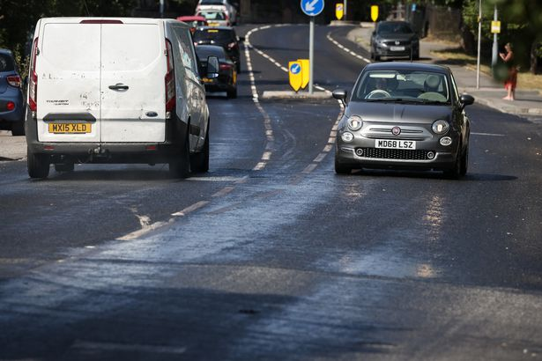
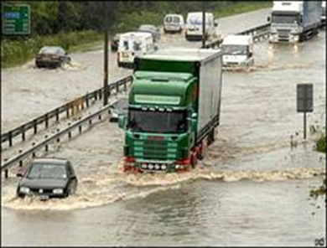
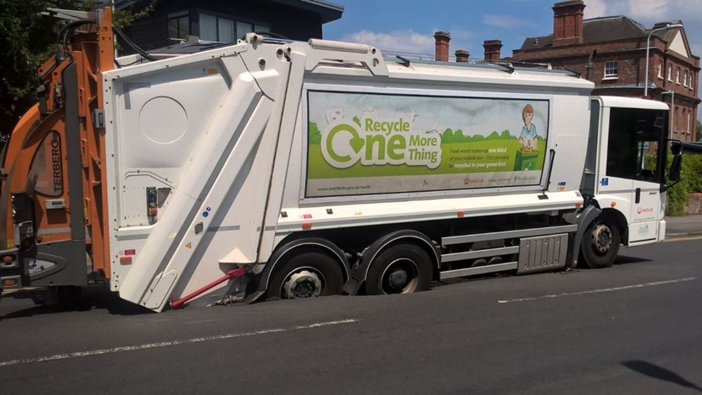
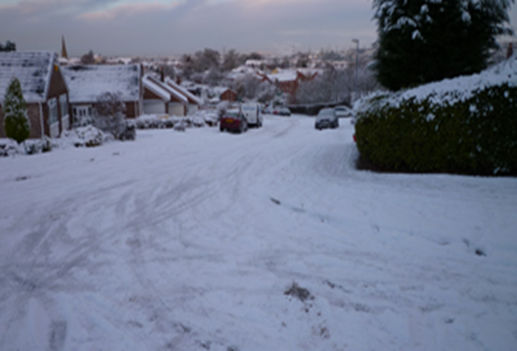
2006
35.3°C
2007
140mm rainfall
2010
-15°C
2018
35.3°C
2022
40.3°C

Slide 5
Mitigating the Effects of Climate Change
80% of local authorities have declared a climate emergency
  Approximately 10% plan to reduce carbon footprint through materials
What can we do to mitigate the impact?
  Improve resilience
  Reduce carbon
  Binder & asphalt have a role to play
Source: ALARM survey 2023.

Slide 6
Mitigating the Effects of Climate Change
Resilient binders: PmB
  Better performance
  Wider temperature envelope
Reduced temperature application
  Reduced energy / emissions
Increased RAP usage / recycling
  Resource efficiency
Lower carbon binders
More permeable pavements
  Include SUDS
  Water management
Optimising maintenance
Carbon emissions reduction
  Electric pavers, rollers, trucks etc

Slide 7
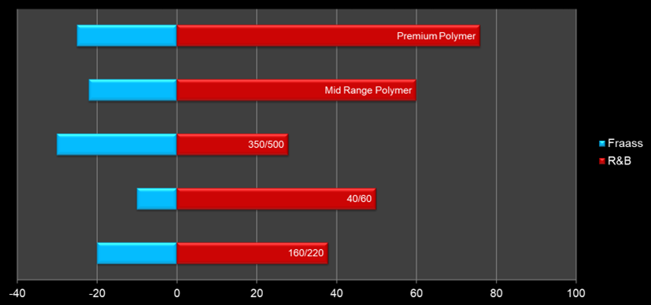
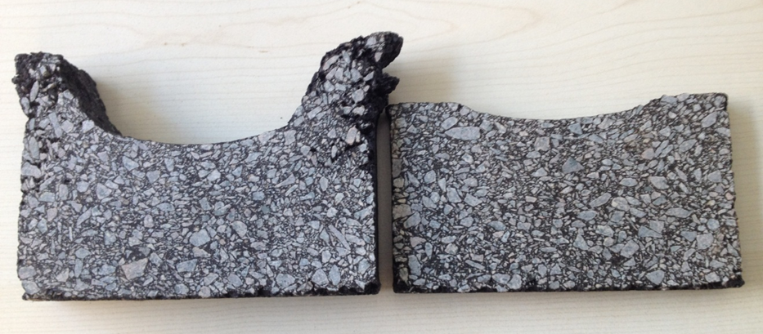
Mitigation / Solution - PmB
What does a PmB do?
  Improves high temperature performance
  Improves low temperature performance
  Improves flexibility
But what about the cost
  PmB costs more – in the short term
  PmB has more carbon – in the short term
Longer life
Fewer maintenance interventions
Long-term gains outweigh short-term costs

Slide 8
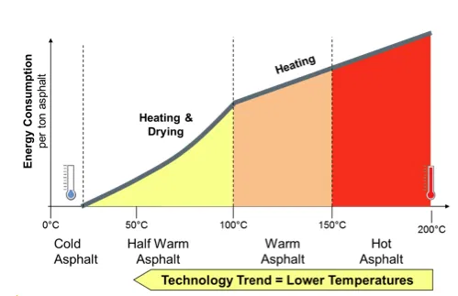
Mitigation / Solution – Temperature reduction
Warm mix / cold mix
  Less emissions
  Lower energy demand
  Better worker conditions
Source: www.eapa.org/warm-mix-asphalt/

Slide 9
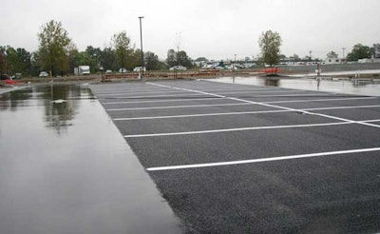
Mitigation / Adaptation – Permeable Pavement
Sustainable urban drainage systems
  SUDS
Porous asphalt
Efficient drain management & maintenance
Source:www.asphalt.com/application/preservation

