Slide 1
EUROBITUME
THE EUROPEAN BITUMEN ASSOCIATION
Binder Innovations

Slide 2
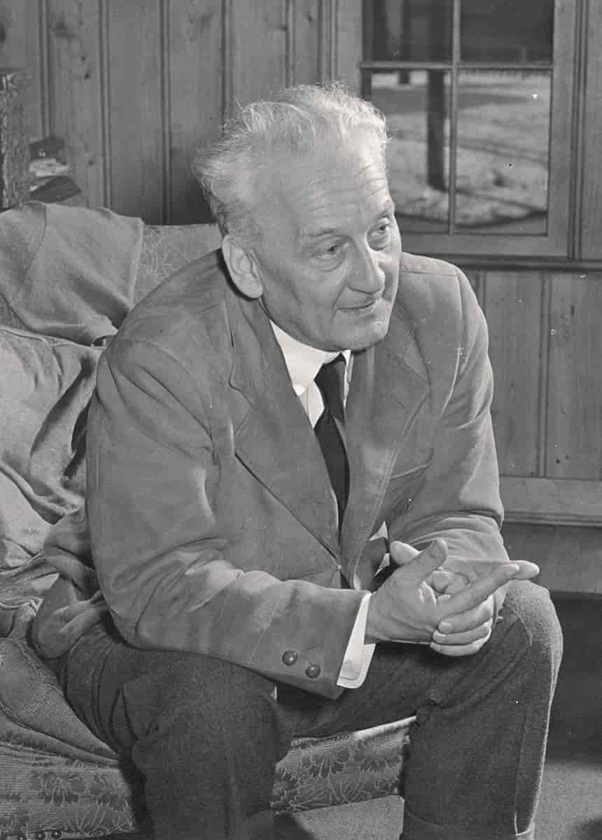
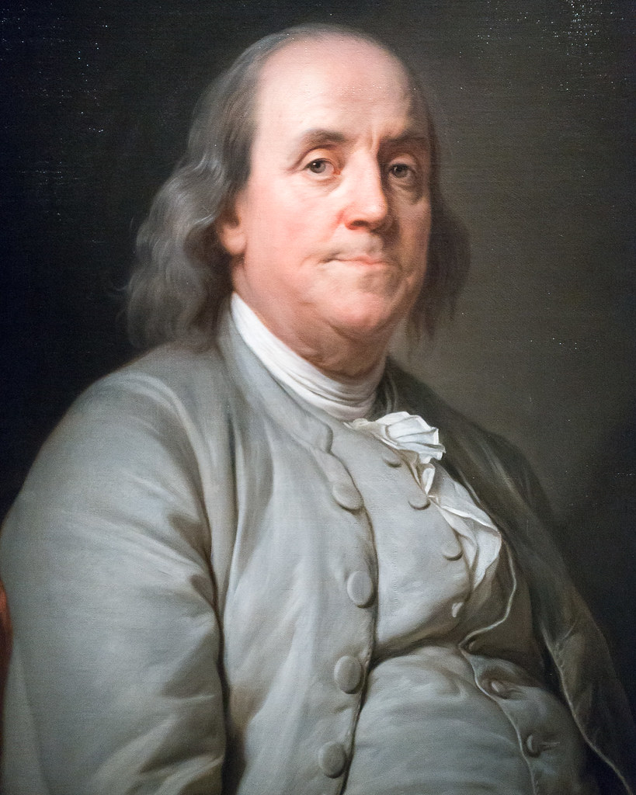
Innovation, Quality & Cost
“Innovation is seeing what everyone has seen & thinking what nobody has thought”
Dr. Albert Szent-György
“The bitterness of poor quality remains long after the sweetness of low price is forgotten”
Benjamin Franklin

Slide 3
Innovations / Developments
Paving grade / pen bitumen
Hard paving / multigrades
Polymer-modified bitumen
Warm mix
Bio-based binders
Long life binders
Recycling binders
Foam mix
Cold mix
Combination of technologies
Binder innovations mirrored by asphalt innovations
Notes:
First references for each system?

Slide 4
Benefits of Innovation
Temperature susceptibility
Polymer-modified bitumen
Flexibility
Polymer-modified bitumen
Stiffness
High modulus binders
Durability
Long life
Longer life asphalt
Application temperature
Warm mix, cold mix
Longer life asphalt
Reduced environmental impact
Effective use of raw materials
Recycling, secondary materials,bio-based binders
Reduced environmental impact
Lower carbon materials
Reduced environmental impact
Notes:
PIARC World Road Association review 2019
4 major categories: recycled asphalt, lower production temperatures, upgrading material at end of life
Increasing use of recycled / secondary materials, Increasing polymer use. Increasing biofuels . Increasing warm-mix
Biofuel reduction up to 60% CO2
Rolling resistance
Innovations are aligned in bitumen & asphalt

Slide 5
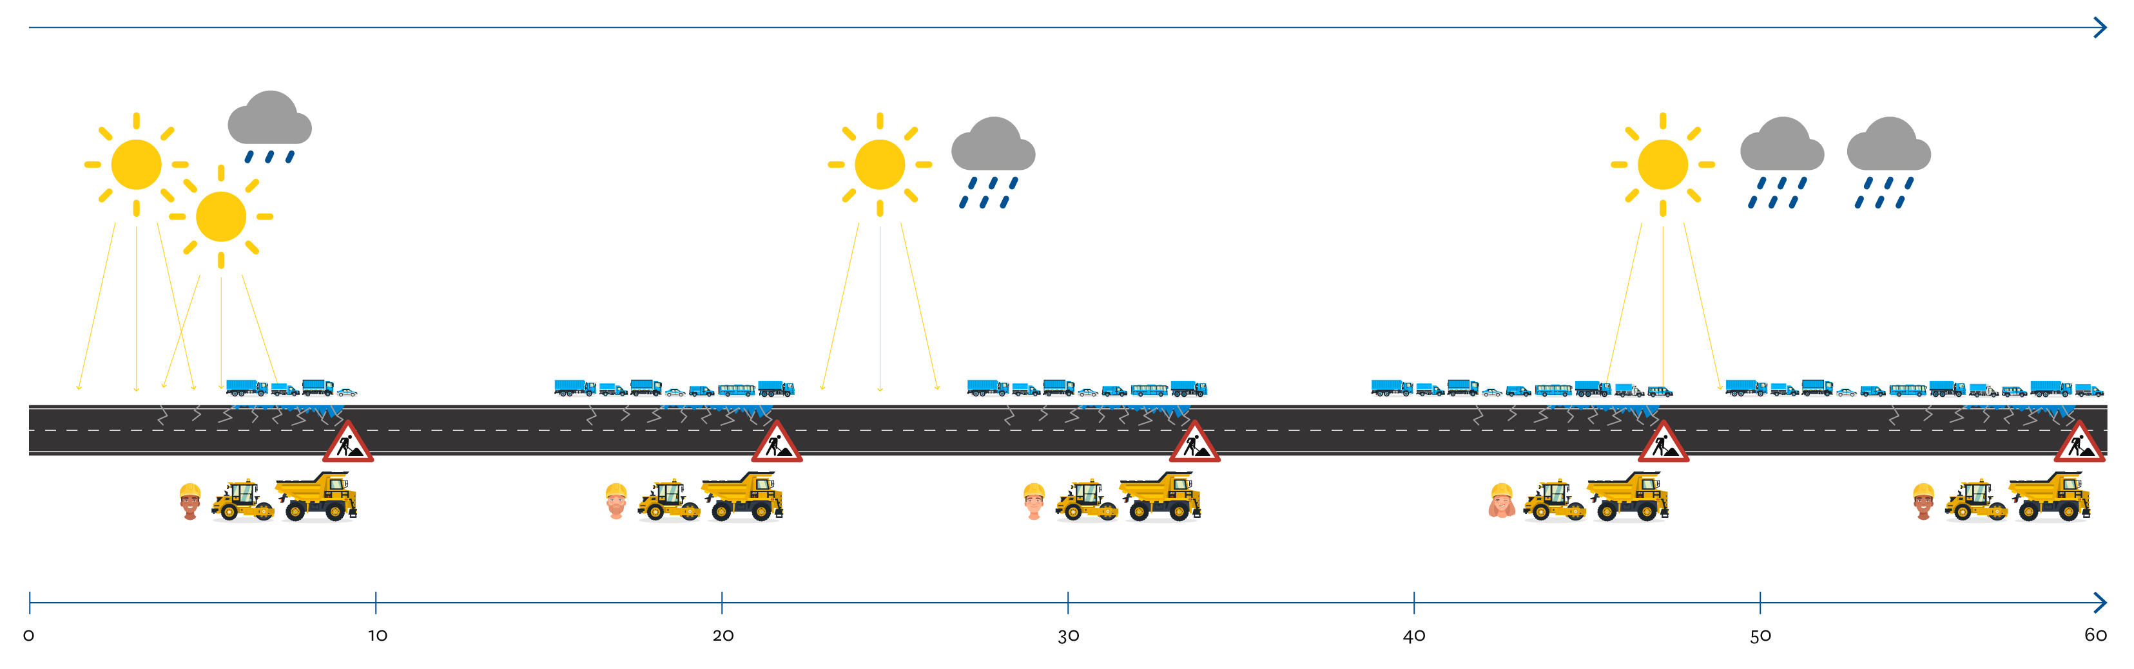
Durability
Air, uv, moisture damage
Increasing traffic
Increasing HGVs
Electric HGVs
Platooning
Climate change
Warmer & wetter?
Surface deformation & cracking
Deterioration & failure
Possibility of 5 maintenance interventions
Notes:
Possibility of maintenance every 10-12 years

Slide 6
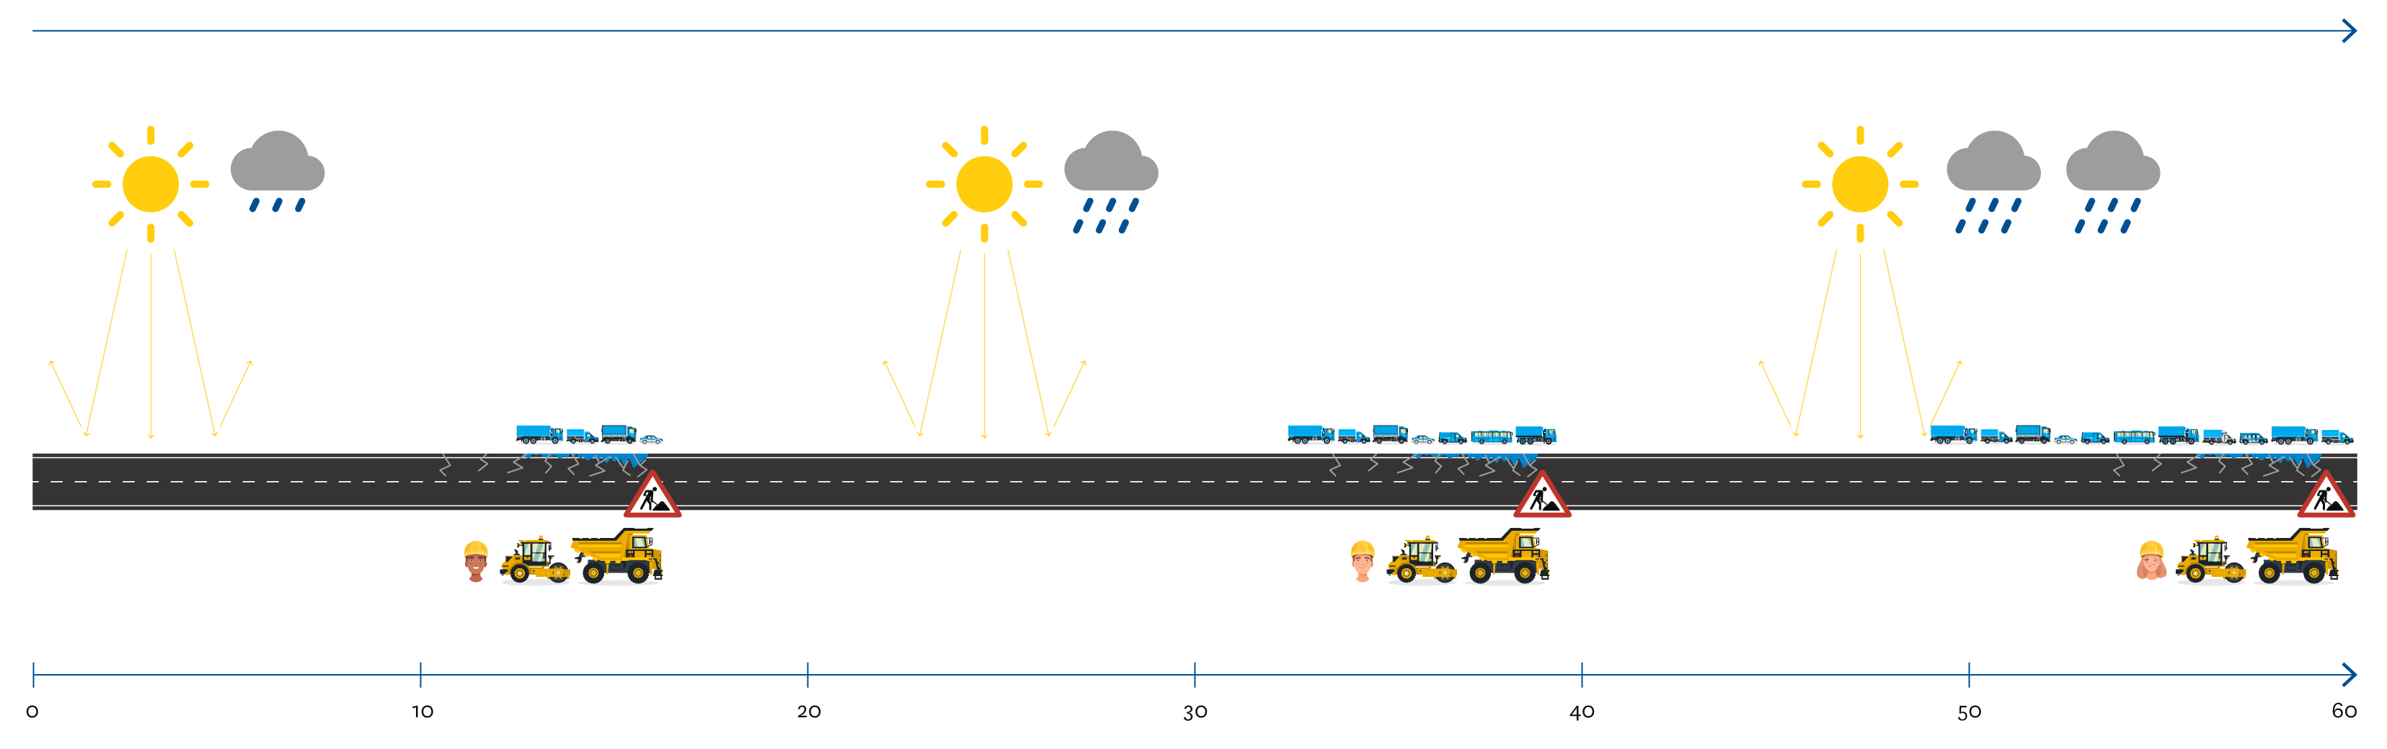
Durability
Longer life construction
Possible reduction to 3 maintenance interventions

Slide 7
Longer-life binders
Reduced rate of oxidation
Reduced rate of hardening
Improved flexibility
A2, A34, A43

Slide 8
Reducing Carbon Impact
Lower carbon binders
Biogenic components
Plant-based materials
A30, A452, A92
Notes:
Effect of calculation method / perspective etc

Slide 9
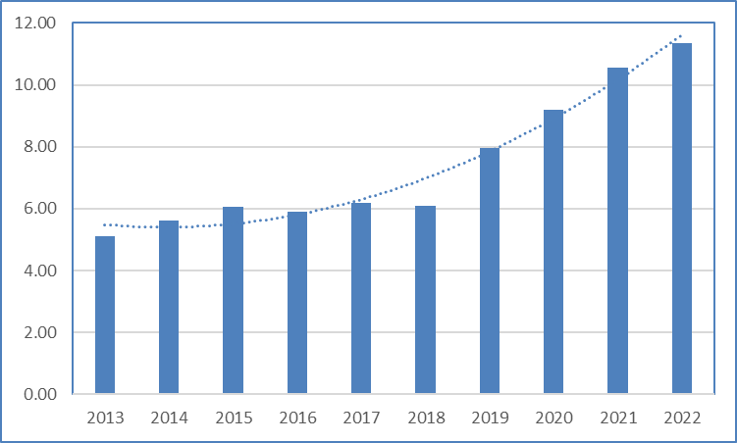
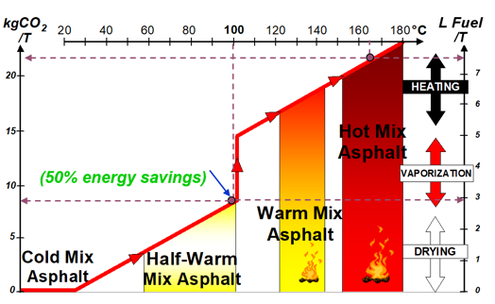
Reducing Temperature
Stack gas emission reduction
Job-site emission reduction
Less binder ageing
Less thermal stress
A better working environment
Warm mix technology growing
Foam mix technology growing
Notes:
Using warm mix is not just about the temperature
Now in SHW
Now in BS 594987
Figures how warm mix increase in Europe. Much greater adoption in USA

Slide 10
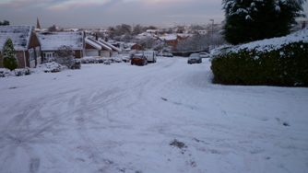
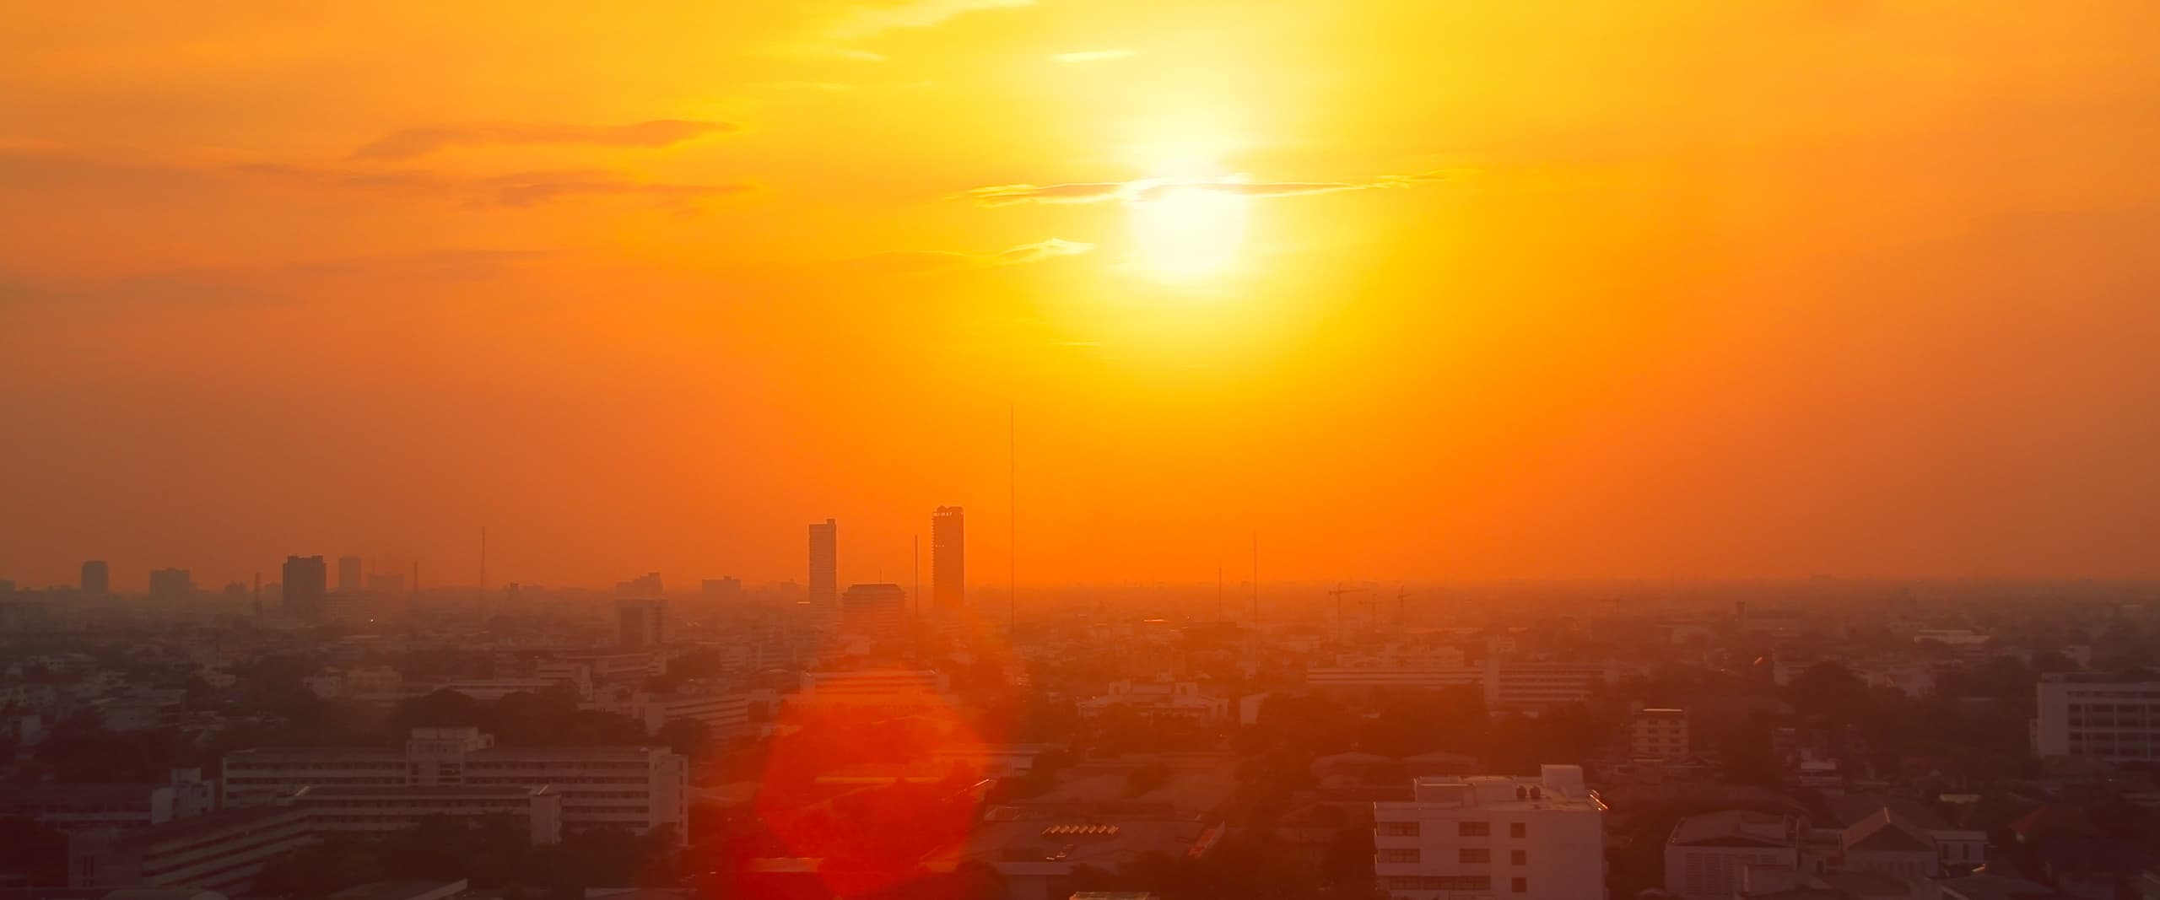
Climate Change
2010
2007
2022
Notes:
Climate is changing. But in what way? Less on global warming more on overall change.
More flooding – pavements under water for days / weeks (Ian Walsh anecdote)
Record low: -27C 1995
Record high: 40.3C 2022

Slide 11
Temperature Susceptibility
Glassy
Soft
Brittle
Viscous
Fretting
Rutting

Slide 12
Temperature Susceptibility
Glassy
Soft
Brittle
Viscous
Fretting
Rutting

Slide 13
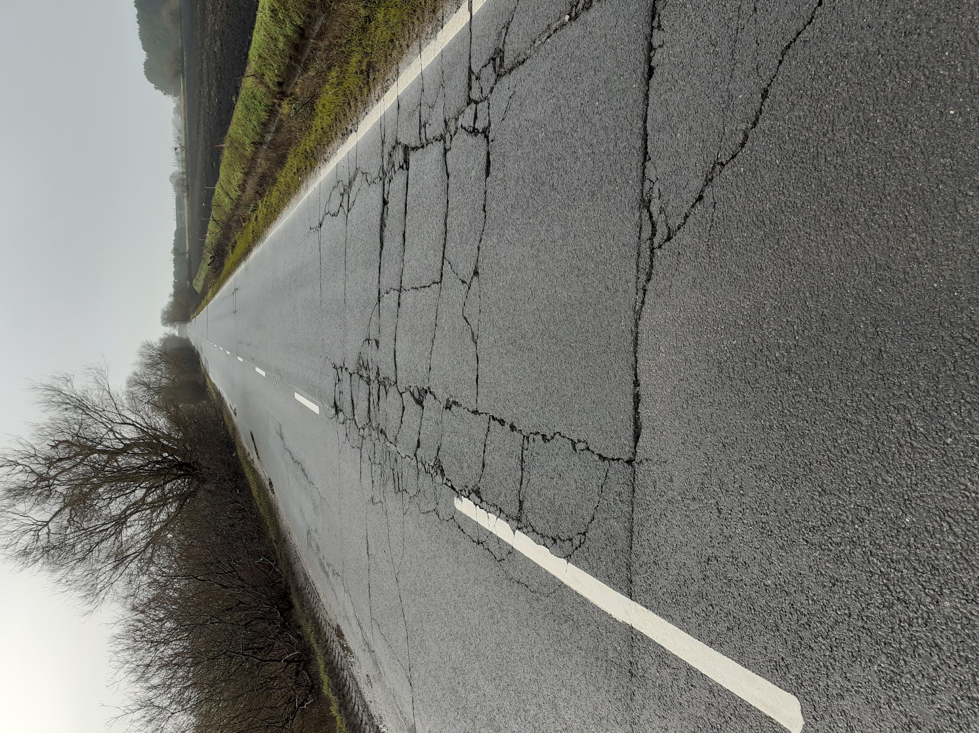

Slide 14
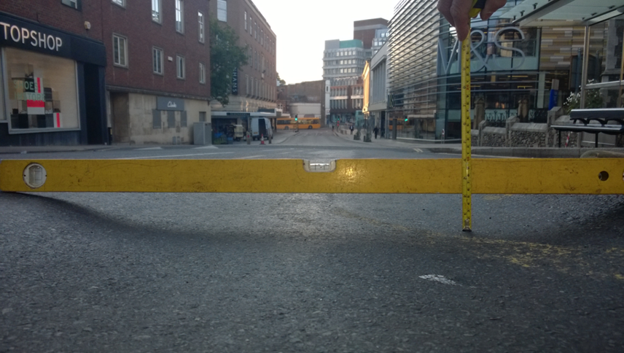

Slide 15
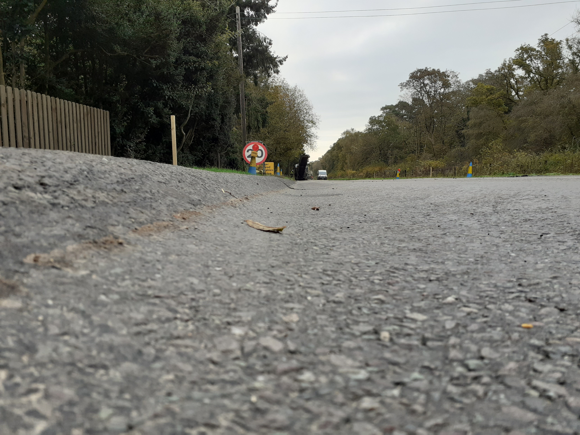

Slide 16
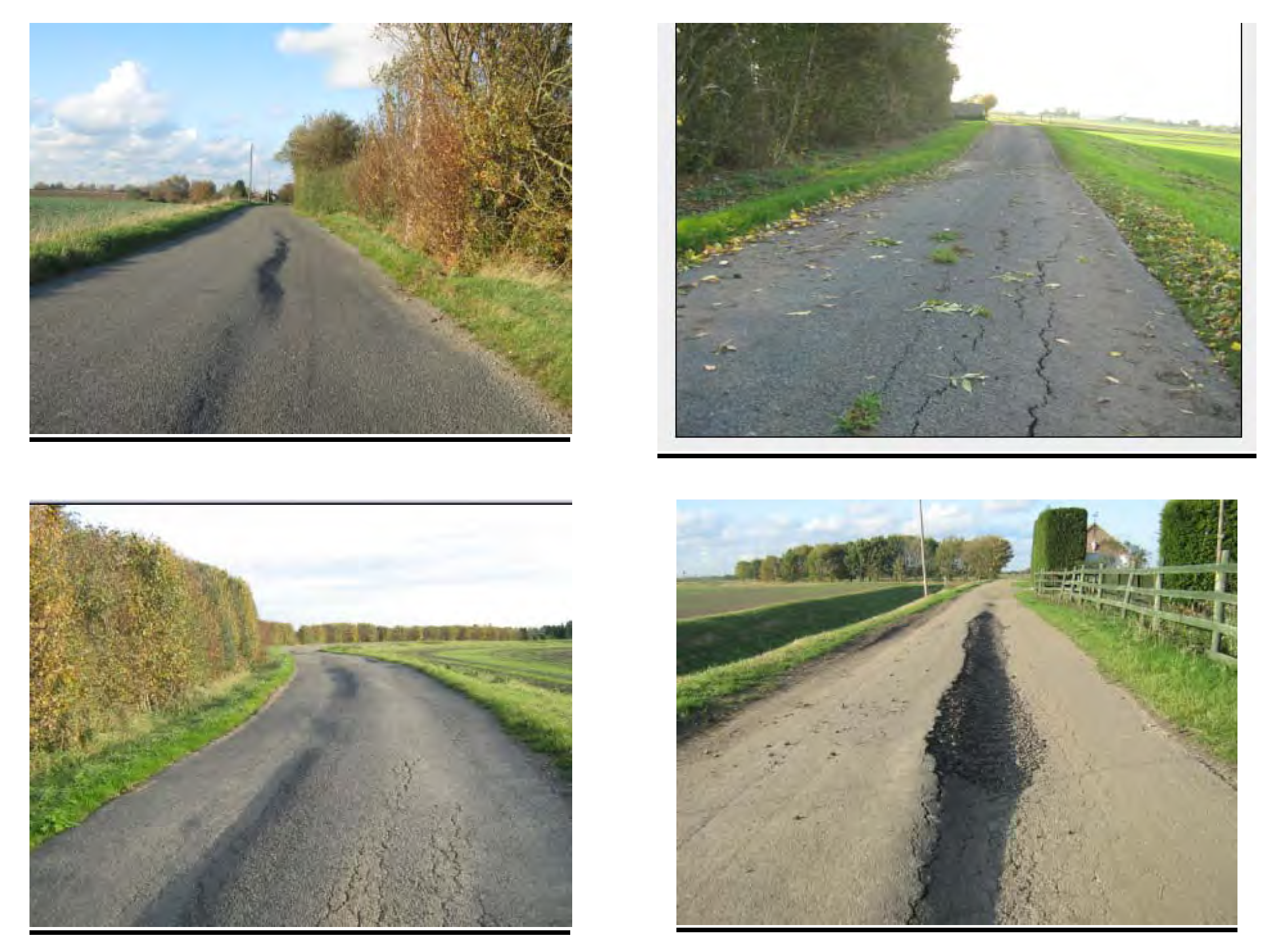

Slide 17
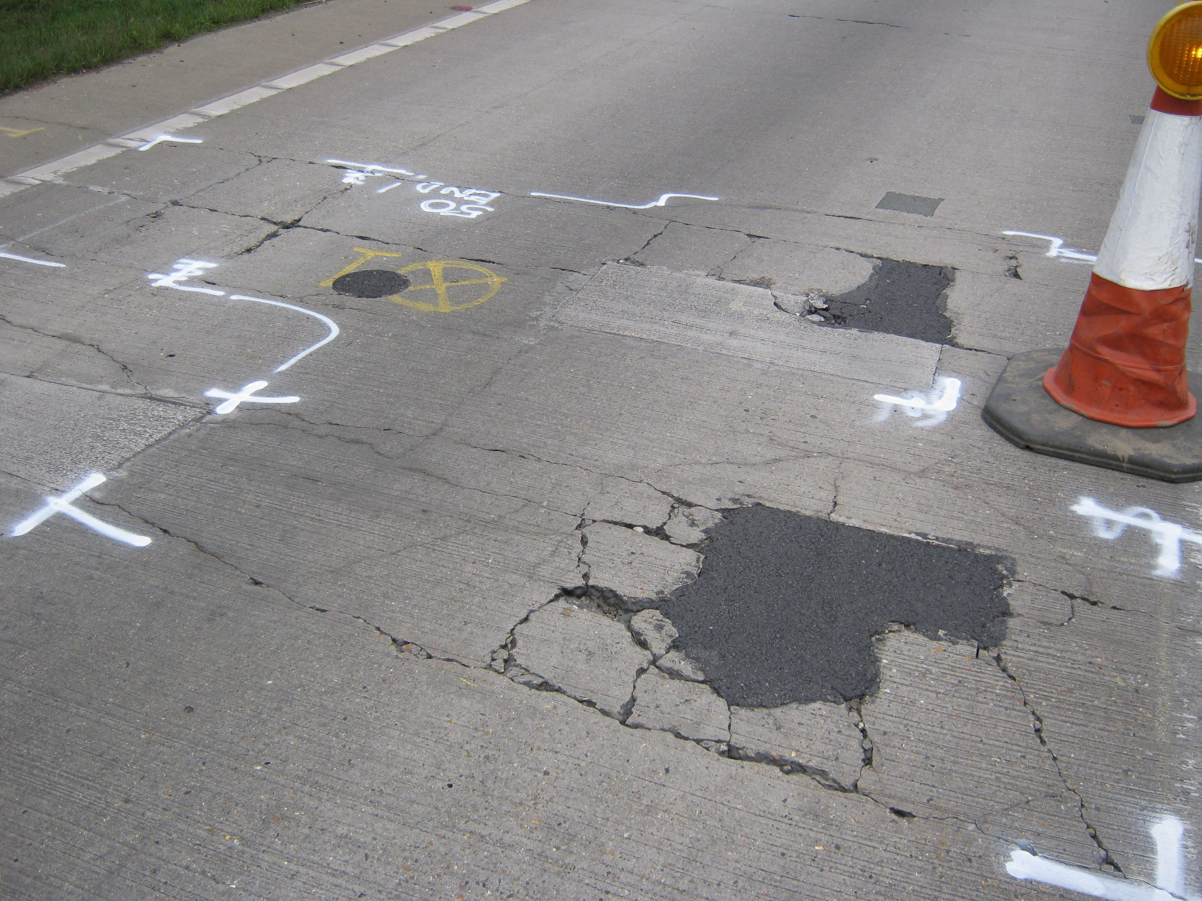
Notes:
Picture of road failure on A140

Slide 18
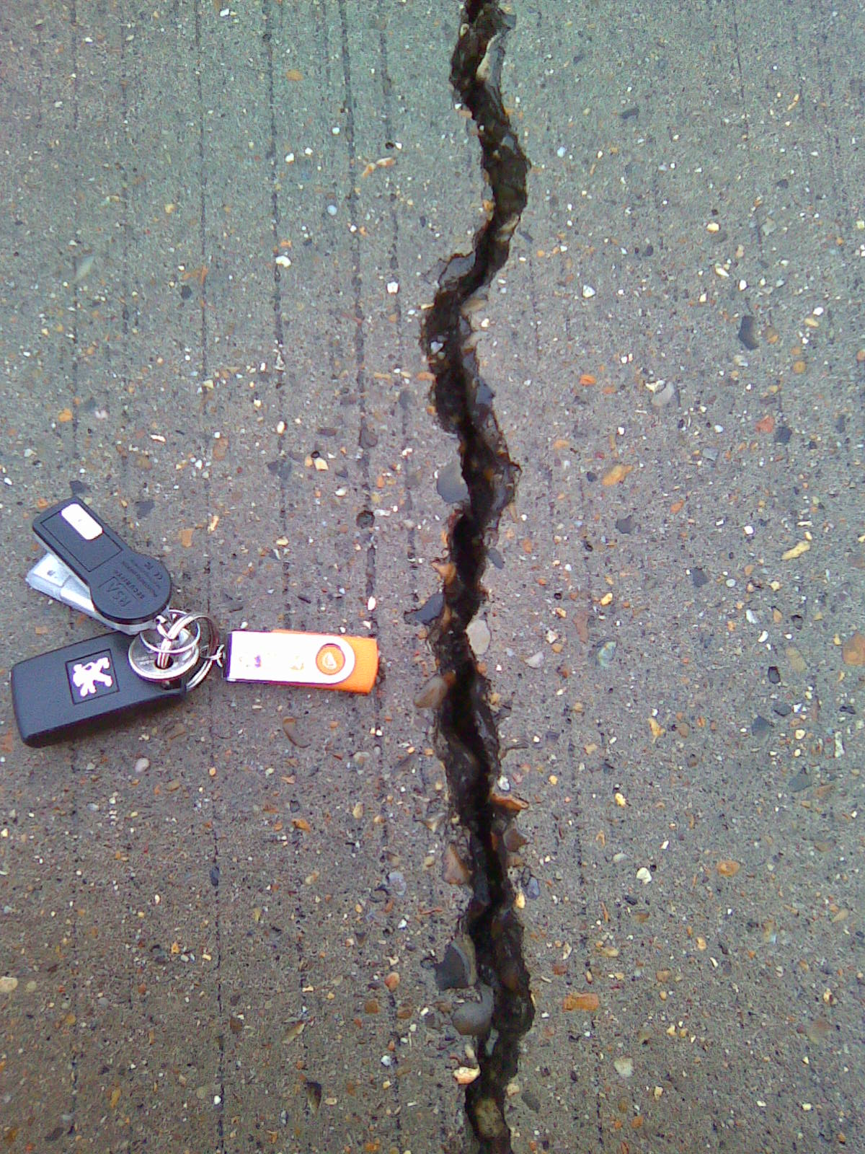

Slide 19
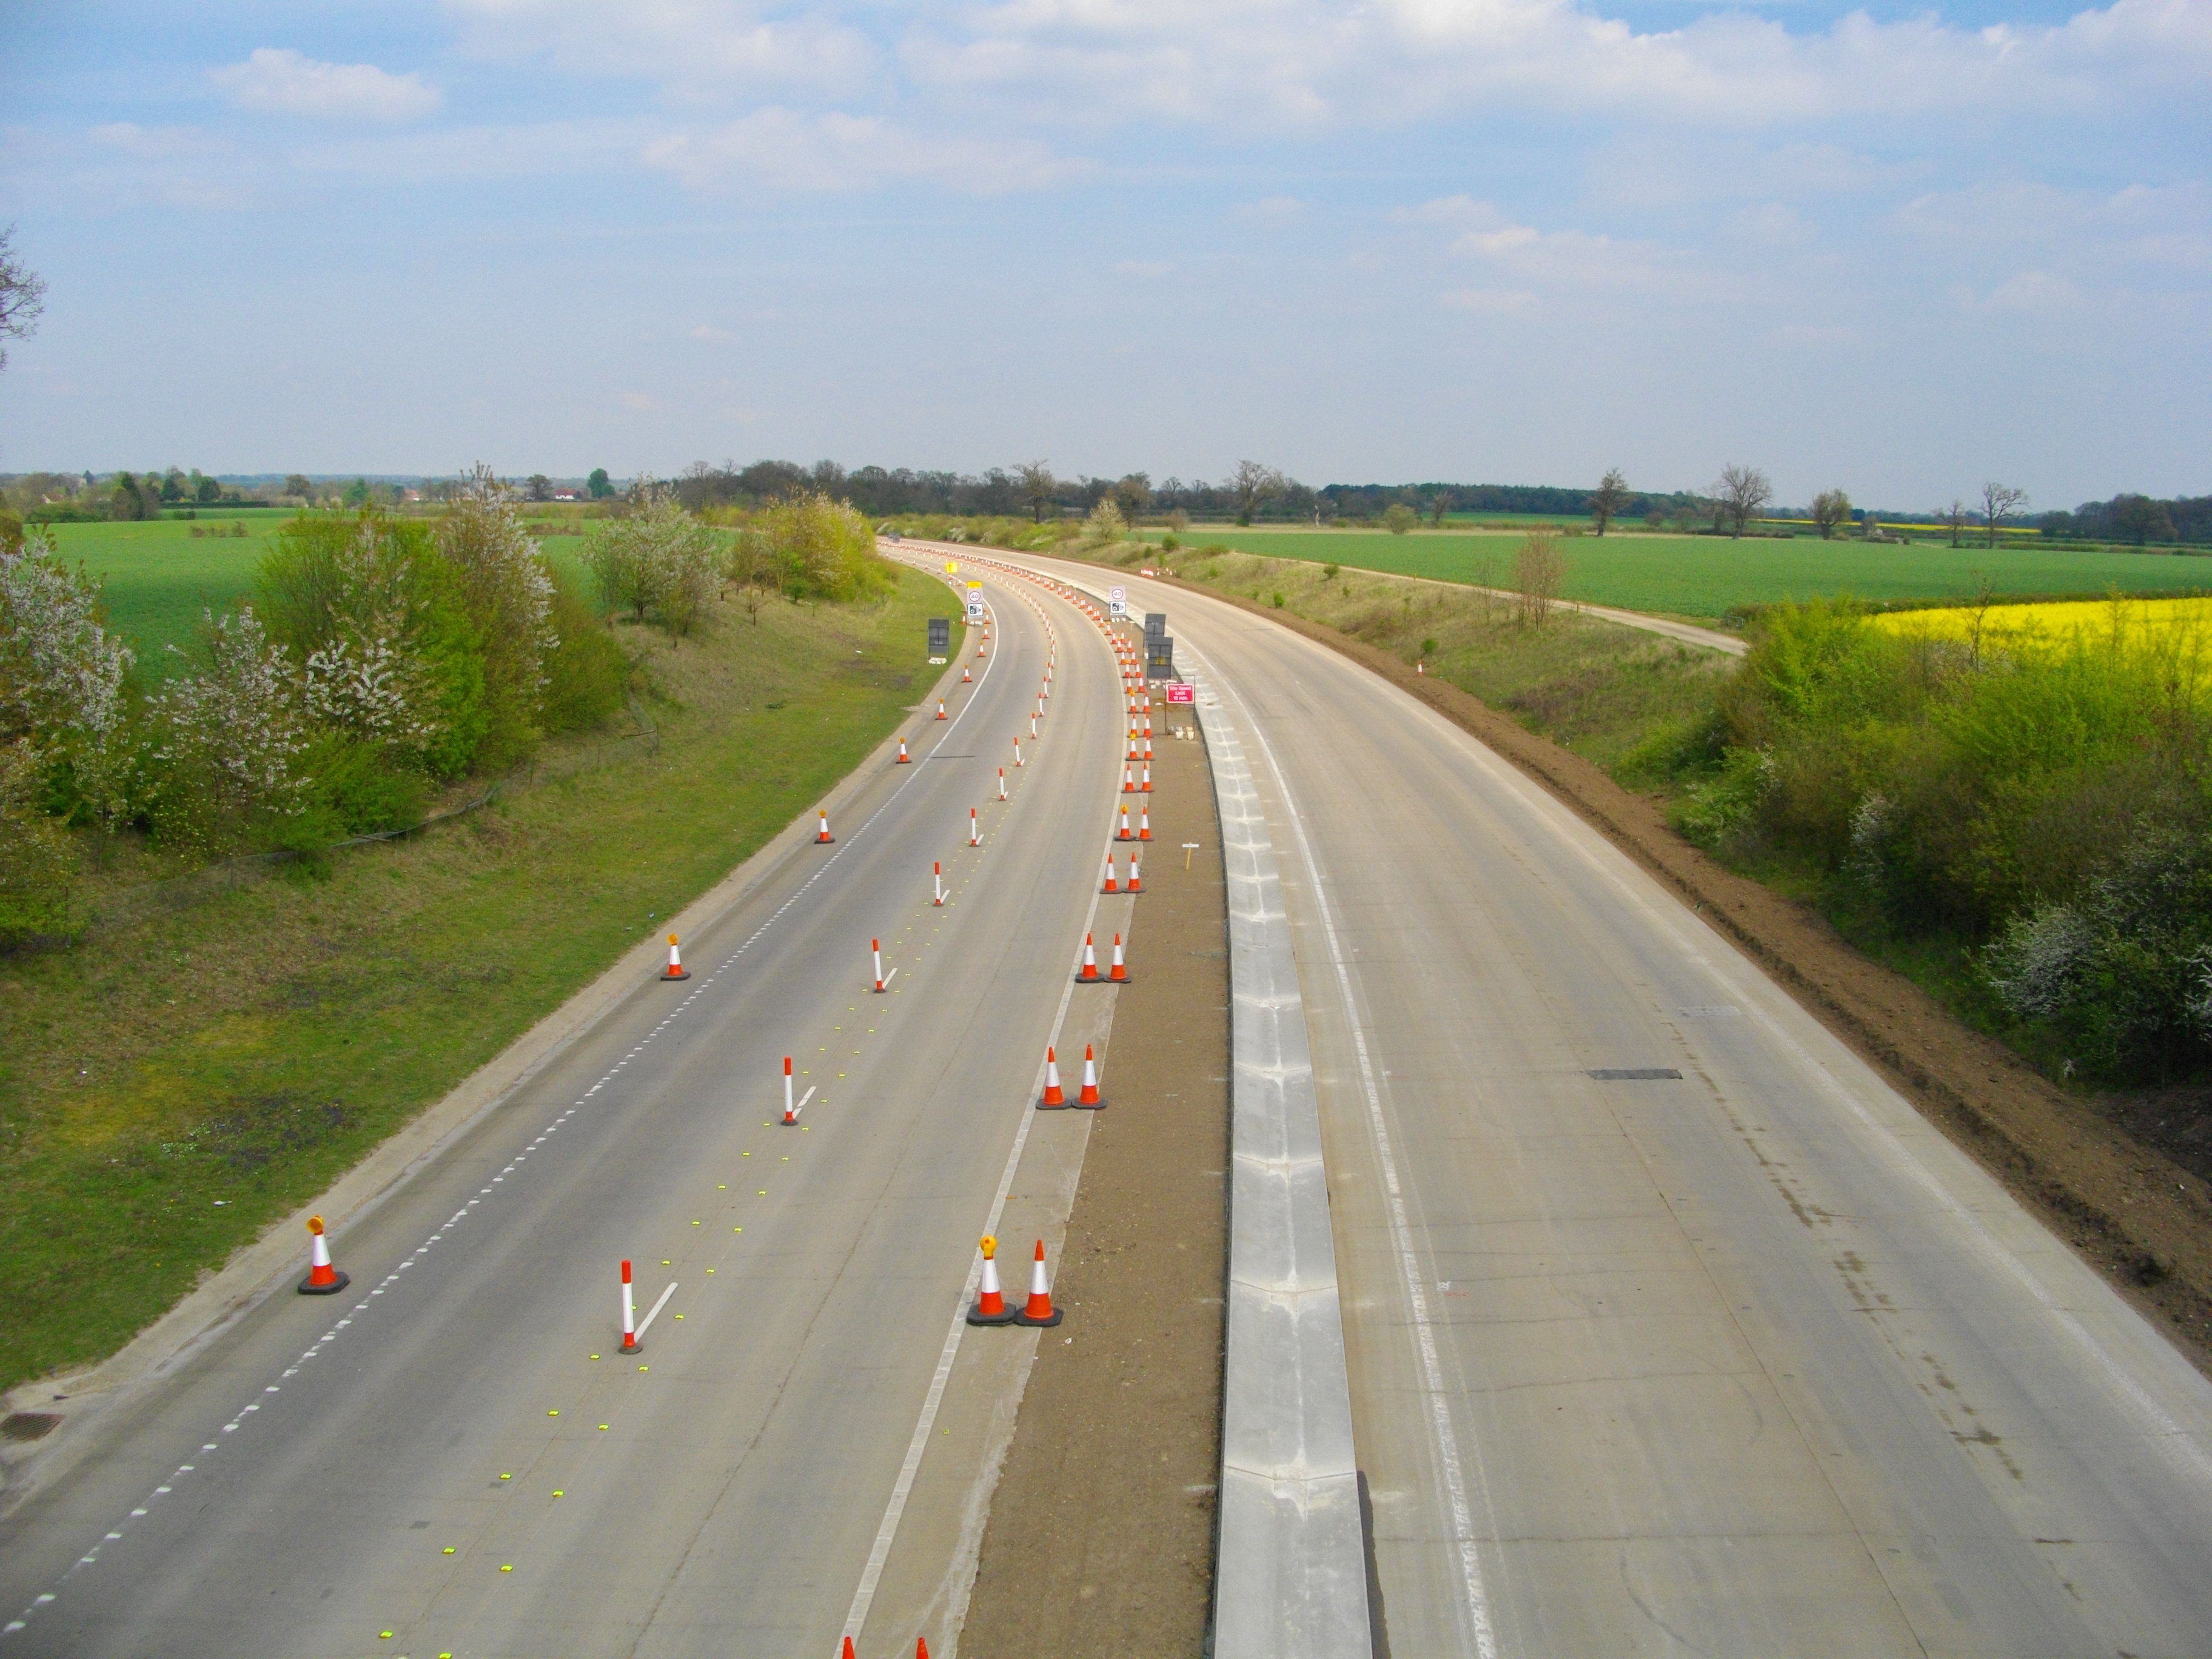

Slide 20
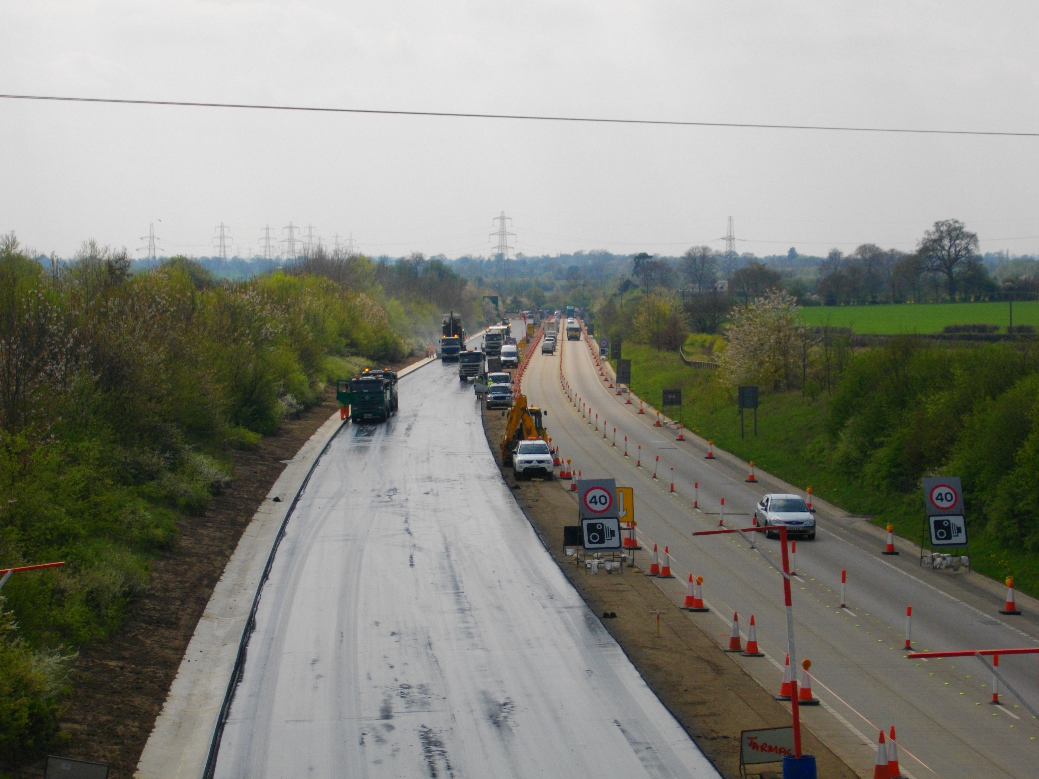

Slide 21
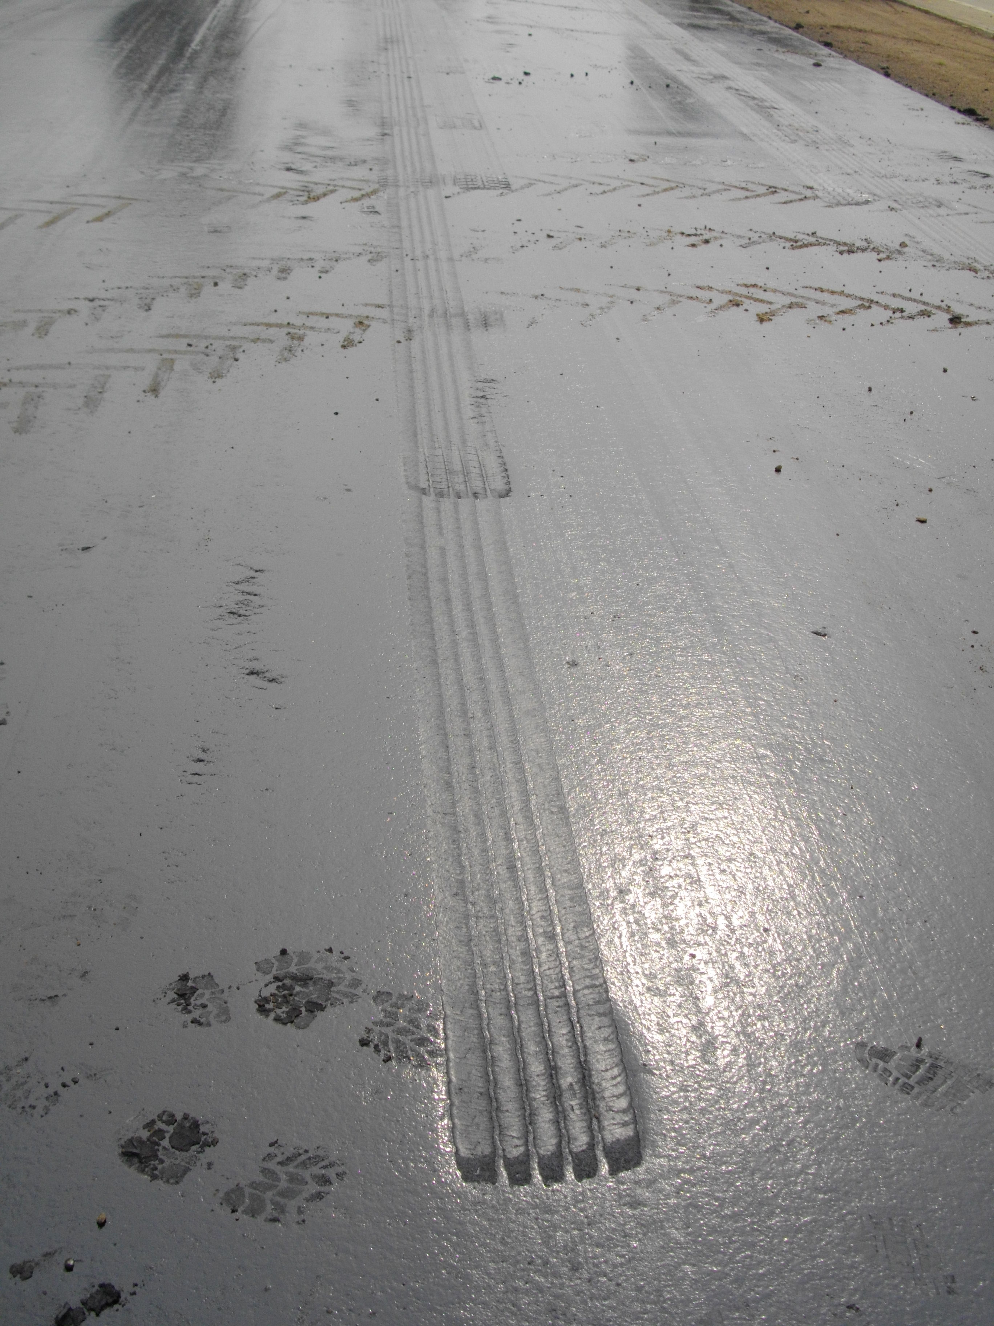

Slide 22
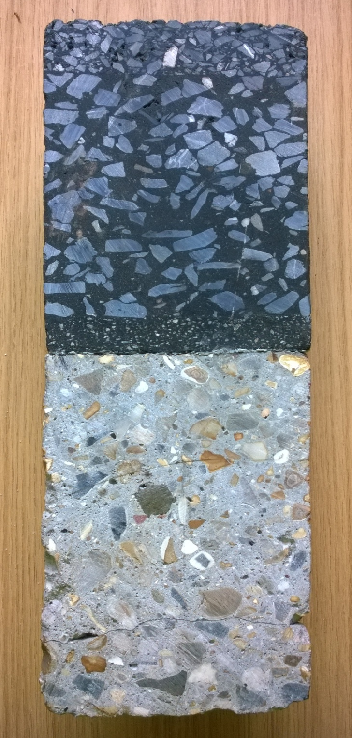
Thermocouple
10mm SMA to PD6691 with PMB Binder
Thermocouple
50/20 HRA binder course with PMB binder
Thermocouple
Bituminous, Stress Absorbing Membrane Interlayer with a PMB binder
Thermocouple
Continually Reinforced Concrete Pavement, 20mm Flint Gravel
Thermocouple
Hydraulically Bound Material, 20mm gravel (Probably CBM 4)
Notes:
SO how do we know that we're not wasting our time with some of the things i've just mentioned
Changing Climates and temperatures are very relevant the pavement design
During the construction work at scole we placed thermocouples in the pavement as it was being built.
To see if road temperature affect the pavement, or if they will in the future
And to look at How far temperatures penetrate below the surface?

Slide 23
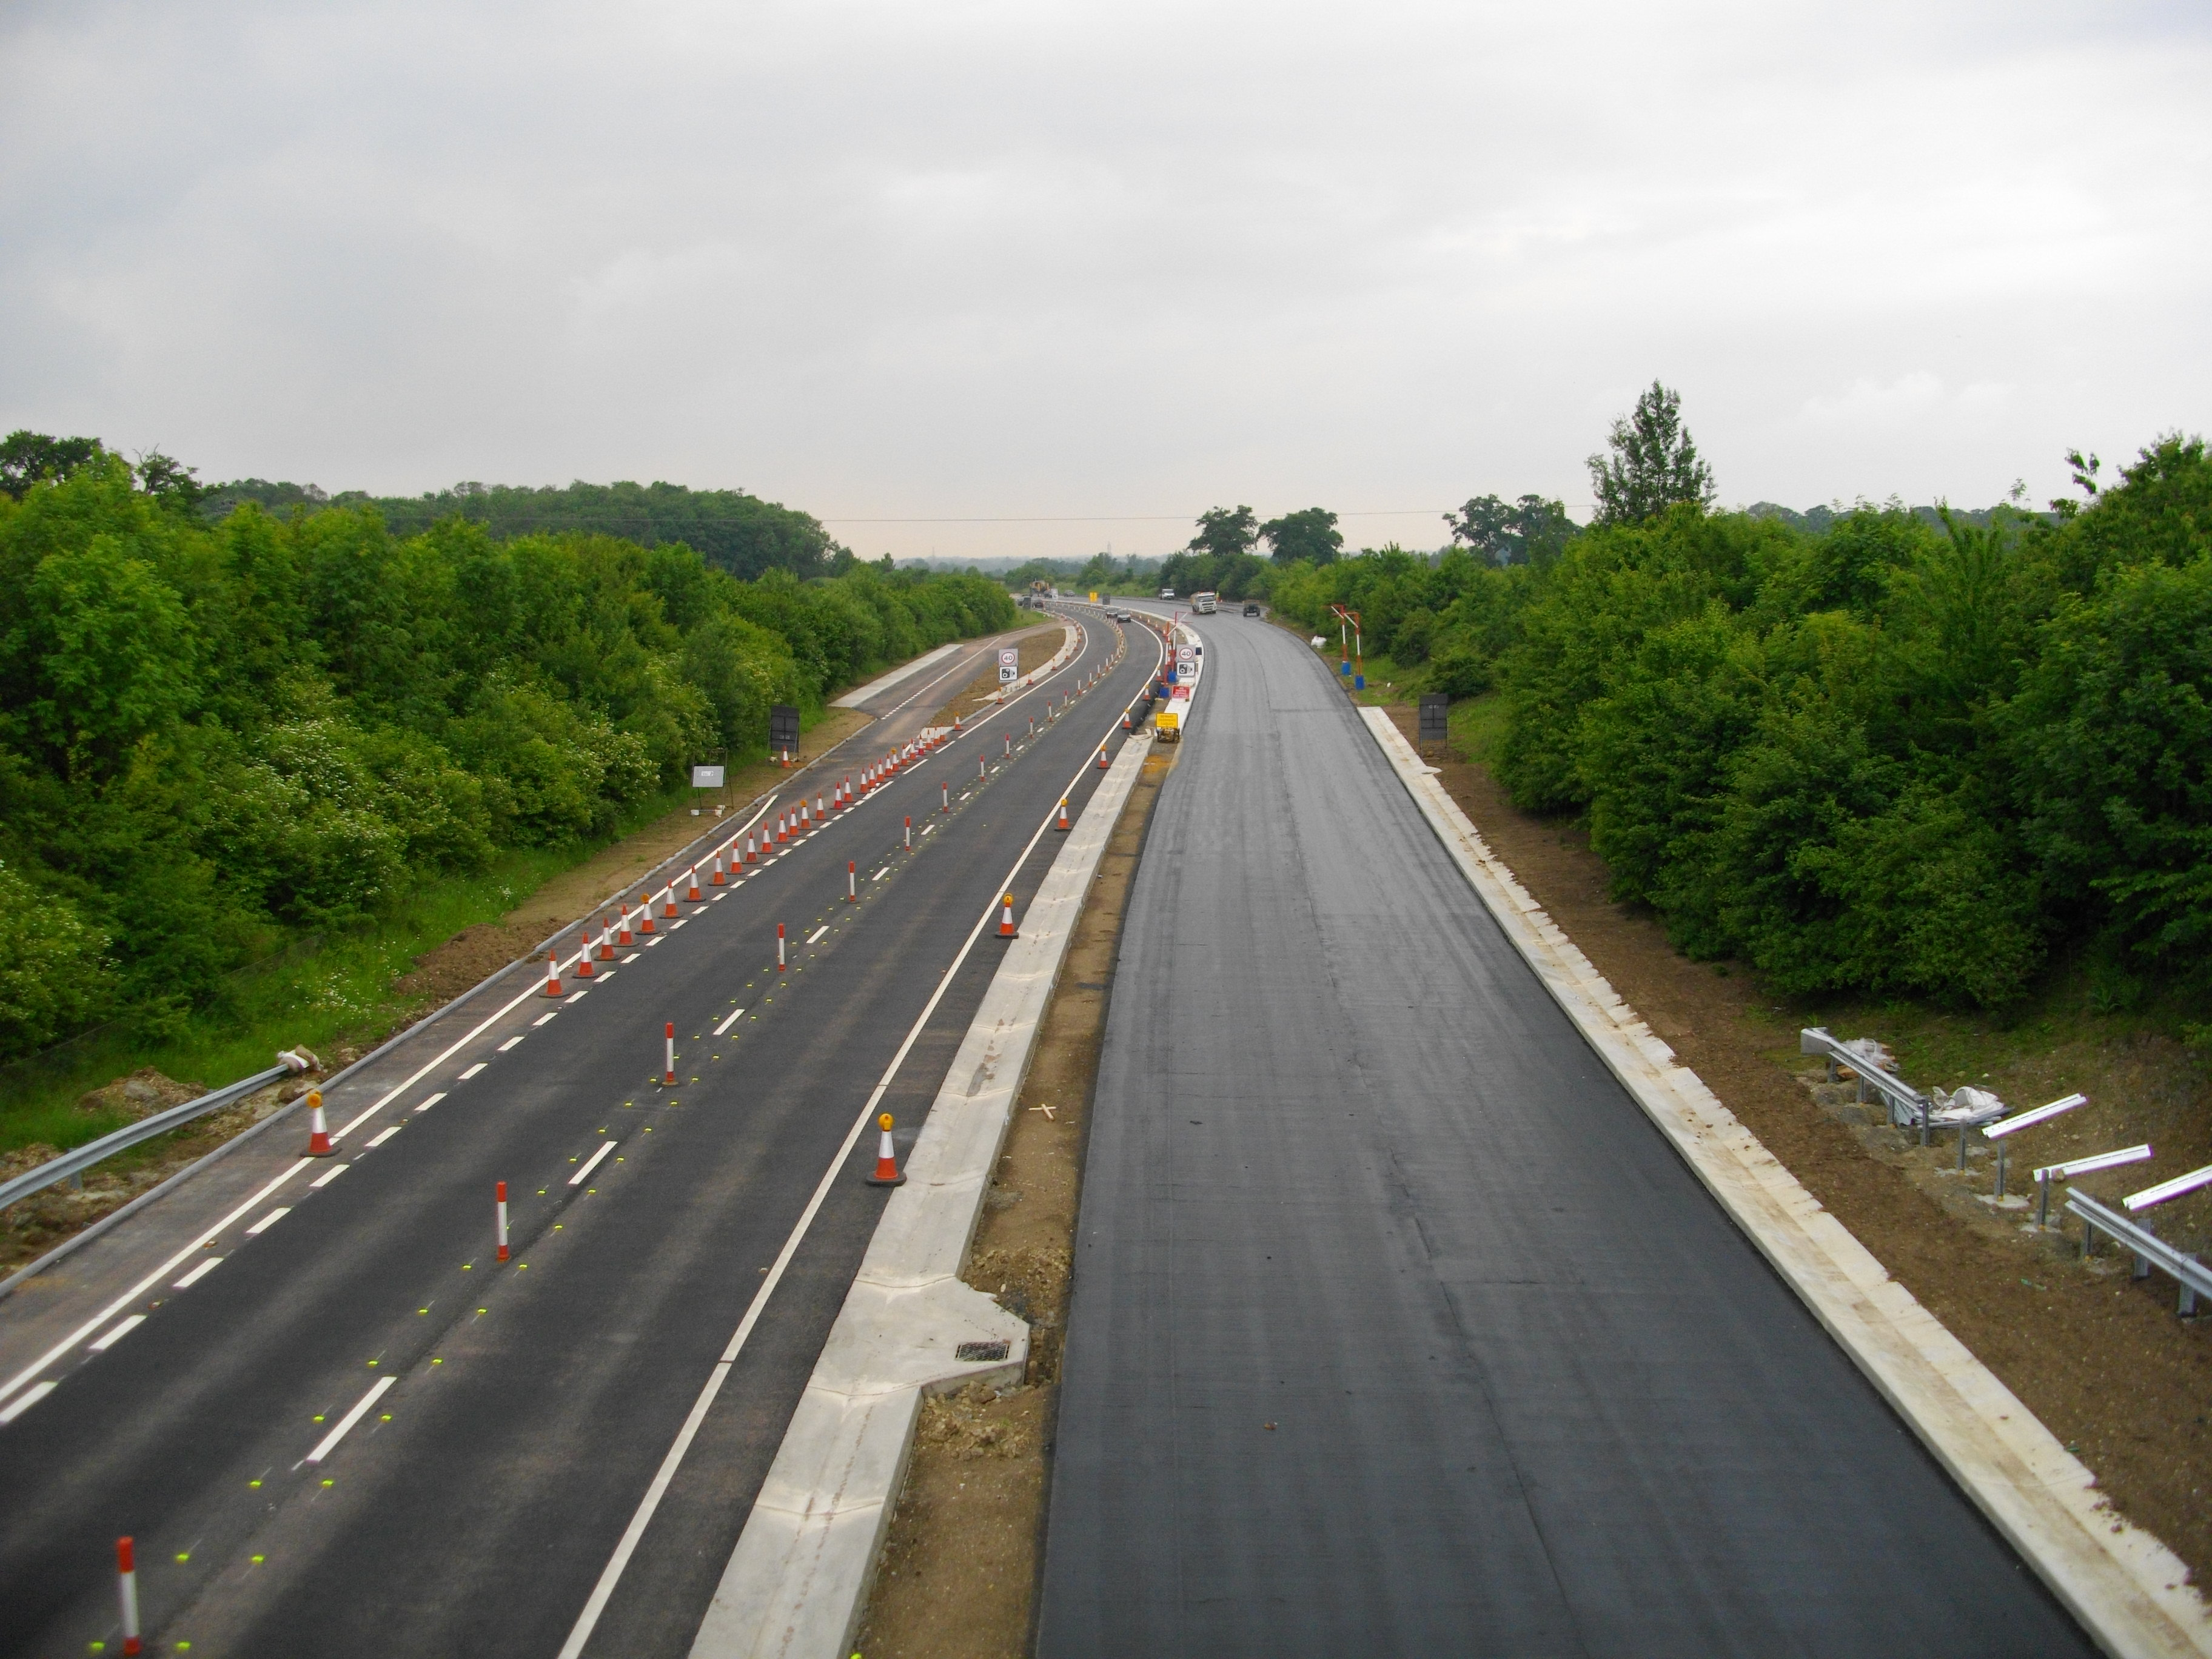

Slide 24
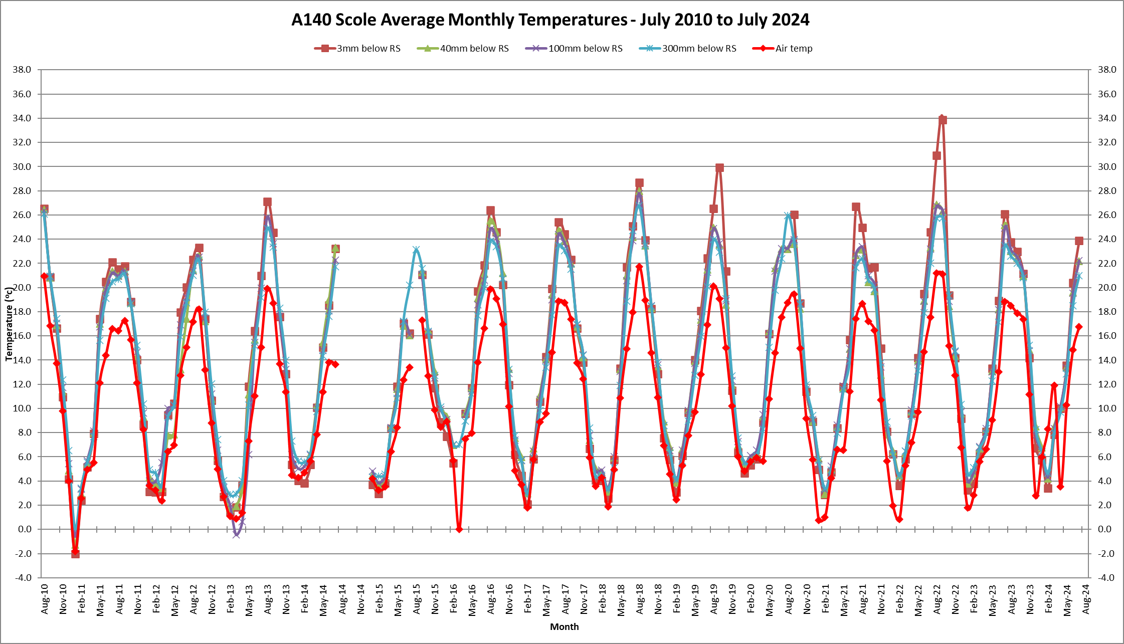

Slide 25
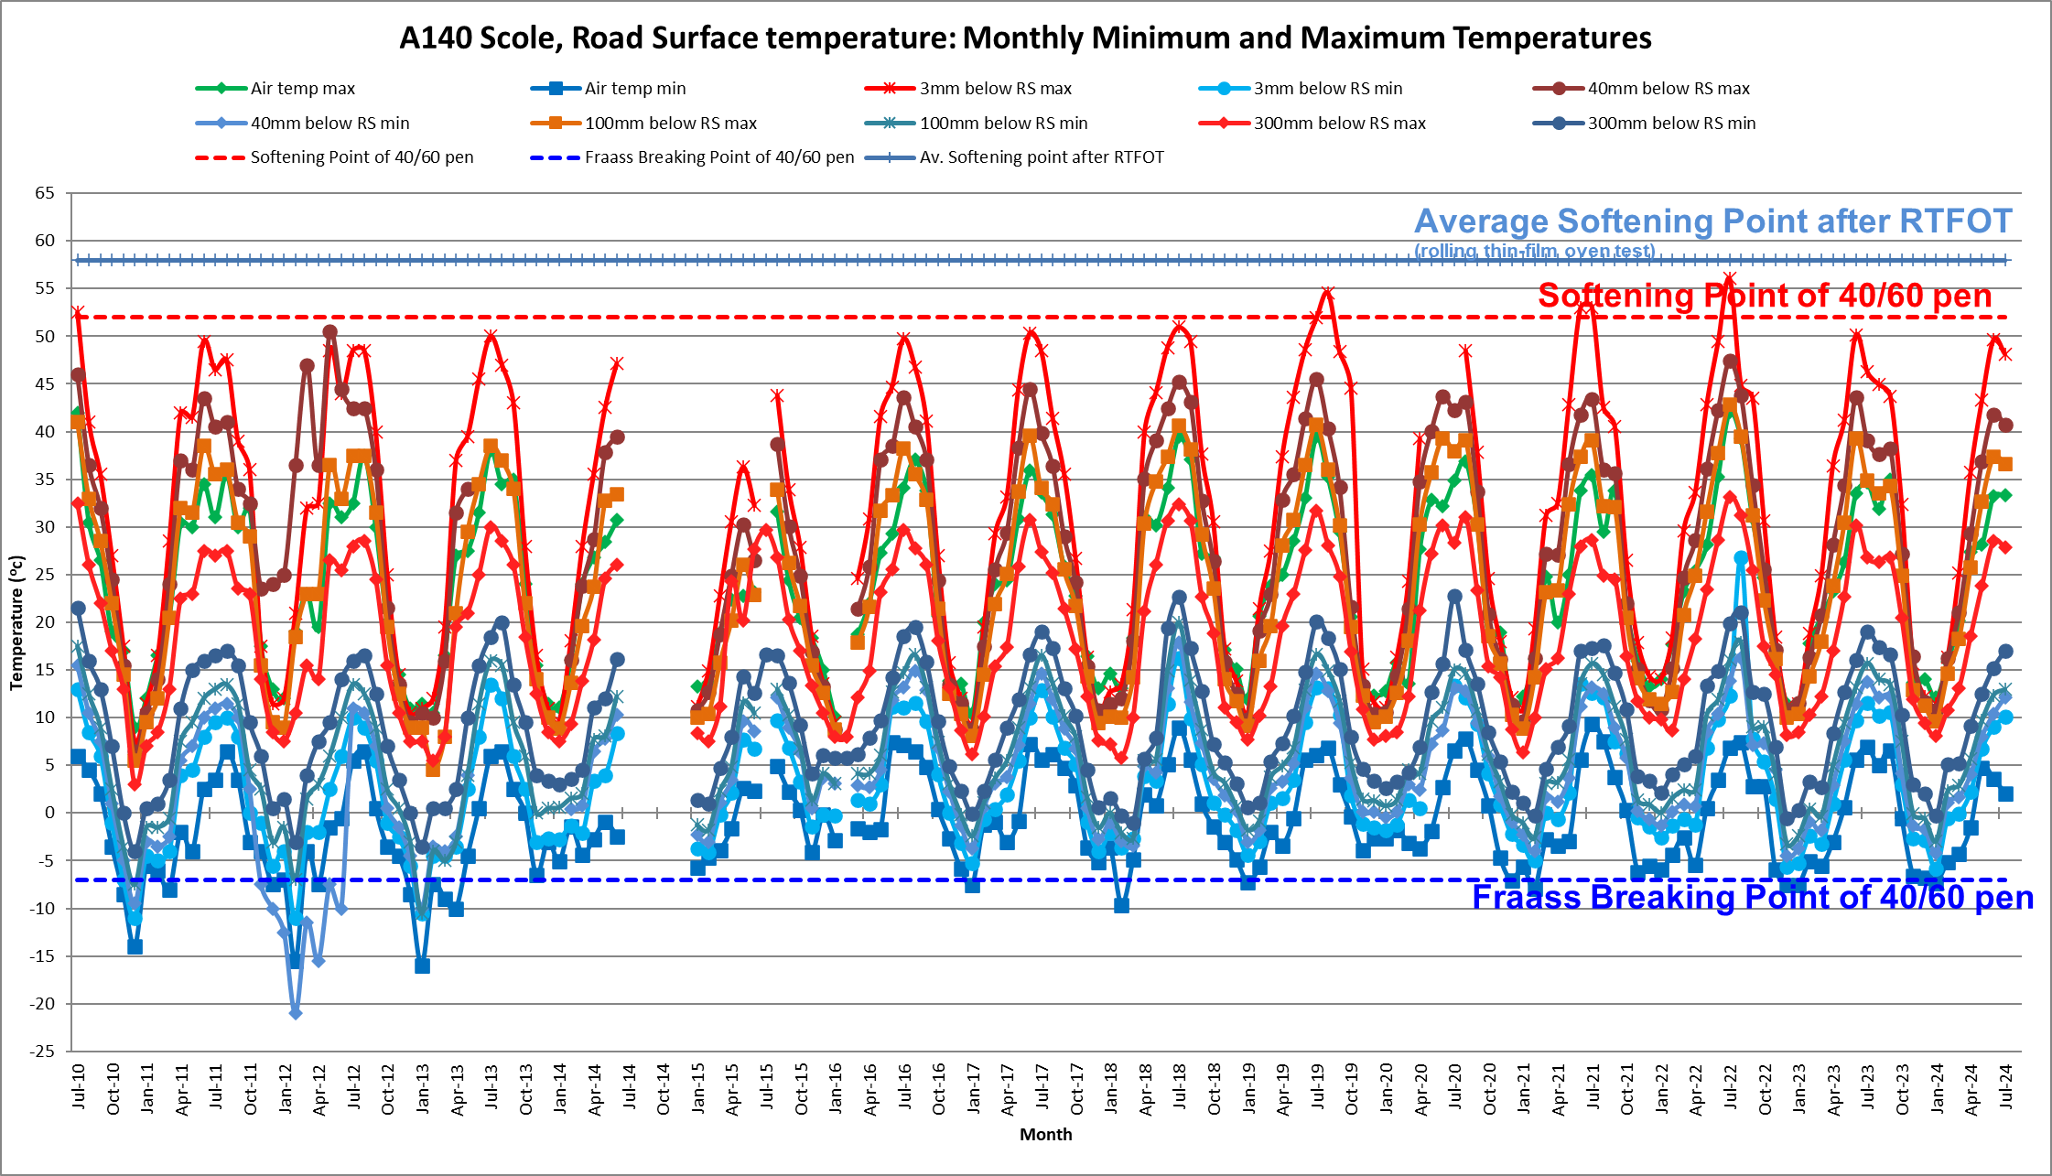

Slide 27
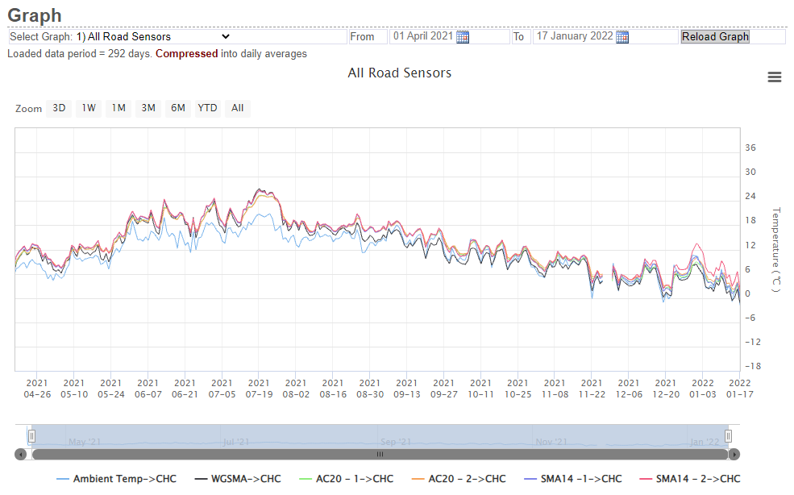
A470 Dolwyddelan, Wales
Data Courtesy of the Welsh Government
Notes:
40mm WGSMA
60mm SMA 14
80-100 AC 20 (slate waste bin/base)

Slide 28
Temperature Susceptibility
Glassy
Soft
Brittle
Viscous
Fretting
Rutting

