Slide 1
Transport Scotland
The national transport agency for Scotland
Alan Ferguson
ASSET MANAGEMENT BRANCH
ROADS DELIVERY
DURABILITY ASSESSMENT OF TS2010

Slide 2
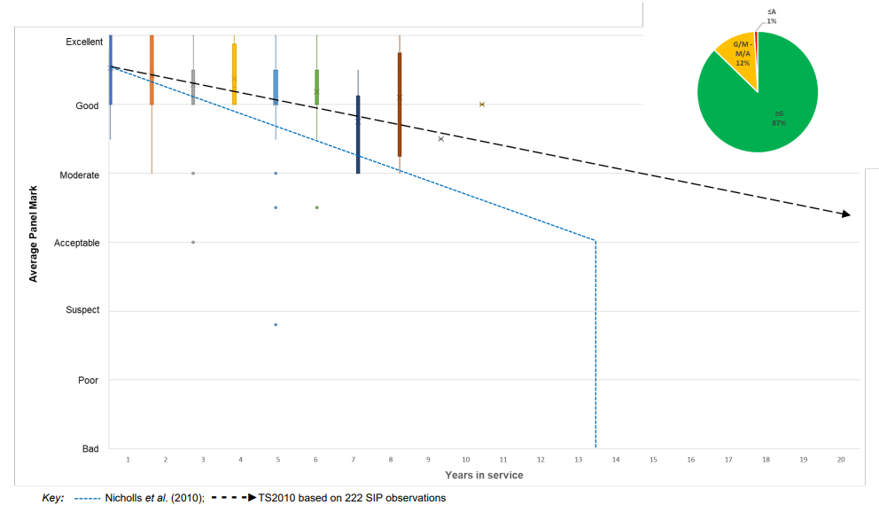
2023 Scottish Inspection Panel (WSP Ltd)
TRL674 methodology for visual assessment
Cl 942 DETERIORATION CURVE
TS2010 DETERIORATION CURVE

Slide 3
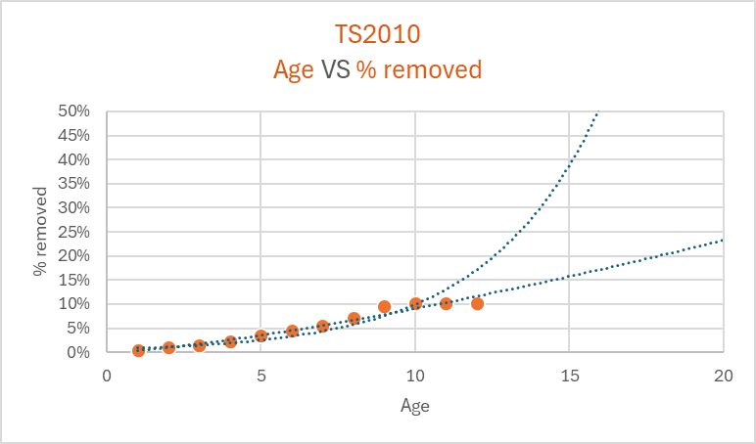
Life of TS2010 SMA to date
Age | % removed
1 | 0.5%
2 | 1.0%
3 | 1.5%
4 | 2.4%
5 | 3.4%
6 | 4.5%
7 | 5.5%
8 | 7.2%
9 | 9.6%
10 | 10.2%
11 | 10.2%
12 | 10.1%
Life Expired Surfacing
Life Expired Structure
Maximising efficiency, fence to fence maintenance etc.
Weather/contamination events
Road Replacement Reasons
Notes:
Extrapolating from the data

