Slide 1
Low carbon asphalt using bio-based binders
Donna James & Gordon Airey
November 2025

Slide 2



Where did we start?
Net Zero Highways plan (2021)
Net Zero Highways – zero carbon roadmap for asphalt (2022)
Focused on asphalt surface courses - 63% of all asphalt used on the SRN in 2020.

Slide 3

Future Asphalt Surface Course linking to NH Net Zero
Objective: develop a pro-active strategy for adoption of suitable technologies as part of the Net Zero Asphalt Roadmap.
Forward-facing project - reviewing the National Highways standards, understanding barriers and developing roadmap to accelerate early adoption of emerging technologies.

Slide 4














Collaboration is key
Extensive collaboration to successfully deliver trials:
Trial design
Departure from Standard Approval
Mix Design
Binder supply
Programme
Installation
Sampling & testing

Slide 5
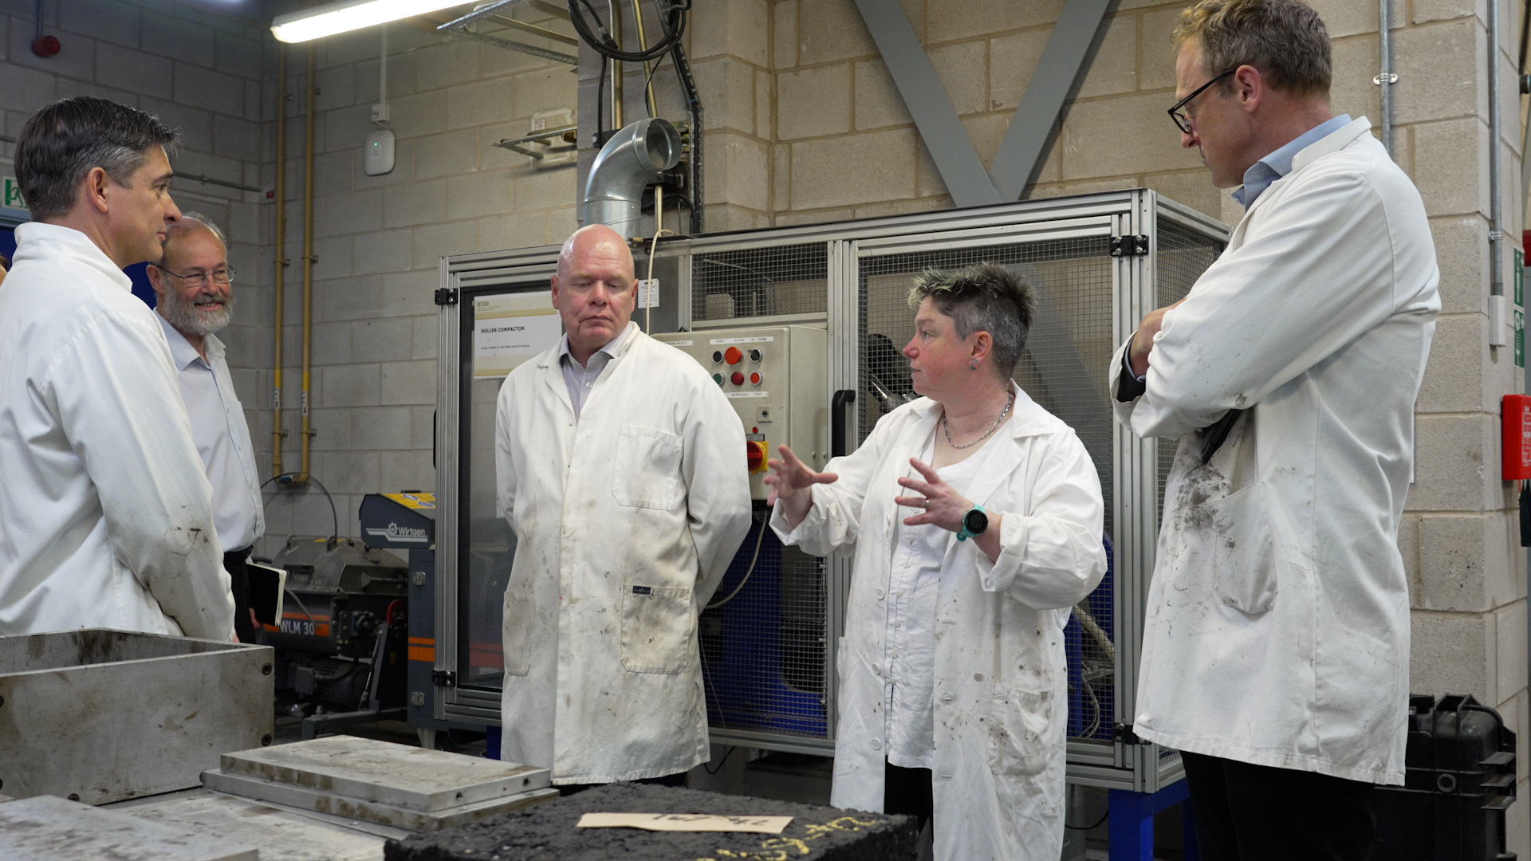
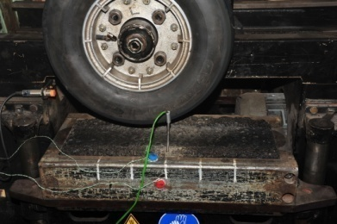

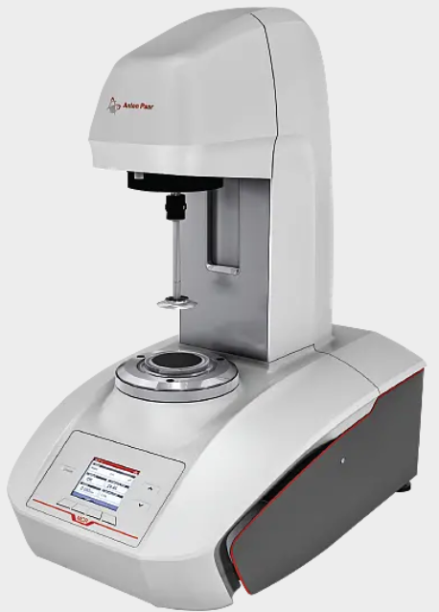
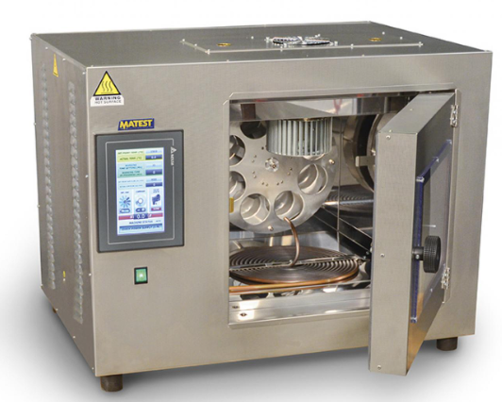
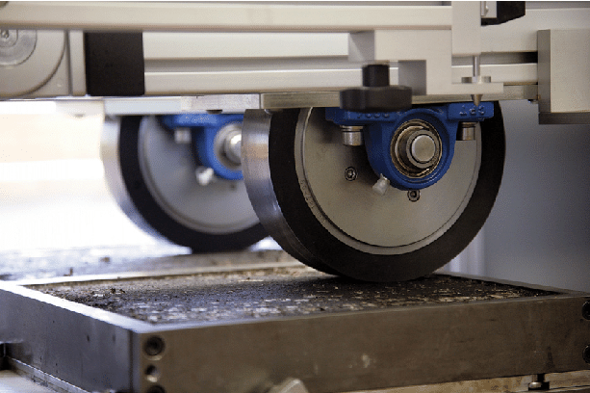
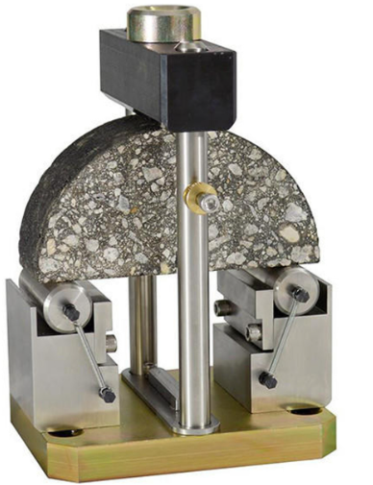
Low Carbon Materials Testing
University of Nottingham - Nottingham Transportation Engineering Centre

Slide 6

Phase 1 -
A30 Bio-based Binder Trial​
Two commercially available PMB bio-based binders installed within Thin Surface Course System
Hot mix with no reclaimed asphalt
Control also installed
First surface course with bio-based binder on the SRN in England
Approval via a Departure from Standard

Slide 7

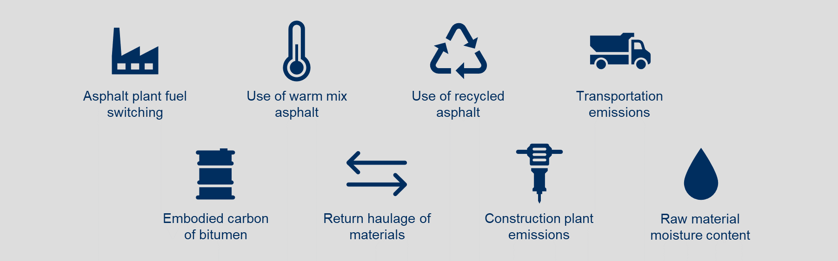
Phase 2 – Stacking Technologies
Phase 2 focussed on combining de-carbonisation levers of bio-based binders with warm-mix asphalt & increased reclaimed asphalt to maximise carbon reduction
A2 Kingston
Bio-based PMB
Bio-based PMB & Warm
Bio-based PMB & Warm & 20% RA
A34 East Ilsley
Bio-based PMB
Bio-based PMB & Warm
Bio-based PMB & Warm & 20% RA
Bio-based PMB & Warm & 30% RA

Slide 8
A30 Trial Bio-based Binder Properties BS EN 14023 Classification
Property | Test Method | Binders Installed on the A30
 |  | Control 1 | Bio-binder 1 | Bio-binder 2
Penetration @ 25ºC | EN 1426 | 7 | 7 | 7
Softening Point | EN 1427 | 3 | 3 | 3
Force Ductility @ 5ºC | EN 13589 / EN 13703 | 3 | 3 | 3
Change in mass | EN12607-1 | 3 | 2 | 3
Change in Softening Point | EN 1427 | 2 | 2 | 2
Retained Penetration | EN 1426 | 7 | 7 | 7
Elastic Recovery @ 25ºC | EN 13398 | ND | 2 | ND
Flash Point | EN ISO 2592 | 2 | 2 | 2

Slide 9
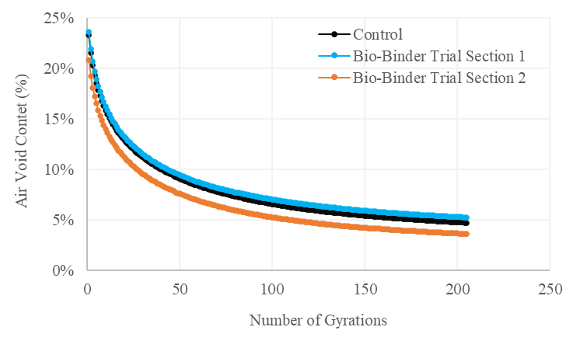
A30 - Gyratory Compaction
The compactability of the asphalt mixtures was assessed by gyratory compaction in accordance with BS EN 12697-10 and BS EN 12607-31

Slide 10
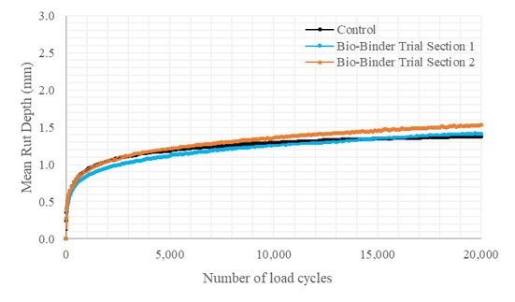
A30 Wheeltracking - Small Device Procedure B @60ºC
Wheeltrack testing was conducted in accordance with BS EN 12697-22 Procedure B in Air at 60ºC.
The Small Device utilises a solid rubber tyre and applies a load of 700N.
All test results complied with the requirements for the PD 6691 Table B.4 “Very heavily stressed sites requiring very high rut resistance” with WTS_{AIR}<0.8

Slide 11
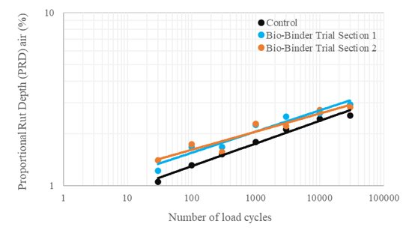
A30 Wheeltracking - Large Device @60ºC
Wheeltracking testing was conducted in accordance with BS EN 12697-22 using the Large Device. Testing was undertaken for 30,000 passes at 60ºC.
The Large Device uses a pneumatic tyre and applies a high load of 5,000N
All trial sections readily achieve the P_{max}5 category in accordance with BS EN 13108-1.

Slide 12
A30 Water Sensitivity – Indirect Tensile Strength Ratio (ITSR)
Moisture damage can be defined as the loss of strength of asphalt mixtures due to the presence of water
Resistance to moisture damage is evaluated by means of the water sensitivity test in accordance with BS EN 12697- 12 (Method A)
The required water sensitivity requirements for Thin Surface Course Systems on SRN in England are defined by SHW Clause #942
The water sensitivity of mixtures conforming with BS EN 13108 Parts 1, 2 and 5 shall conform to, at least, category ITSR_{min}70
Asphalt Mixture | Indirect Tensile Strength Ratio (%)
Control 1 | 96.0
Bio-binder Trial Section 1 | 100.0
Bio-binder Trial Section 2 | 95.0

Slide 13

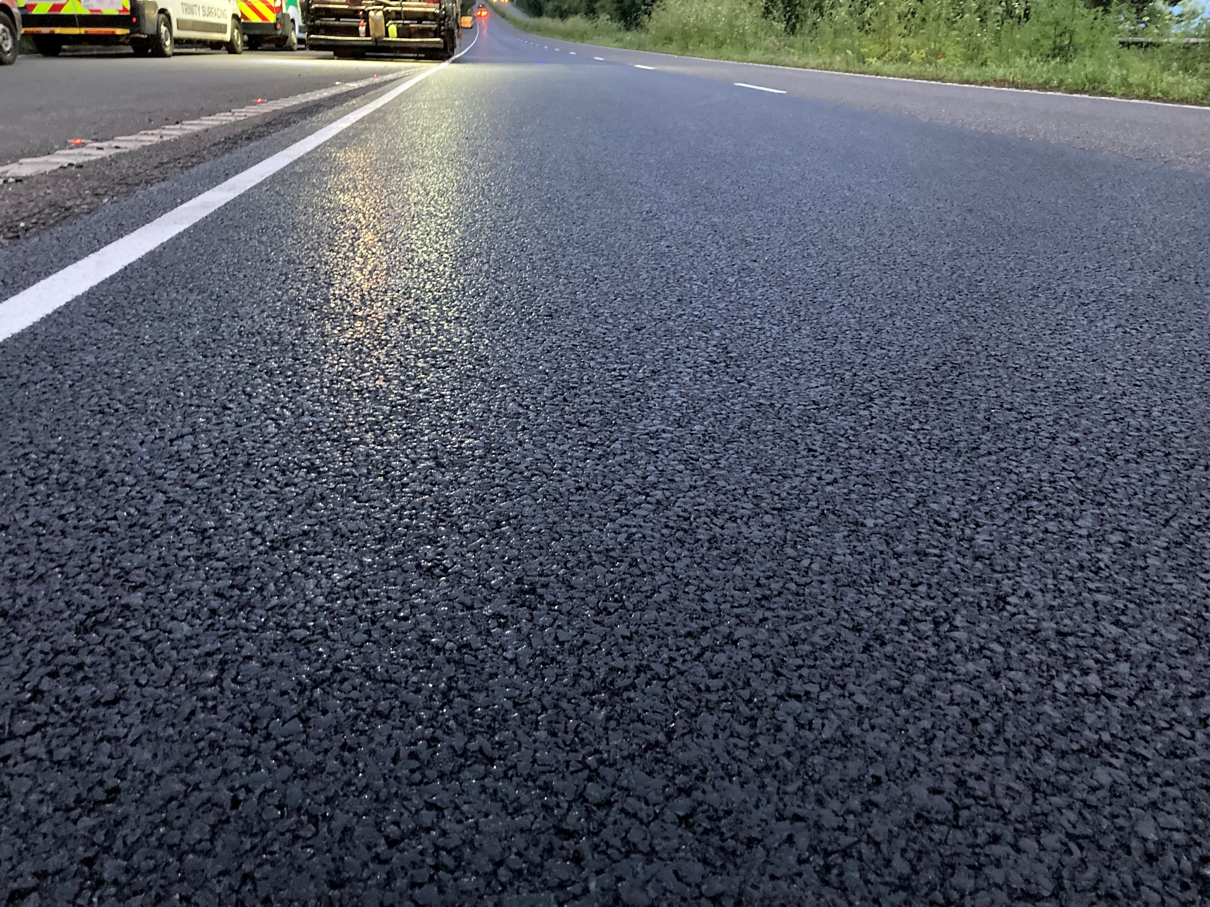
A2 Kingston – First warm mix surface course with bio-based binder & reclaimed asphalt installed on the SRN

Slide 14
A2 Wheeltracking - Small Device Procedure B @60ºC
Wheeltrack testing was conducted in accordance with BS EN 12697-22 Procedure B in Air at 60ºC
All test results complied with the requirements for the PD 6691 Table B.4 “Very heavily stressed sites requiring very high rut resistance” with WTS_{AIR}<0.8

Slide 15
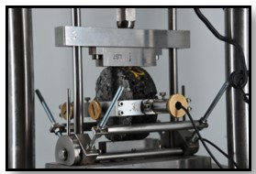
A2 Stiffness and Water Sensitivity
Indirect Tensile Stiffness Modulus (20ºC)
Indirect Tensile Strength Ratio
Mix Ref | Bituminous Mixture | Mean Indirect Tensile Stiffness Modulus (MPa)
1 | Control + 0% RA (Warm) | 3500
2 | Bio + 0% RA (Hot) | 3100
3 | Bio + 0% RA (Warm) | 2600
4 | Bio + 20% RA (Warm) | 3900
Mix Ref | Bituminous Mixture | Indirect Tensile Strength Ratio (%)
1 | Control + 0% RA (Warm) | 100.0
2 | Bio + 0% RA (Hot) | 98.0
3 | Bio + 0% RA (Warm) | 102.0
4 | Bio + 20% RA (Warm) | 93.0

Slide 16
A2 Binder Rheology - Black Space Diagram (unaged)

Slide 17
A2 Recovered Binder Properties

Slide 18
Carbon Calculations – Measurable Results
A1-A5 emissions per tonne of asphalt (kgCO2e/t)
Using benchmark results for generic estimates (using actual mix designs and default values for other factors consistent with the Road Map).

